Slide 1
LIBRARY ORIENTATION
Sr. Joel CMC
Librarian
St.Mary’s College, Thrissur
Notes:
Click to add notes

Slide 2
Google can Bring You Back 1,00,000 Answers, A Librarian can Bring You Back the Right One
IN THE HIGHEST CIVILIZATION, THE BOOK IS THE HIGHEST DELIGHT (Ralph Waldo Emerson)
Notes:
How presentation will benefit audience: Adult learners are more interested in a subject if they know how or why it is important to them.
Presenter’s level of expertise in the subject: Briefly state your credentials in this area, or explain why participants should listen to you.

Slide 3
WHAT WE ARE COVERING
Introduce fresher students to:
Customer oriented services, resources, and operations of St.Mary’s College,Thrissur
St.Mary’s College Library Website
Resources for finding books, e-books, and journal articles.
Bibliographic Citation
Avoiding Plagiarism
Strategies to complete the Library’s component of SMC 2018
Notes:
Lesson descriptions should be brief.

Slide 4
Why you should use library?
Students who use the library have a higher cumulative GPA than students who do not. (Soria, et. al.)
Users of Library Services Average GPA
Non-users of Library Services Average GPA
3.18
2.98
Soria, Krista M., et. al., “Library Use and Undergraduate Student Outcomes: New Evidence for Students’ Success and Retention” Libraries and the Academy, Vol. 13, No. 2 (2013), pp. 147-164. Johns Hopkins University Press, Baltimore, MD.
Notes:
Example objectives
At the end of this lesson, you will be able to:
Save files to the team Web server.
Move files to different locations on the team Web server.
Share files on the team Web server.

Slide 5
A BRIEF HISTORY
A hundred and forty-one years back, in 1873, to be precise, a small Public Library started functioning where our College Library Functions today
Trichur is acclaimed as the cultural capital of Kerala for reasons unknown. The presence of the three academics and the famous Pooram festival may account for it partly. But it was this Library that has contributed a great deal to the intellectual and mental developments of the townsfolk to make the generations truly cultured.
In the year 1938 public library got shifted to the newly built Town Hall. It was in the year 1946, St.Mary’s college established and this beautiful college library was inaugurated in December 1986.

Slide 6
Mission Statement
Library Exists
To Provide with the Resources and Facilities necessary to Support and enhance the academic and extra curricular Programmes of the College
To serve the Students, Faculty, and Alumnae with Efficiency, Competency and Amiability

Slide 7
vision Statement
To Support and Enrich the Curriculum in all subject areas
To Support Personal Development Through Access to a Wide Range of Materials and Media
To Promote the Development of Study and Research Skills as a Basis for Lifelong Learning
To Respond to the varied Individual Information Needs of Students, Faculty, and the Staff

Slide 8
CUSTOMER SERVICES AND OPERATIONS
Primary customer service areas include:
Reference and Information Services
Library Online resources.docx
Circulation Services
Every UG Student is allowed to take out three books at a time for a period of 14 days. And is allowed to renew once. That is also for a period of 14 days
Every PG Student is allowed to take out ten Books at a time for a period of 14 days. And is allowed to renew once. That is also for a period of 14 days
St.Mary’s College Historical Collection & Archives
http://111.92.84.71:8080/jspui/

Slide 9
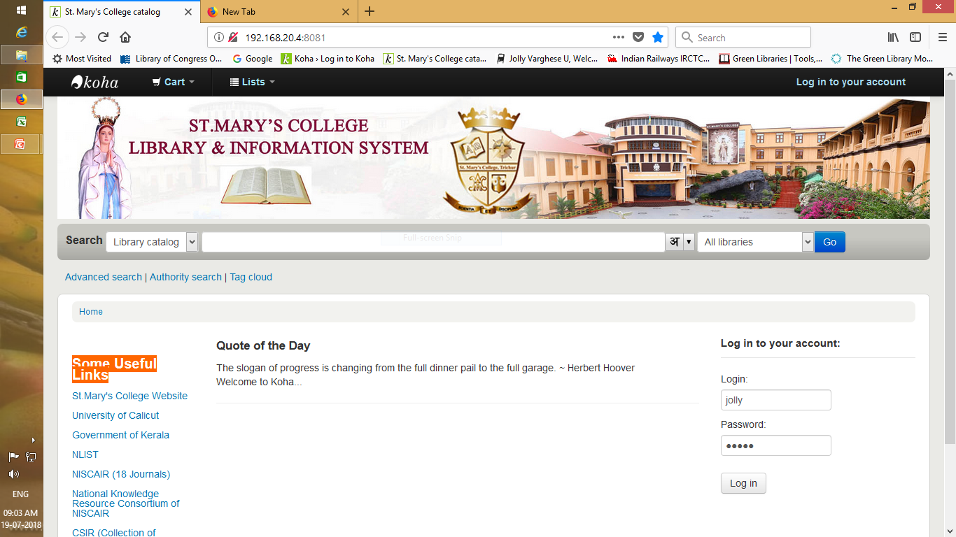
LIBRARY OPAC

Slide 10
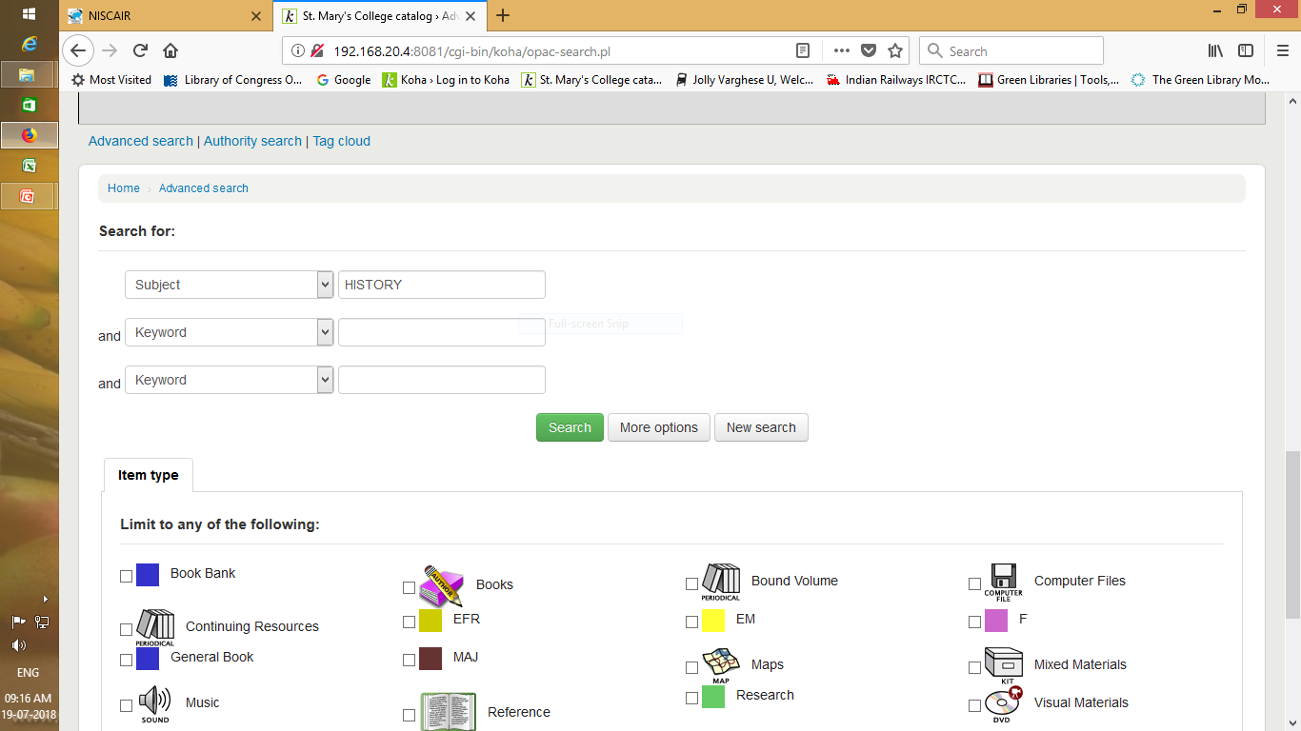
OPAC SEARCH
Summarize important points.
Allow time for questions.

Slide 11
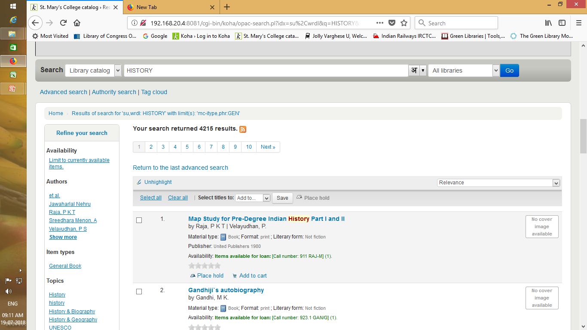
SEARCH RESULT
Summarize important points.
Allow time for questions.

Slide 12
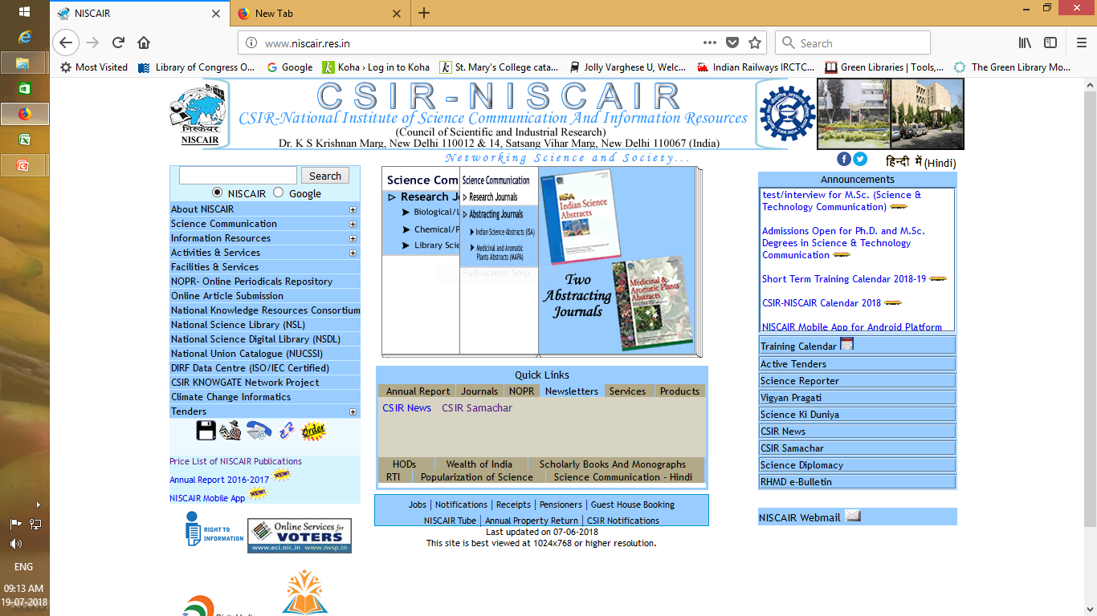
SOME USEFUL LINKS IN OPAC
List the intended outcomes for this training session.
Each objective should be concise, should contain a verb, and should have a measurable result.

Slide 13
SOMETHING ABOUT BIBLIOGRAPHIC CITATION
The push and pull of hip-hop: a social
movement analysis.
Erin Trapp
American Behavioral Scientist July 2013 v48 ill p 1482
Title of article
Author of article
Title of Journal
Date of publication
Volume of publication
Publication page number
After you have retrieved all of the information needed to write your paper, you may be required to cite articles or sources in the paper. In order to do this, you need to know not only what type of document it is (book, journal, newspaper, etc.) but also know the parts of a citation. Make sure when citing references to include all parts of the bibliographic citation.
Notes:
After you have retrieved all of the information needed to write your paper, you may be required to cite articles or sources in the paper. In order to do this, you need to know not only what type of document it is (book, journal, newspaper, etc.) but also know the parts of a citation. Make sure when citing references to include all parts of the bibliographic citation.

Slide 14
AVOID PLAGIARISM
Give credit to those whose works you use in your research paper.
Cite references within research paper.
List cited references on Reference or Bibliography page.
Consult style manual as guide to citing references.
Consult course instructor for recommended style manual.
See Citation and Writing Style Guides on library’s Web page. Citation and Writing Style.docx
Notes:
Another reason for citing your works is to help you avoid plagiarism. Plagiarism is using other people’s created works without giving them credit. Thus, the above suggestions show be followed in order to avoid plagiarism.

Slide 15
Orientation 2017 edited.pptx

Slide 16
TO OBSERVE
WHILE you come to the libray always come with ID Card AND
SWIPE YOUR ID CARD AT THE GATE TO RECORD YOUR ENTRY
LEAVE YOUR ID Card in the counter before you move further inside the library
Library has got one entry and one exit. You are to enter through one entry door and exit through the exit door.
AND WHILE YOU EXIT, THERE IS ANOTHER COMPUTER WHERE YOU ARE TO SWIPE YOUR ID TO RECORD YOUR EXIT

Slide 17
To observe (continued..)
You will be given three library cards. You can take at a time 3 books on loan using these cards. You are not supposed to exchange cards with your friends.
Books are given on loan for 14 days. You are to return the book to the library on or before 14th day. If the days are exceeded, you will be charged ₹1/day/book.

Slide 18
To observe (continued..)
Remember that closed circuit cameras are always watching over you in the library
You are to leave all your books and baggage in the property counter.
You can take inside the library one or two loose sheet and pen to take down notes if you need.
You can take books outside the library only after it is entered in the issue return counter.

Slide 19
To Observe (continued…)
Loss of books from your part is liable to be penalized. Either you will have to replace the book or you will have to pay 5 times/3times/2times the price of the book according to the date of publication of the lost book. This is done according to the Govt. Order.
Remember, if you help your friend by lending your book card to take book for her and the book is lost from her, it is you who is liable to make the penalty to the library. Same is the case with overdue charges, i.e. fine for exceeding the loan period.

Slide 20
To Observe (continued…)
Reference Books (“REFERENCE” seal affixed) are not for lending. You can refer it in the library and can take photocopy if it is needed following the prescribed procedures.

Slide 21
To Observe (continued…)
Remember, books are not to be misplaced in the stack according to your wish and will and due to your carelessness also. Once you take book outside the shelf, you just leave the book on the table. It will be replaced in the shelf by the library staff. So don’

Slide 22
SUMMARY
Electronic Resources used to find journals, magazines newspapers, and E-books.
Style manuals can provide guidance on avoiding plagiarism and on citing references.
Course instructor should be consulted for recommended style manual.

Slide 23
THINGS TO DO TO COMPLETE LIBRARY ORIENTATION
Go to library homepage http://www.library.stmaryscollegethrissur.edu.in/
Review Library Orientation
Print and Complete the Library Treasure Hunt Submit completed assignment to the Library by July 31st 2019

Slide 24
PRIZES
The Best user will be selected at the end of the year based on
Number of visits to the library and amount of time spent in the library.
The number of books that the user has borrowed from the library

Slide 25
Questions

