Slide 1
Absorption Of Soil Water By Plants
Dr. Rekha K.
Assistant Professor
Dept. of Botany
St. Mary’s College, Thrissur

Slide 2
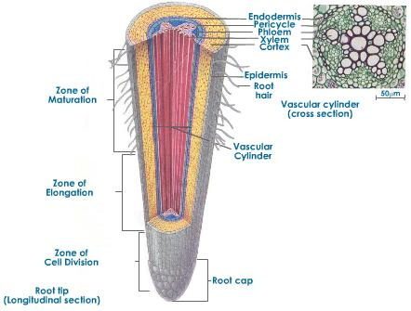
Organs of water absorption-root hairs
Cell walls highly hydrophilic with high water absorbing powers
Absorption of soil water by plants, Dr.Rekha K, St.Mary’s College

Slide 3
Factors affecting absorption
1.Available soil water
Four types of water present in the soil
(a)Gravitational water
(b) Hygroscopic water
(c) Chemically combined water
(d) Capillary water
2. Temperature of the soil
Optimum temperature-20°C to 30°C
3.Concentration of soil solution
4. Aeration of soil
Absorption of soil water by plants, Dr.Rekha K, St.Mary’s College

Slide 4
Field capacity and permanent wilting percentage
Field capacity -the maximum amount of water that a soil can hold against gravity following saturation by rain or irrigation.
The permanent wilting percentage- The amount of water a soil contains after plants are wilted beyond recovery
Absorption of soil water by plants, Dr.Rekha K, St.Mary’s College

Slide 5
Mechanism of water absorption
a.Passive absorption
Force of absorption –transpiration pull
No expenditure of energy
Apopalst pathway- through cell wall
Physical processes involved: imbibition, diffusion and osmosis
b. Active absorption
Transpiration is less
cells have enough water
Entry of water by the expenditure of energy
Occurs during night time
Two types: osmotic and non-osmotic
Absorption of soil water by plants, Dr.Rekha K, St.Mary’s College

Slide 6
Water moves to cortical cells where the OP is higher TP is lower
Water finally reaches endodermis and through passage cells and pericycle enters into root xylem vessels
Expenditure of energy for the synthesis of organic substances dissolved in cell sap
Occurs through symplast pathway
Absorption of soil water by plants, Dr.Rekha K, St.Mary’s College

Slide 7
Osmotic theory of active water absorption
Absorption along the water potential gradient
Osmotic potential of soil water below 1 atm.
Osmotic potential of cell sap 2-8atm
DPD and SP high for cell sap
Water from soil enters into root hairs by osmotic diffusion
TP of root hair cytoplasm increased
Absorption of soil water by plants, Dr.Rekha K, St.Mary’s College

Slide 8
Non osmotic theory of active water absorption
Absorption against water potential gradient
Requires ATP
Energy for increasing the permeability of cell membrane
Absorption of soil water by plants, Dr.Rekha K, St.Mary’s College

Slide 9
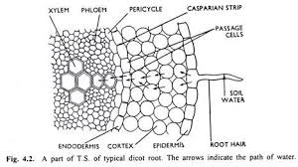
Radial conduction of water from root hairs to root xylem
Absorption of soil water by plants, Dr.Rekha K, St.Mary’s College

Slide 10
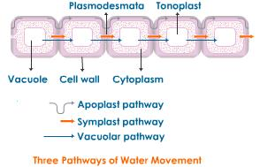
Routes of radial movement
Absorption of soil water by plants, Dr.Rekha K, St.Mary’s College

Slide 11
REFERENCES
V. K. Jain. Fundamentals of Plant Physiology. S.Chand & Company Ltd., 2011.
V.Verma. Plant Physiology. Athena Academic, 2016.
Absorption of soil water by plants, Dr.Rekha K, St.Mary’s College

