Slide 1
PTERIDOSPERMALES
(SEED FERNS)
Aiswaria Raj
Assistant Professor
Department of Botany
St. Mary’s College, Thrissur

Slide 2
GEOLOGICAL HORIZONS
Pteridospermales - characteristic gymnosperm plants that bore fern like foliage and un-protected seeds
Large order includes tree like or reclining or sprawling plants.
Came in to existent during the upper Devonian and lived through carboniferous and Permian periods and reached their climax in the Mesozoic era
This group was discovered in 1877 by Grand Eury.
Pteridospermales (seed ferns),Aiswaria Raj,St.Mary’s College

Slide 3
India -occur in lower middle and upper gondwana systems that where formed in the Paleozoic and Mesozoic era
The common genera and species includes Gangamopteris buriadica, G. srivasthavae,Glossopteris
HABIT & MORPHOLOGY
The plants have erect, slender or weak stem
The leaves are large, pinnately compound and frond like
The leaves have resistant cuticle
Pteridospermales (seed ferns),Aiswaria Raj,St.Mary’s College

Slide 4
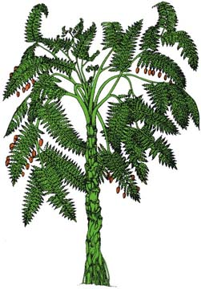
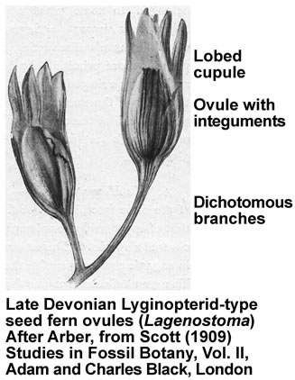
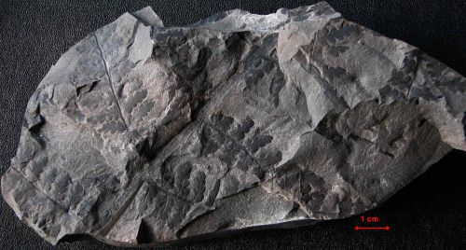
Pteridospermales (seed ferns),Aiswaria Raj,St.Mary’s College

Slide 5
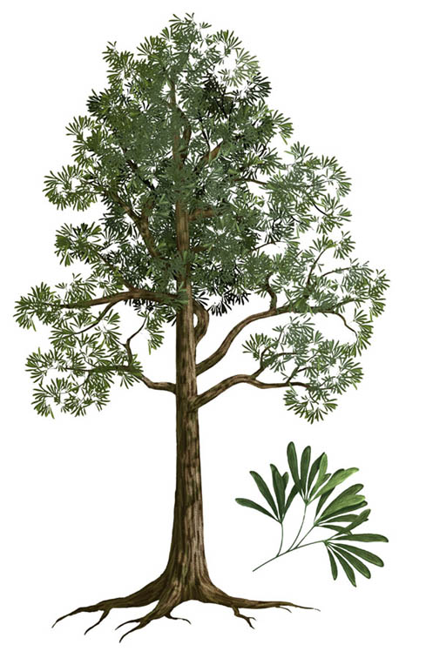
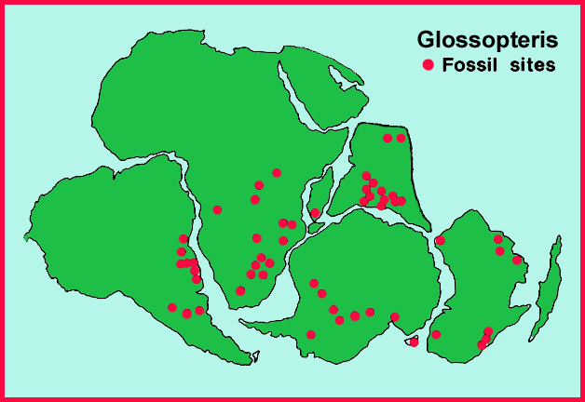
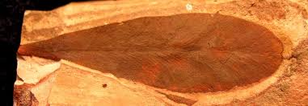
Pteridospermales (seed ferns),Aiswaria Raj,St.Mary’s College

Slide 6
ANATOMY
Primary xylem – solid or medullated protostele, usually mesarch, rarely exarch in some forms it is reduced to circum medullary strand.
Polystelic condition also present.
Secondary wood, phloem-smaller amounts
Secondary wood-manoxylic
Tracheids of secondary wood bear multiseriate boarded pits on their radial walls .
Pteridospermales (seed ferns),Aiswaria Raj,St.Mary’s College

Slide 7
REPRODUCTION
Seeds - born directly on modified or unmodified foliate (not in corns or inflorescence)
Seeds resembles recent cycads
Ovule lack annulus and are surrounded by cupule like structure
Ovule- integuments (either free or fused with the nucellus), distinct pollen chamber, micropyle
Integuments are vascularised ,in some ovules nucellus is vascularised.
Pteridospermales (seed ferns),Aiswaria Raj,St.Mary’s College

Slide 8
Microsporangium- no annulus ,some times grouped in to synangia
Microsporangium born on the ultimate branches of the frond
Microsporangia may be free or bisporangiate
Microspore monolete or trilete
Ovules and seeds may be cupulate or non cupulate
Glands may be present in cupules
Pteridospermales (seed ferns),Aiswaria Raj,St.Mary’s College

Slide 9
Bell shaped sheath may be present, nucellar beak may be absent, sclerotesta may be present or distinguished
Single or double vascular system present in seed
Decomposition lacunae present in seed coat
Pollen grain –lacked pollen grains, male gametes –motile and discharged directly in to the pollen chamber .
Pollen grain germination-a number of peripheral cells enclosing a central cavity(stephanospermum akenoies,physostoma elegans)
Pteridospermales (seed ferns),Aiswaria Raj,St.Mary’s College

Slide 10
Pollen grains-monolete (medullosaceae), trilete (lyginopteridaceae)
Megaspore –thick wall
Leaf traces –mesarch may be double or multiple(medullosaceae)
INTERRELATIONSHIPS
Resemblances with pteridophytes
Leaves-large and pinnately compound
Lateral veins-dichotomously branched
Stem-protostele, polystelic condition in medullosaceae
Pteridospermales (seed ferns),Aiswaria Raj,St.Mary’s College

Slide 11
Xylem- mesarch, rarely exarch
Leaf traces - mesarch, may be single or multiple, they arises by the tangential division of the cauline strand.
Microspores - trilete
Leaves have circinate ptyxis
Spermatozoids - mortile, multiflagellate
Pteridospermales (seed ferns),Aiswaria Raj,St.Mary’s College

Slide 12
Gametophytes –endosporic
Presence of archegonia
Xylem vessels absent ,phloem lacks companion cells
Microsporangiate synangia born on pinnulus are quite reminiscent of the recent marattiaceae
Megaspore-thick wall
Pteridospermales (seed ferns),Aiswaria Raj,St.Mary’s College

Slide 13
Resemblane with cycadophytes
Stem- aerial ,erect, pinnately compound leaves
Leaf traces –mesarch, arise mostly by the tangential division, they multiple in medullosaceae and cycadales
Microspores- monolete(medullosaceae and cycadales)
Sporangia-indistinct sori and posses indusial hair
Heterosporous
Gametophytes-endospori, quite reduced
Pteridospermales (seed ferns),Aiswaria Raj,St.Mary’s College

Slide 14
Male gametes –multicilliate
Ovule-singe integument, three layers
Pollen chamber present ,archegonia present (female sex organ)
Double vascular system in seeds (medullosaceae and cycadales )
Circinate vernation of leaves
Sporangia lacks annulus
Xylem and phloem are of similar nature
Megaspore- thick wall
Pteridospermales (seed ferns),Aiswaria Raj,St.Mary’s College

Slide 15
LYGINOPTERIDACEAE
MEDULLOSACEAE
CALAMOPITYACEAE
PTERIDOSPERMALES
GLOSSOPTERIDACEAE
PELTASPERMACEAE
CORYSTOSPERMACEAE
CAYTONIACEAE
Pteridospermales (seed ferns),Aiswaria Raj,St.Mary’s College

Slide 16
REFERENCE
Vasishta P.C, Sinha A. K., Anil Kumar, Gymnosperms, S. Chand Publications
Pteridospermales (seed ferns),Aiswaria Raj,St.Mary’s College

