Slide 1
PENTOXYLALES
Aiswaria Raj
Assistant Professor
Department of Botany
St. Mary’s College, Thrissur

Slide 2
PENTOXYLALES
The name was proposed by Prof. Birbal Sahini in the year 1948 for a group of fossil plants.
Distribution- Rajmahal hills [Bihar] of India & from New Zealand.
The order includes - number of stems [Pentoxylon and Nipanioxylon ], Leaves [Nipaniophyllum].
Pollen bearing organs [ Sahnia ].
Seed bearing organs [ Carnoconites ].
Pteridospermales (seed ferns),Aiswaria Raj,St.Mary’s College

Slide 3
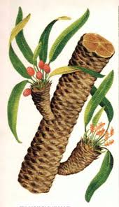
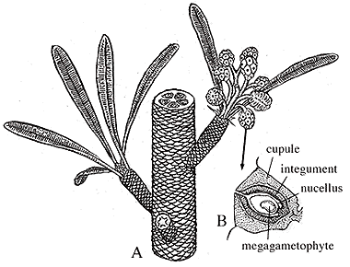
MORPHOLOGY
The plants were probably shrubs or small trees.
The stems were 3 mm to 2 cm long. It bore rhomboidal leaf scars & spirally arranged leaf.
The branches were of two types-
Long shoots
Dwarf shoot
Pteridospermales (seed ferns),Aiswaria Raj,St.Mary’s College

Slide 4
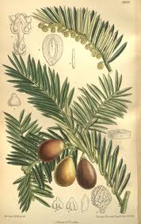
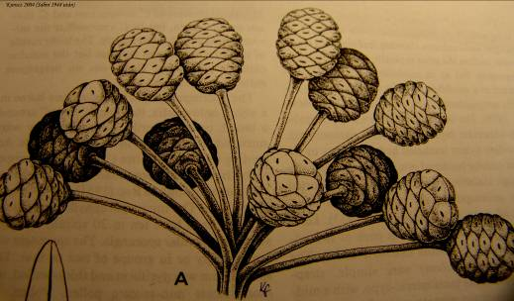
Pteridospermales (seed ferns),Aiswaria Raj,St.Mary’s College

Slide 5
ANATOMY
The stem were polystelic with 5&6 primary steles hence the name pentoxyleae.
Each stele have it’s own cambium, it produced more secondary tissue towards center so that secondary wood became exocentric.
The secondary xylem was pycnoxylic, ie; the wood was very compact.
The secondary wood shows growth rings but it cannot be definitely stated whether they represent annual rings.
Pteridospermales (seed ferns),Aiswaria Raj,St.Mary’s College

Slide 6
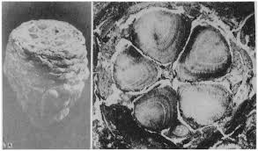
Pteridospermales (seed ferns),Aiswaria Raj,St.Mary’s College

Slide 7
In the leaf anatomy it has diploxylic condition ie; two distinct regions of xylem one centripetal & the other is centrifugal.
The stomata were regarded by Sahni to be syndetocheilic but later Vishnu Mitter found that haplocheilic or cycadalean stomata also occur.
Syndetocheilic-guard cells are surrounded by 2 subsidiary cells.
Haplocheilic-guard cells surrounded by 6 or 7 subsidiary cells.
Pteridospermales (seed ferns),Aiswaria Raj,St.Mary’s College

Slide 8
Reproductive organ
The reproductive organs were unisexual. Both the seed bearing organs [carnoconities] & pollen bearing organs [sahnia] were born terminally on the dwarf shoots.
Female cones looked like stalked mulberry fruits.
There were no sterile structures similar to magasporophylls.
The ovule is surrounded by single integument that was free from nucellus.
Pteridospermales (seed ferns),Aiswaria Raj,St.Mary’s College

Slide 9
The male flowers born terminally on short lateral shoots.
Each flower consisted of a receptacle.
About 24 microsporangiophores were arranged around it in a single whorl.
The sporangia is unilocular & contain boat-shaped pollen grains.
Each sporangium received a single vascular bundle that divided into several radiating branches.
Pteridospermales (seed ferns),Aiswaria Raj,St.Mary’s College

Slide 10
Interrelationship
Pentoxylales resemble the cycadophytes in their leaf anatomy eg; the diploxylic bundles & the haplocheilic stomata in leaf.
Pycnoxylic wood resemble conifers.
The pteridospermous family Medullosaceae in having a polystelic vascular bundle.
Presence of syndeticheilic stomata, in addition to haplocheilic [cycad character] ones is a bennettitalean character.
Pteridospermales (seed ferns),Aiswaria Raj,St.Mary’s College

Slide 11
REFERENCE
Vasishta P.C, Sinha A. K., Anil Kumar, Gymnosperms, S. Chand Publications
Pteridospermales (seed ferns),Aiswaria Raj,St.Mary’s College

