Slide 1
PREDOMINANT GYMNOSPERMS: GLOSSOPTERIS
Aiswaria Raj
Assistant Professor
Department of Botony
St. Mary’s College
Thrissur-680020
Kerala

Slide 2
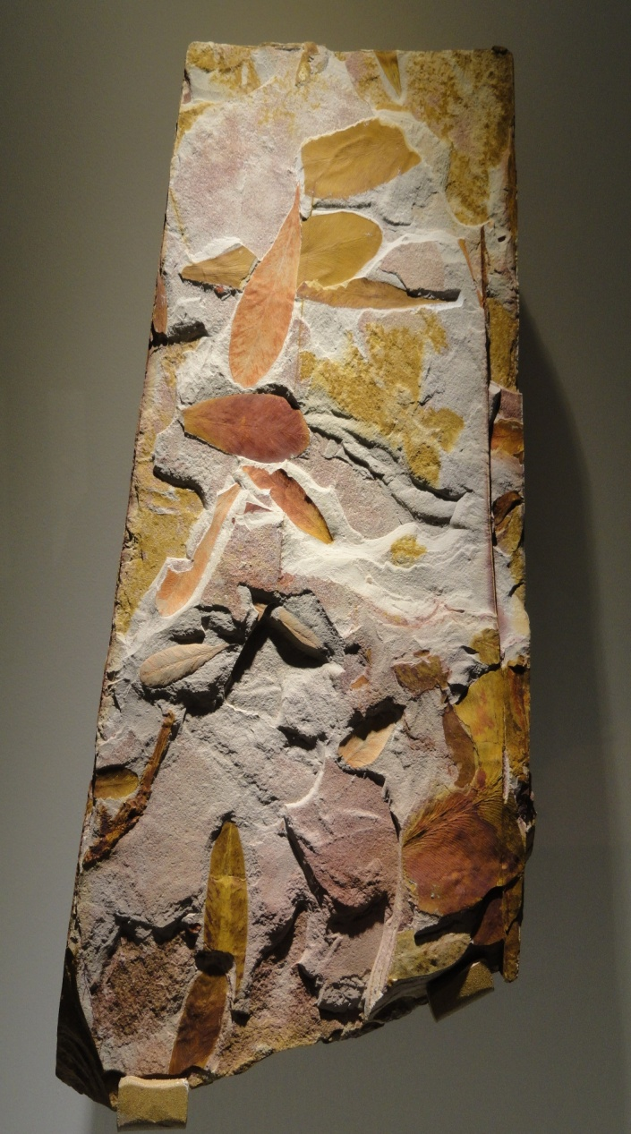
GLOSSOPTERIS
Fossils of the gymnosperm Glossopteris (dark green) found in all of the southern continents .
Glossopteris (Ancient Greek: glossa, meaning "tongue", because the leaves were tongue-shaped).
The name glossopteris is first used by Brongniart.
Glossopteris,Aiswaria Raj,St.Mary’s College

Slide 3
SCIENTIFIC CLASSIFICATION
Kingdom: Plantae
Division : Pteridospermatophyta
Order : Arberiales
Family : Glossopteridaceae
Genus : Glossopteris
Glossopteris,Aiswaria Raj,St.Mary’s College

Slide 4
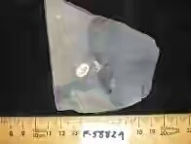
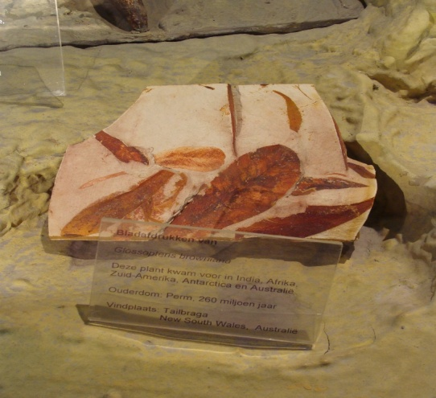
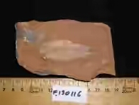
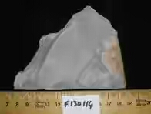
SPECIES
G.angustifolia
G. brasiliensis
G. browniana
G. communis
G. indica
G. occidentalis
Glossopteris,Aiswaria Raj,St.Mary’s College

Slide 5
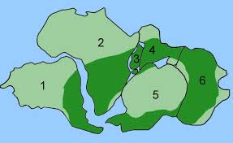
GEOLOGICAL HORIZONS AND DISTRIBUTION
Gondwana land was greatest ice age.
This condition extended from upper carboniferous to lower permian period.
Gondwana land flora is also called glossopteris flora.
Gondwanaland system are of 3 types.
Lower gondwana system
Middle gondwana system
Upper gondwana system
Glossopteris,Aiswaria Raj,St.Mary’s College

Slide 6
LOWER GONDWANA SYSTEM
It was the luxuriant growth period of gymnosperm. It include several several speciesof Gangamopteris, Glossopteris withVertebraria, and Gondwanadium
MIDDLE GONDWANA SYSTEM
Glossopteris genera, glossopteris with vertebraria,gamopteris , are included in this system.
Glossopteris,Aiswaria Raj,St.Mary’s College

Slide 7
UPPER GONDWANA SYSTEM
Glossopteris genera,glossopteris with vertebraria are seen in this system.
Leaves - tongue like with reticulate venation.
Has a central mid rib, lateral veins are arise from the mid rib and these extended to the margin.
Dorsiventral.
Seeds are borne on the sides of variably branched or fused structures.
Microsporangia are borne on the tip of filaments ,containing large no. of pollen.
.
Glossopteris,Aiswaria Raj,St.Mary’s College

Slide 8
Seeds and pollen bearing organs were partially fused to leaves or positioned in the axils of leaves.
Seed bearing structures are remain within the megasporophyll
It is not clear that glossopteris is monoecious or dioecious.
They had unusual roots called vertebraria
Glossopteris,Aiswaria Raj,St.Mary’s College

Slide 9
ANATOMY
Presence of vascular bundle, made of tracheids with scalariform as well as pitted thickening.
Shows growth rings in wood. In summer and spring season they grows strengthly ,but in winder the growth become suddenly stopped this leads to the formation of growth ring.
Stomata on the ventral side(hypostomatic). They are sunken (remain in grooves).
In case of leaves mesophyll is differentiated into palisade and spongy cells.
The stele is eustele
Glossopteris,Aiswaria Raj,St.Mary’s College

Slide 10
REPRODUCTION
MALE REPRODUCTIVE ORGAN
Microsporangia are stalked oval in shape.
Abundant striations are present in wall.
Spores are two winged.
FEMALE REPRODUCTIVE ORGAN
Seeds may be stalked or sessile.
Winged or wingless seeds.
Frutification are of two kinds:-
cupulate frutification
Multiovulate frutification
Glossopteris,Aiswaria Raj,St.Mary’s College

Slide 11
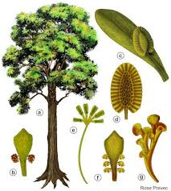
CUPULATE FRUTIFICATION
The seeds are protected by cup like structure called cupule.
Each cupule contain one seed.
Cupule arise from pedicel,borne from the region of mid -vein.
MULTIOVULATE FRUTIFICATION
It had a cusion like receptacle.
Borne singly on the pedicel.
The receptacle is protected by 1 or 2 scale leaves
Glossopteris,Aiswaria Raj,St.Mary’s College

Slide 12
REFERENCES
Dr. P. C. Vasishta, Dr. A. K. Sinha,Dr.Anil Kumar, Gymnosperms, S. Chand Publications, 2014
Glossopteris,Aiswaria Raj,St.Mary’s College

