Slide 1

BIOREACTORS & LARGE SCALE
CELL PRODUCTION
Amritha M. S
Assistant Professor
Department of Botany
St. Mary’s College Thrissur

Slide 2

INTRODUCTION
“Application of plant cells , tissues or organs for the production of secondary metabolites in large quantities” started in 1947
Its usually done with the help of large Bioreactors
Free – cell suspension culture
Cell suspension culture is the most convenient
mode of mass cultivation of cells &
scale production of secondary compounds..
Bioreactor & large scale cell production, Amritha M. S, St.Mary’s College

Slide 3
BIOREACTORS
Bioreactors is the specialized equipment to perform
cell suspension culture
Size : 21 – 20000 l
Designed to grow high densities of plant cells
Bioreactors is a device in which the organisms are cultivated & motivated to form the desired products
Bioreactor & large scale cell production, Amritha M. S, St.Mary’s College

Slide 4
It’s a controlled system which provide right environment like
    Aeration
    Stirring
    Contamination control
    Replacement of used medium
Fermentation technology used
Biofermentors is controlled system for cultivation of prokaryotes, Where Bioreactors helps for the cultivation of eukaryotes
Traditional bioreactors was made up of wood or slate
Stainless steel bioreactors are used in recent years
High quality stainless steel won’t corrode or leak
Bioreactor & large scale cell production, Amritha M. S, St.Mary’s College

Slide 5
OPERATIONS INSIDE BIOREACTOR
5 steps
    Sterilisation
      Insitu sterilisation
      Continuous heat sterilisation
    Inoculation & Sampling
    Aeration
      Air – lift system of aeration
    Control System
      Mixing
      pH
      Nutrient concentration
      Dissolved oxygen probes
      Temperature & Foaming
    Cleaning
Bioreactor & large scale cell production, Amritha M. S, St.Mary’s College

Slide 6
NUTRITIONAL ASPECTS
Media used in bioreactors should contain all elements.
It’s of 2 types
  Synthetic media : All constituents in pure form in desired proportion, it’s not practical
  Crude media : Media with naturally available sources suitable for fermentation
    Carbon Sources: Molasses, methanol, ethanol, starch, dextrose, cellulose, malt extracts..
    Nitrogen Sources:
        Inorganic : Ammonia, ammonia salts
        Organic : Urea, peptones, corn steep liquor
    3. Growth Factors: Yeast extracts
Bioreactor & large scale cell production, Amritha M. S, St.Mary’s College

Slide 7
STERILISATION OF MEDIA & GASES
Sterilisation is essential for successful fermentation
    Sterilisation of culture media :
      Heat sterilisation
      Batch sterilisation
      Physical methods
      Continuous sterilisation
    Sterilisation of air:
      Heat
      Filteration
Bioreactor & large scale cell production, Amritha M. S, St.Mary’s College

Slide 8
BIOREACTOR USED WITH IMMOBILIZED CELLS
Its used with immobilized cells entrapped in gels or foam
May be placed in
1. Fluidised bed : Immobilised cells are
agitated either by flow of air or by
pumping the medium through
bioreactor
2. Fixed bed : Immobilised cells are not
agitated but held stationary &
perfused with an aerated liquid
culture medium at a relatively slow rate
Bioreactor & large scale cell production, Amritha M. S, St.Mary’s College

Slide 9
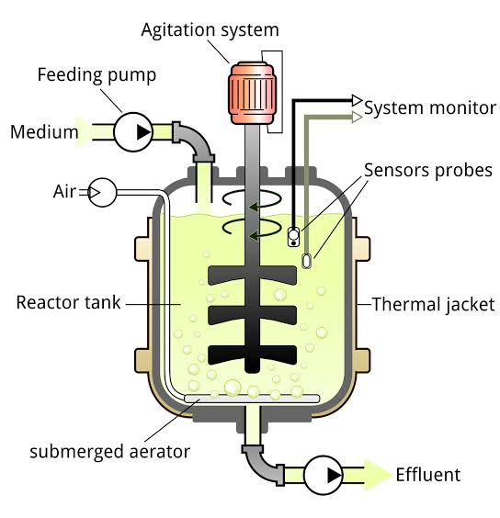
Eg: STIRRER BIOREACTORS
Also called as Continuous Bioreactors
Modified paddle type impeller or rotating drum is used
75 g/l dry weight
High yield of berberine is obtained from hollow paddle like stirrer
Continuous inflow of fresh & outflow of used medium
Bioreactor & large scale cell production, Amritha M. S, St.Mary’s College

Slide 10
  CHARACTERISTIC FEATURES:
  Central shaft is provided with spinning filter which enables removal of used medium free of cell
  Stirrer plate coupled with central shaft provides continuous stirring
  Aeration done by sparger
  Separate ports for removal & addition of medium
Bioreactor & large scale cell production, Amritha M. S, St.Mary’s College

Slide 11
ADVANTAGES
Large scale production of secondary metabolites is possible
Over exploitation & extinction of plant species can be reduced
It can be used in cases where plant material is limited in supply or plants are slow growing
Cultured cell produce higher biochemical level than differentiated plant cells
Plant cell carry out many biotransformation
Bioreactor & large scale cell production, Amritha M. S, St.Mary’s College

Slide 12
LIMITATIONS
High production cost
Cultured plant cells are incapable of producing valuable products
Many system are difficult to improve due to the lack of basic knowledge about biosynthetic pathway. This knowledge is essential for enhancing the production level to make the process economical
Bioreactor & large scale cell production, Amritha M. S, St.Mary’s College

Slide 13
Oxygen plays a major role
Some culture requires CO2 in addition to O2
They improve cell growth & metabolite synthesis
Level of these gases should be controlled in bioreactors
A particular mathematical model is developed that allowed the concentrations to be controlled without changing total gas flow rate of agitation
Bioreactor & large scale cell production, Amritha M. S, St.Mary’s College

Slide 14
REFERENCE
Bajaj Y.P.S (Ed.). High Tech Micropropagation. Springer
Dutta G. S. and Ibaraki Y, (Ed.). Plant Tissue Culture Engineering. Springer
Bioreactor & large scale cell production, Amritha M. S, St.Mary’s College

