Slide 1
Introduction to Classical
Genetics
Amritha M. S
Assistant Professor
Department of Botany
St. Mary’s College Thrissur

Slide 2
GENETICS
“Study of Heredity and Variance
Classical
Into 3 Molecular
Population
Inheritance is the process by which characters are passed on from parent to progeny; it is the basis of HEREDITY
Variation is the degree by which progeny differ from theirparents.
Introduction to Classical Genetics, Amritha M. S, St.Mary’s College

Slide 3
Classical Genetics :
It deals with organisms genotype & how it get
transmitted.
Molecular genetics :
Is the field of biology that studies the structure and
function of genes at a molecular level
Population genetics :
Is the study of genetic variation within populations,
and involves the examination and modelling of
changes in the frequencies of genes and alleles in
populations over space and time.
Introduction to Classical Genetics, Amritha M. S, St.Mary’s College

Slide 4
Gene :
Fundamental Unit of Heredity
Alleles :
Different forms of a Gene
Eg: Height
Coded By Tall & Dwarf
Represented By T & t
Normally obtained from parents
Maternal & Paternal
Multiple Alleles:
Genes coded by More than 2 alleles
Eg: Blood Grouping
4 Blood Groups A, B, AB, O
i I^{A} I^{B}
Introduction to Classical Genetics, Amritha M. S, St.Mary’s College

Slide 5
A Group : I^{A} I^{A}
I^{A} I
B Group : I^{B} I^{B}
I^{B} I
AB Group : I^{A} I^{B}
O Group : ii
No. of Alleles (n) = 3
No. of Genotype = n (n+1)
2
3 (3+1) = 6
2
4 Phenotypes & 6 Genotype
Introduction to Classical Genetics, Amritha M. S, St.Mary’s College

Slide 6
There are Two types of Alleles
Homozygous :
Pure Breed
Same Alleles
TT = Tall
tt = Dwarf
I^{A} I^{A} = A group
Heterozygous :
Hybrid
Different alleles of same Trait
Tt = Height
Rr = Color
I^{A} I^{B} = AB Group
Introduction to Classical Genetics, Amritha M. S, St.Mary’s College

Slide 7
Character :
Common terms
Height, colour…..
Phenotype :
Different forms of a Character
TRAIT
Color
Fair & Dark
Introduction to Classical Genetics, Amritha M. S, St.Mary’s College

Slide 8
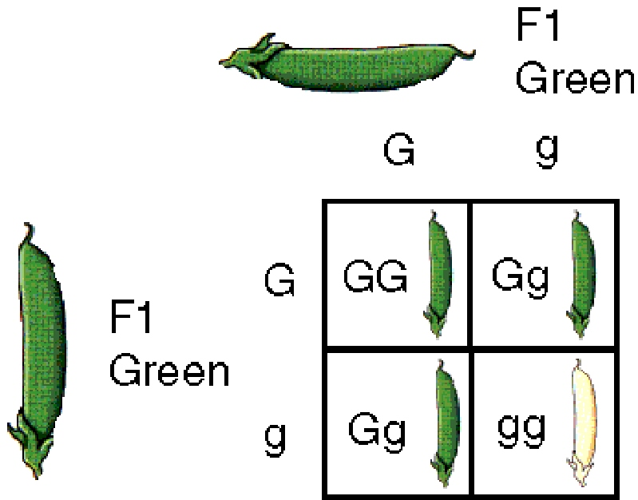
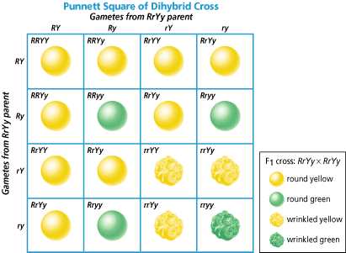
Monohybrid cross : a cross between two parents that differ by a single pairs of alleles (GG x gg) . The character being studied in a monohybrid cross are governed by two or multiple variations for a single locus ie;Gg x Gg
Dihybrid cross a cross between two parents that differ by two pairs of alleles (RRYY x rryy)
Introduction to Classical Genetics, Amritha M. S, St.Mary’s College

Slide 9
MENDELIAN LAWS IN GENETICS
Law of Dominance
(i) Characters are controlled by discrete units called factors.
(ii) Factors occur in pairs.
(iii)In a dissimilar pair of factors one member of the pair dominates(dominant) the other (recessive).
Used to explain the expression of only one of the parental characters in a monohybrid cross in F1 and expression of both in the F2.
It also explains the proportion of 3:1 obtained at the F2.
Introduction to Classical Genetics, Amritha M. S, St.Mary’s College

Slide 10
Law of Segregation
The alleles do not show any blending and that both the characters are recovered as such in the F2 generation though one of these is not seen at the F1 stage.
Parents contain two alleles during gamete formation, the factors or alleles of a pair segregate from each other such that a gamete receives only one of the two factors
Introduction to Classical Genetics, Amritha M. S, St.Mary’s College

Slide 11
REFERENCE
Benjamin Pierce : Genetics: a Conceptual Approach
Introduction to Classical Genetics, Amritha M. S, St.Mary’s College

