Slide 1
General characteristics of alkali metals
Dr. Srilakshmi P. Bhaskar
Assistant Professor
Department of Chemistry
St. Mary’s College, Thrissur

Slide 2
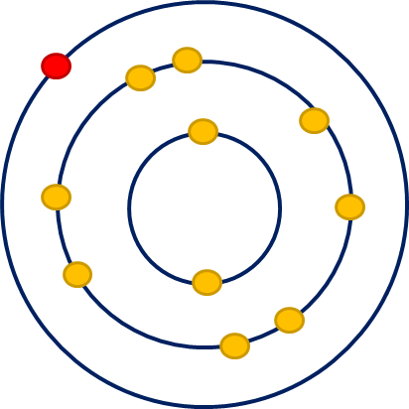
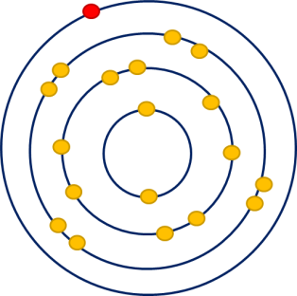
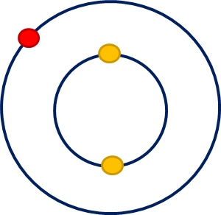
Outer Electronic Configuration
ns¹
All alkali metals have one electron in their valence shell
Most electropositive of metals
They can readily lose the valence electron to form monopositive ions
General Characteristics of Alkali Metals, Dr. Srilakshmi P. Bhaskar, St. Mary’s college

Slide 3
Density
Alkali metals have low densities
Li, Na, and K are lighter than water
increase in molar volume
Element | Density at 20 ºC (g/cm³) | Molar volume (cm³/mol)
Lithium | 0.534 | 12.97
Sodium | 0.972 | 23.68
Potassium | 0.859 | 45.36
Rubidium | 1.530 | 55.80
Cesium | 1.903 | 69.95
Li
Na
K
Rb
Cs
General Characteristics of Alkali Metals, Dr. Srilakshmi P. Bhaskar, St. Mary’s college

Slide 4
Atomic and ionic radii
An extra shell of electrons is added as we move down the group
Shielding effect increases
Shrinking effect caused by increased nuclear charge increases
Element | Atomic Radius (Å) | Ionic Radius (Å)
Lithium | 1.34 | 0.60
Sodium | 1.54 | 0.95
Potassium | 1.96 | 1.33
Rubidium | 2.11 | 1.48
Cesium | 2.25 | 1.69
Li
Na
K
Rb
Cs
increase in size
General Characteristics of Alkali Metals, Dr. Srilakshmi P. Bhaskar, St. Mary’s college

Slide 5
Melting and Boiling Points
In alkali metals, metallic bonding is weak
They have low melting and boiling points
They are soft
decrease in charge density
Li
Na
K
Rb
Cs
Element | Melting Point (ºC) | Boiling Point (ºC)
Lithium | 180.0 | 1326
Sodium | 97.8 | 883
Potassium | 64.0 | 756
Rubidium | 38.9 | 688
Cesium | 28.7 | 690
General Characteristics of Alkali Metals, Dr. Srilakshmi P. Bhaskar, St. Mary’s college

Slide 6
Heat of atomization
decrease in M-M bond strength
Lithium has the maximum metal - metal bond strength
Element | Heat of atomization (kJ/mol)
Lithium | 159.0
Sodium | 108.1
Potassium | 90.2
Rubidium | 82.1
Cesium | 78.2
Li
Na
K
Rb
Cs
General Characteristics of Alkali Metals, Dr. Srilakshmi P. Bhaskar, St. Mary’s college

Slide 7
Ionization energy
Alkali metals have low ionization energies
They have only one electron in the valence shell
increase in atomic radius
Li
Na
K
Rb
Cs
Element | First ionization energy (kJ/mol)
Lithium | 520.1
Sodium | 495.2
Potassium | 418.7
Rubidium | 403.0
Cesium | 375.7
General Characteristics of Alkali Metals, Dr. Srilakshmi P. Bhaskar, St. Mary’s college

Slide 8
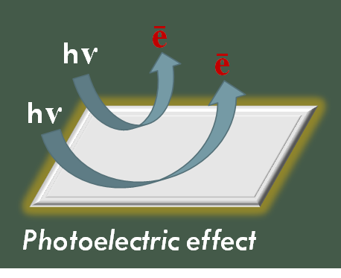
Electropositive nature
increase in electropositive nature
Alkali metals are highly electropositive
Their ionization energies are very low
Li
Na
K
Rb
Cs
General Characteristics of Alkali Metals, Dr. Srilakshmi P. Bhaskar, St. Mary’s college

Slide 9
Hydration enthalpy
decrease in charge to size ratio
Cation | Hydration enthalpy (kJ/mol)
Li⁺ | -515
Na⁺ | -405
K⁺ | -312
Rb⁺ | -296
Cs⁺ | -263
Li⁺
Na⁺
K⁺
Rb⁺
Cs⁺
General Characteristics of Alkali Metals, Dr. Srilakshmi P. Bhaskar, St. Mary’s college

Slide 10
Continuation…..
Li⁺ has the maximum degree of hydration
Li⁺ has smallest size and highest charge to radius ratio among alkali metal cations
Li⁺ has the lowest mobility in electric field
Li⁺ has greatest reducing power in aqueous medium
Li⁺ > Na⁺ > K⁺ > Rb⁺ > Cs⁺
Order of ionic radii of hydrated alkali metal ions
General Characteristics of Alkali Metals, Dr. Srilakshmi P. Bhaskar, St. Mary’s college

Slide 11
Flame coloration
increase in energy emitted
Element | Flame color
Lithium | Crimson red
Sodium | Golden yellow
Potassium | violet
Rubidium | violet
Cesium | violet
Li
Na
K
Rb
Cs
General Characteristics of Alkali Metals, Dr. Srilakshmi P. Bhaskar, St. Mary’s college

Slide 12
References
B. R Puri, L. R Sharma and K. C Kalia. Principles of Inorganic Chemistry
General Characteristics of Alkali Metals, Dr. Srilakshmi P. Bhaskar, St. Mary’s college

