Slide 1
FLOWER-AS A MODIFIED SHOOT
Dr. Sr. Meena K Cheruvathur
Assistant Professor
Department of Botany
St. Mary’s College Thrissur

Slide 2
MORPHOLOGY OF FLOWER
Flower is the most attractive and functionally important part of a plant designed for reproductive functions.
Foliar Theory
Most accepted theory regarding the origin of Angiosperm flower.
Flower is a specialised stem tip or axillary branch with compressed internodes and closely appendage - bearing nodes.
Appendages are modified leaves specialised for reproductive purposes.
Floral whorls (sepals, Petals, stamens, and carpels) produced in acropetal succession from floral base to tip.
Condensation of floral parts may leads to difficulty in identification of various floral whorls.
Flower as a modified shoot,Dr.Sr.Meena.K.Cheruvathur,St.Mary’s College

Slide 3
FLOWER IS A MODIFIED SHOOT- GOTHE (1870)
An ordinary shoot has an axial stem divided into nodes and internodes.
Foliage leaves born at the nodes in an alternative or cyclic manner.
In flower, axial stem modified into highly condensed thamus –node are difficult to distinguish.
Leaves modified into specialised floral leaves on the nodes with small internodes.
Phyllotaxy is either spiral (Nymphae) or cyclic
In cyclic 1st node is a whorl of sepals, 2nd node is a whorl of petals, 3rd node is a whorl of stamens and carpel at the apex.
Flower as a modified shoot,Dr.Sr.Meena.K.Cheruvathur,St.Mary’s College

Slide 4
ARGUMENTS:
Homology of the flower bud
Flower bud has the same axillary or terminal position as that
of vegetative shoot and develop in the same way.
Floral buds may sometimes be transformed into vegetative buds or bulbils
Eg: Agave , Globba marantina, Allium sativum, etc.
Flower as a modified shoot,Dr.Sr.Meena.K.Cheruvathur,St.Mary’s College

Slide 5
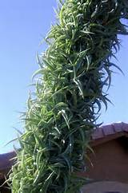
Flower buds are axillary or terminal and arise from bract as that of vegetative buds. They some times modified into vegetative buds or bulbils. Eg: Agave sp.
Flower as a modified shoot, Dr. Sr. Meena. K. Cheruvathur, St.Mary’s College

Slide 6
Bulbils-Allium
Flower buds turn into bulbils in Agave
Flower as a modified shoot,Dr.Sr.Meena.K.Cheruvathur,St.Mary’s College

Slide 7
Growth of the thalamus is limited by the carpel. But some times, thalamus grows beyond the gynoecium and bears leafy shoot or a flower above the first flower. Eg: Rose, Euphorbia milli
Elongated thalamus of Rose
Euphorbia milli- origin of shoots from thalamus
Flower as a modified shoot,Dr.Sr.Meena.K.Cheruvathur,St.Mary’s College

Slide 8
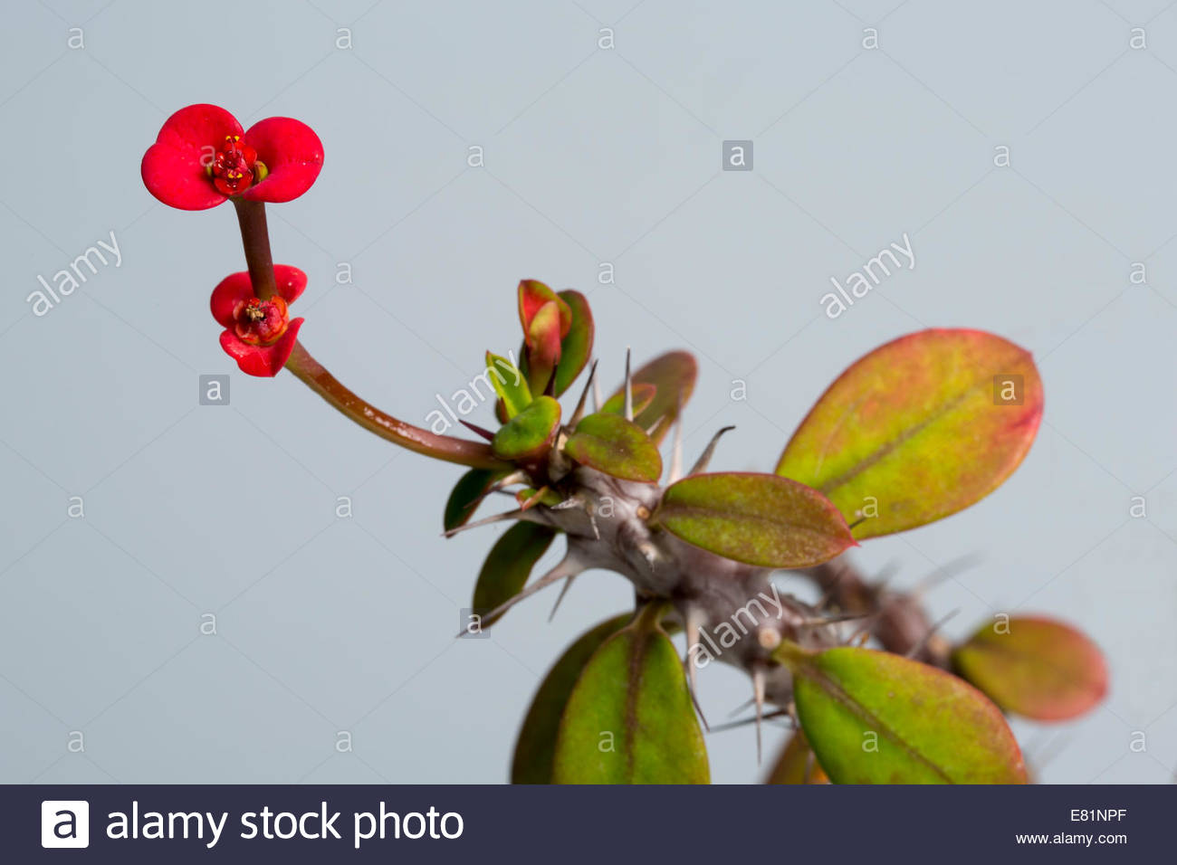
Euphorbia splendens
Flower as a modified shoot,DrSr.Meena.K.Cheruvathur,St.Mary’s College

Slide 9
2. Axial nature of the thalamus
a. In Majority of the flowers, thalamus is condensed, and axial nature is not clear. But in some exceptional cases, internodes do develop and shows its stem character clearly. The internode when present between corolla and androecium – androphore.
Eg: Androphore in passion fruit (Passiflora edulis), Gynandropsis ( Gynandropsis gynandra)
Gynophore in Cadaba aphylla
Flower as a modified shoot,DrSr.Meena.K.Cheruvathur,St.Mary’s College

Slide 10
Gynandropsis gynandra Passiflora
Flower as a modified shoot, Dr. Sr. Meena. K. Cheruvathur, St.Mary’s College

Slide 11
Gynophore in Cadaba aphylla
Flower as a modified shoot, Dr. Sr. Meena. K. Cheruvathur, St.Mary’s College

Slide 12
Gynophore in Capparis
Androphore in Passion fruit
Carpophore in Faeniculum
Flower as a modified shoot, Dr. Sr. Meena. K. Cheruvathur, St.Mary’s College

Slide 13
b. Region of thalamus bearing carpels elongates like an ordinary shoot and giving rise to an aggregate fruit. Eg: Michelia chambaka (Magnoliaceae), Polialthia (Annonaceae).
Michelia chambaka-flower
Aggregate fruit
Flower as a modified shoot,Dr.Sr.Meena.K.Cheruvathur,St.Mary’s College

Slide 14
3. Leaf Nature of Floral Members:
The sepals, petals, stamens and carpels reveal their leaf nature in the following:
The phyllotaxy of floral leaves on the thalamus (cyclic or spiral) strongly resem­bles that of foliage leaves on the stem. The floral leaves even show ptyxis and prefoliation (aestivation) in the same manner as foliage leaves.
(b) The four types of floral members (viz., sepals, petals, stamens and carpels) and foliage leaves often change from one to the other.
(c) Clear gradual transition of one type of floral member into another is seen in the flower of water-lily (Nymphaea sp.) where there are a large number of floral leaves arranged spirally on the thalamus.
Flower as a modified shoot,Dr.Sr.Meena.K.Cheruvathur,St.Mary’s College

Slide 15
Clear gradual transition of one type of floral member into another is seen in the flower of water-lily (Nymphaea sp.) where there are a large number of floral leaves arranged spirally on the thalamus.
The lowermost sepals are leafy green showing venation, these gradually merge into petals, petals gra­dually narrow down and merge into stamens developing anthers on the top.
TRANSITION STAGES: SEPALS TO PETALS AND PETALS TO STAMENS IN NYMPHAEA
Flower as a modified shoot,Dr.Sr.Meena.K.Cheruvathur,St.Mary’s College

Slide 16
d. Gradual transition from leaves to sepals and sepals to petals in Peony
Flower as a modified shoot, Dr.Sr.Meena.K.Cheruvathur, St.Mary’s College

Slide 17
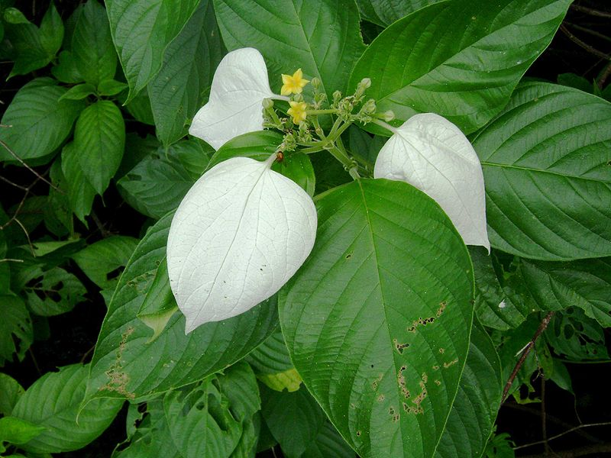
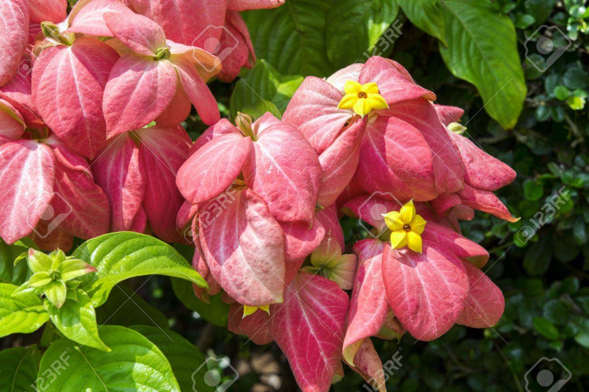
e. In Mussaenda frontosa, one of the sepals becomes large and veinsmarked like leaf.
In Mussaenda philipica all the sepals become petaloid
Flower as a modified shoot,Dr.Sr.Meena.K.Cheruvathur,St.Mary’s College

Slide 18
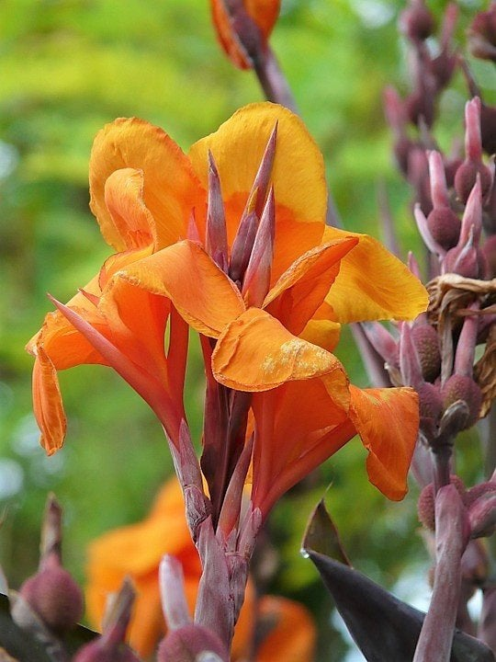
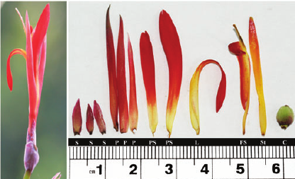
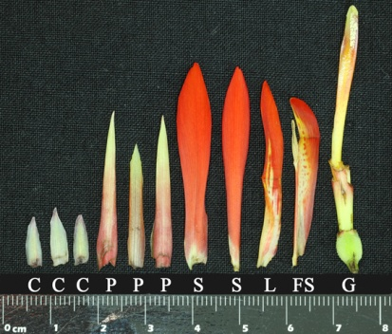
f. Canna flowers shows petaloid stamens.
Transition from petal to stamen
Flower as a modified shoot,Dr.Sr.Meena.K.Cheruvathur,St.Mary’s College

Slide 19
g. In certain flowers like the legumes (peas, etc), the carpel (specially the ovary part) clearly looks like a folded green leaf.
Flower as a modified shoot,Dr.Sr.Meena.K.Cheruvathur,St.Mary’s College

Slide 20
h. In the green rose, the sepals look like foliage leaves and even the petals are green and leafy.
Green Roses
Flower as a modified shoot,Dr.Sr.Meena.K.Cheruvathur,St.Mary’s College

Slide 21
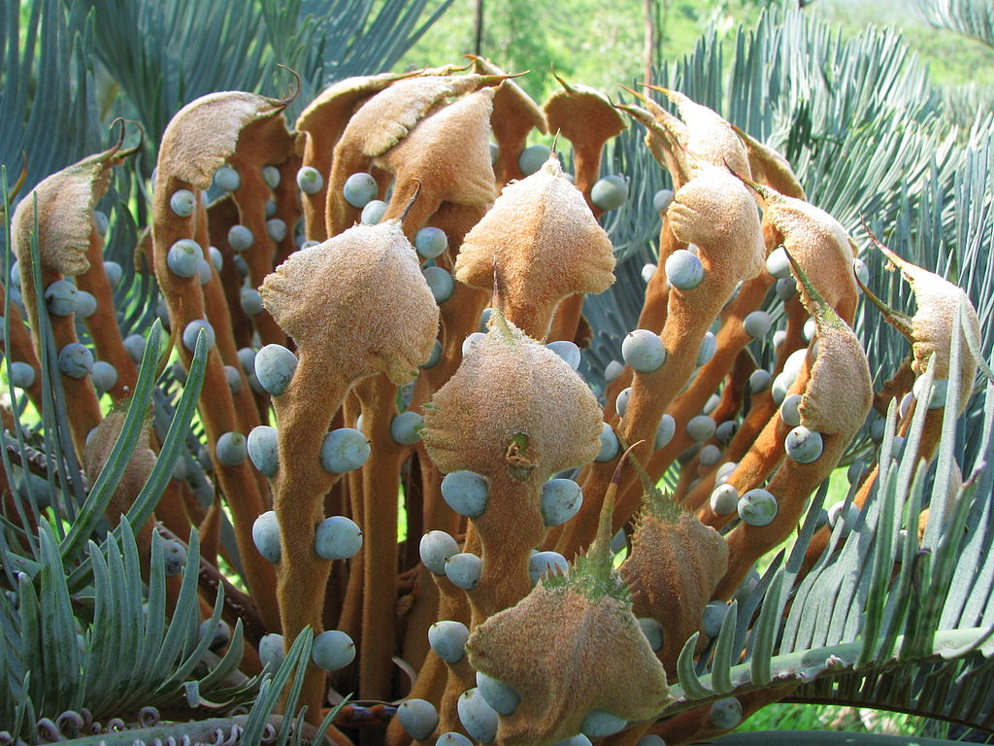
i. In the lower groups like the Pteridophytes and the Gymnosperms, the sporophyll is clearly seen to be an ordinary leaf, modified or not, bearing sporangia.
The above evidences clearly shows that flower is a modified shoot
Flower as a modified shoot,Dr.Sr.Meena.K.Cheruvathur,St.Mary’s College

Slide 22
REERENCES:
Can Flower be a Modified Shoot: Soumendra Kumar
https://instagramwebs.com/p/BxWj7Ubllhs
Flower as a modified shoot,Dr.Sr.Meena.K.Cheruvathur,St.Mary’s College

