Slide 2
RESERVE FOOD MATERIALS
Excess of food materials kept in a cell as storage products.
Reserve food materials stored in underground stem, roots, seeds etc.
They include carbohydrates, proteins, amino acids, fats and oils
Reserve carbohydrates are of 2 types-
1. Soluble-found in cytoplasm and vacuolar sap
Eg: sugars, inulin, glycogen etc
2. Insoluble
Eg: starch, cellulose etc
Reserve Food Materials Of Plants, Dr.Sr.Meena.K.Cheruvathur,st.Mary’s College

Slide 3
STARCH
Starch-storage form of plant polysaccharide-composed of long chains of glucose molecules
Consits of 2 kinds of glucose polymers
a. Alpha amylose (water soluble, unbranched portion)
b. beta ammyose / amylo pectin (water inoluble, branched portion
Starch appears in the form of starch grains-shape vary from oval, poly gonal and globular
Bluish black with iodine/ pottassium iodide
Starch -1st formed in chloroplast-then break down and move as sugar to storage tissues- resynthesised in amyloplasts.
Reserve Food Materials Of Plants, Dr.Sr.Meena.K.Cheruvathur,st.Mary’s College

Slide 4
STARCH GRAINS
Reserve Food Materials Of Plants, Dr.Sr.Meena.K.Cheruvathur,st.Mary’s College

Slide 5
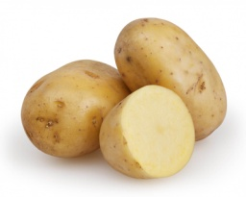
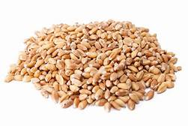
Starch is deposited around a central core point called hilum
Based on the position of hilum, 2 kinds of starch grains
Concentric b. Eccentric
In concentric grains-hilum in the centre.
Eg: Wheat
In eccentric grains-hilum present at one end
Eg: Potato tuber
Reserve Food Materials Of Plants, Dr.Sr.Meena.K.Cheruvathur,st.Mary’s College

Slide 6
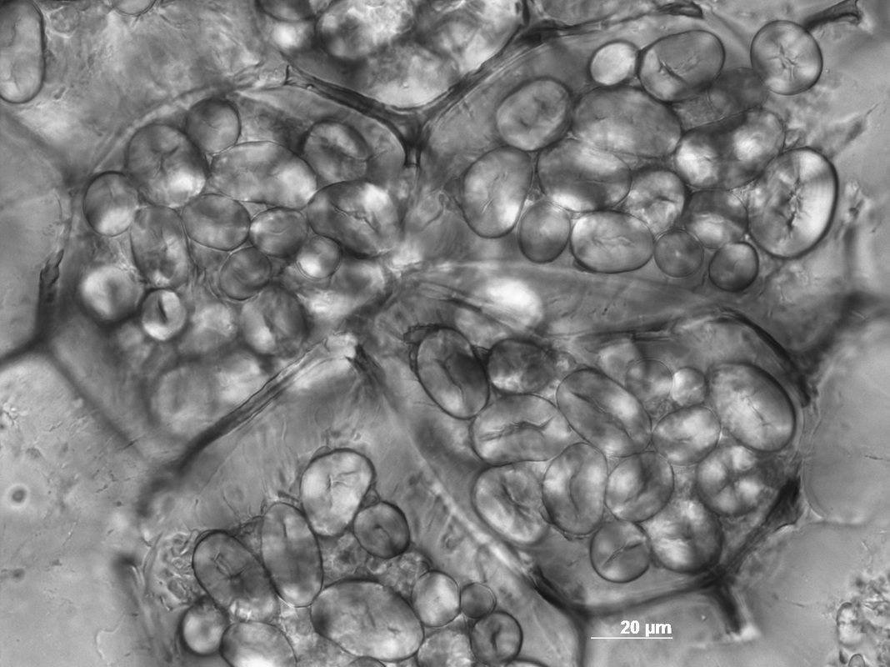
STARCH GRAINS
Concentric grains-wheat
Eccentric grains-potato
Reserve Food Materials Of Plants, Dr.Sr.Meena.K.Cheruvathur,st.Mary’s College

Slide 7
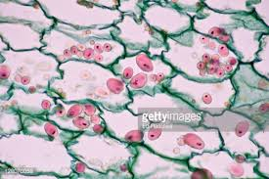
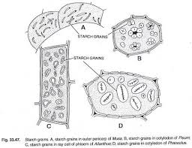
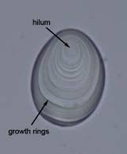
Reserve Food Materials Of Plants, Dr.Sr.Meena.K.Cheruvathur,st.Mary’s College

Slide 8
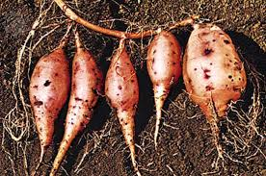
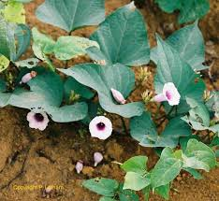
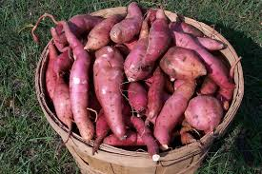
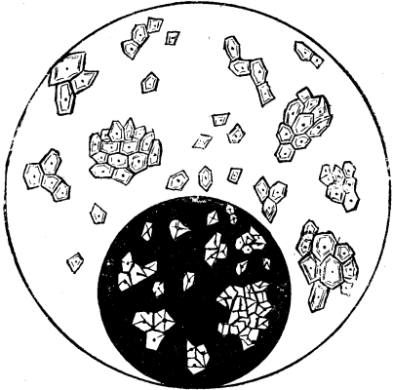
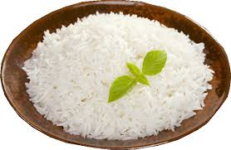
COMPOUND GRAINS IN SWEET POTATO & RICE
Reserve Food Materials Of Plants, Dr.Sr.Meena.K.Cheruvathur,st.Mary’s College

Slide 9
STARCH GRAINS OF DIFFERENT PLANTS
Reserve Food Materials Of Plants, Dr.Sr.Meena.K.Cheruvathur,st.Mary’s College

Slide 10
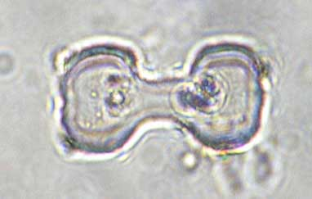
Starch grains are stored in amyloplast (leucoplast) for future use.
In some species of Euphorbia, dumb-bell shaped or rod shaped starch grains occur in the latex cells.
Starch grains of Rice are the smallest and Canna is the largest.
Dumb-bell shaped starch grains in Euphorbia
Reserve Food Materials Of Plants, Dr.Sr.Meena.K.Cheruvathur,st.Mary’s College

Slide 11
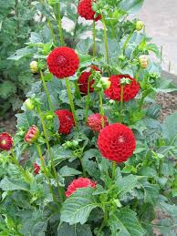
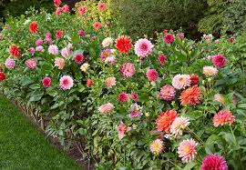
INULIN
Inulin is a water soluble carbohydrate present in cell sap of tuberous roots of Dahlia, Helianthus tuberosus, in members of family companulaceae, compositae, monocotyledons etc.
Reserve Food Materials Of Plants, Dr.Sr.Meena.K.Cheruvathur,st.Mary’s College

Slide 12
INULIN
Inulin is a polysaccharide.
It precipitates in the form of spherical, star shaped, fan like or wheel like crystals when treated with alcohol.
Reserve Food Materials Of Plants, Dr.Sr.Meena.K.Cheruvathur,st.Mary’s College

Slide 13
Hemicellulose
Hemicellulose is a polysaccharide found in the cell walls of palm seed.
Eg: areca seed
It impart strength and toughness.
They may be digested by some reserve food and hence may be used as reserve food.
Thickened walls of hemicellulose from Areca seed
Reserve Food Materials Of Plants, Dr.Sr.Meena.K.Cheruvathur,st.Mary’s College

Slide 14
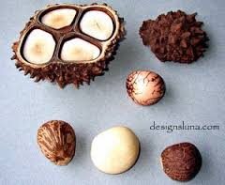
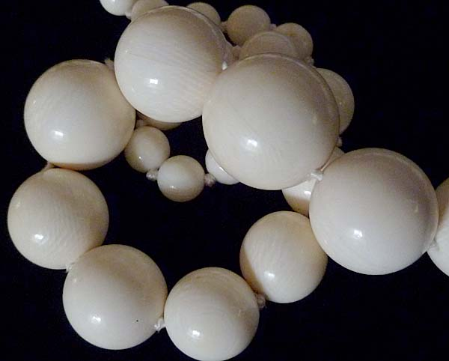
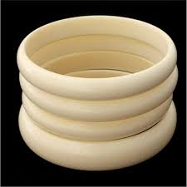
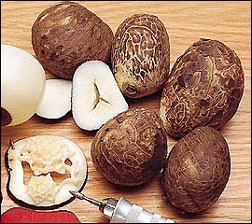
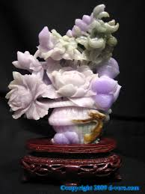
Tagua nuts from Palm tree used for craft works due to its hardness and strength.
Reserve Food Materials Of Plants, Dr.Sr.Meena.K.Cheruvathur,st.Mary’s College

Slide 15
Hemicellulose
Artistic products from tough hemiellulosic Tagua nuts
Reserve Food Materials Of Plants, Dr.Sr.Meena.K.Cheruvathur,st.Mary’s College

Slide 16
CELLULOSE
Typical sructuaral constituent of cell wall.
Gives rigidity to plant cell wall, not present in animal cells.
It is insoluble polysaccharide and mostly indigestible.
Microorganisms present in the digestive track of ruminants and termites helps them to digest it.
Additional layers get deposited over cell wall as reserve food
Ex: palm seeds-cellulose form reserve food of germinating seeds.
It’s a solid carbohydrate with the general formula (C6H10O5)
Reserve Food Materials Of Plants, Dr.Sr.Meena.K.Cheruvathur,st.Mary’s College

Slide 17
SUGARS
Soluble carbohydrates found in various parts of plants.
Eg: Fruit of Grapes, apple, Stem of sugar cane , roots of beet etc
Eg: Glucose –Monosaccharide (dextrose)-Grape sugar
Fructose- Monosaccharide (Laevulose)-Fruit Sugar
Sucrose-Disaccharide-Cane Sugar-Ordinary table sugar obtained from Sugar cane or Sugar Beets.
Reserve Food Materials Of Plants, Dr.Sr.Meena.K.Cheruvathur,st.Mary’s College

Slide 18
PROTEINS
Protiene exists in the form of small grains -called aleurone grains.
Amorphous proteins present in outer most layrs of endosperm-aleurone layer of caryopsis of rice, maize, peas, beans, castor etc
Aleurone grain is a solid ovate or rounded body which encloses a crystal like body called crystalloid and a rounded body called globoid.
Globoids are mineral deposits formed mainly from double phosphate of Ca and Mg.
Crystalloids are protein bodies.
Proteine in the form of cuboidal crystaloids found in the peripheral parenchyma of potato tuber and fruit parenchyma of capsicum.
Reserve Food Materials Of Plants, Dr.Sr.Meena.K.Cheruvathur,st.Mary’s College

Slide 19
Reserve Food Materials Of Plants, Dr.Sr.Meena.K.Cheruvathur,st.Mary’s College

Slide 20
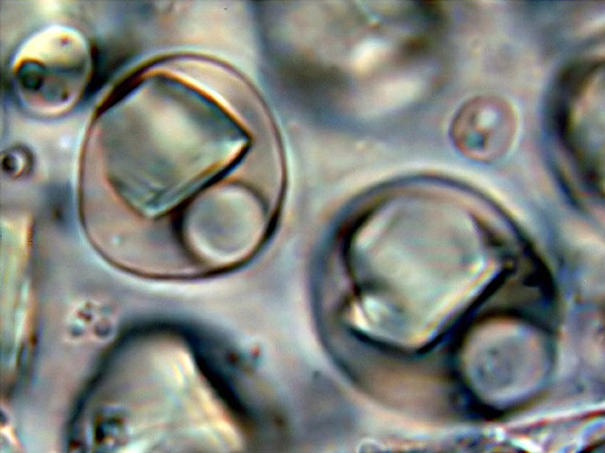
Aleurone grains in the endosperm of castor seed
Few grains magnified containing crystalloids and globoids in them
Reserve Food Materials Of Plants, Dr.Sr.Meena.K.Cheruvathur,st.Mary’s College

Slide 21
Kernel of wheat
Reserve Food Materials Of Plants, Dr.Sr.Meena.K.Cheruvathur,st.Mary’s College

Slide 22
AMINO COMPOUNDS
Nitrogenous food materials found in the form of amino acids and amines in cell sap
OILS , FAT AND WAXES
They are compounds containing carbon, hydrogen, and oxygen.
Oxygen content is very less and hence highly reduced compounds capable of giving more energy than that of carbohydrates.
They are insoluble in cytoplasm.
Occur in cytoplasm/ vacuole of seeds & /fruits as globules or droplets.
They are glycerides of fatty acides-produced by elaioplasts or spherosomes.
Fats-solid at room temperature
Oils-liquids at room temperature
Reserve Food Materials Of Plants, Dr.Sr.Meena.K.Cheruvathur,st.Mary’s College

Slide 23
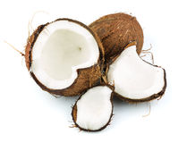
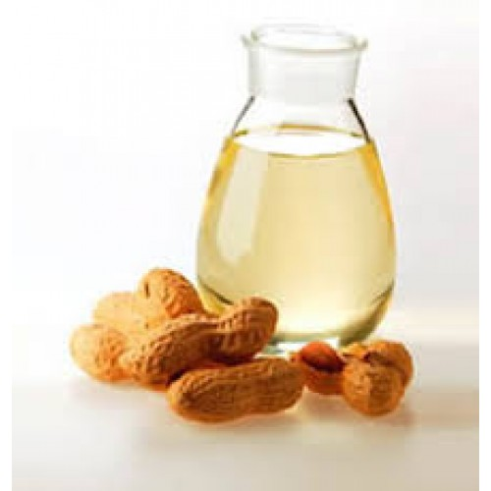
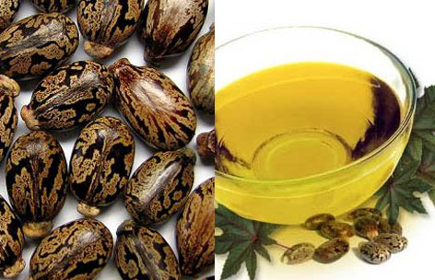
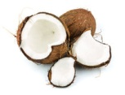
Lipid bodies of irregular shape present in the vacuole of epidermal cell
Oils and fats are abundantly present in fruits and oily seeds
like ground nut, coconut, castor seed etc
Reserve Food Materials Of Plants, Dr.Sr.Meena.K.Cheruvathur,st.Mary’s College

Slide 24
Economic importance of reserve food materials in plants:
Carbohydrates provide energy. There are two types - simple and complex.
Simple carbohydrates are sugars, like glucose and lactose. They are a fast acting source of energy.
Complex carbohydrates are a source of slow release energy, like rice and pasta. Cellulose – is found in plant cell walls and cannot be digested by humans. However, as fibre, it helps the peristaltic movement of muscles.
Starch – is broken down by digestive enzymes into glucose, which can be used by cells to make energy
Reserve Food Materials Of Plants, Dr.Sr.Meena.K.Cheruvathur,st.Mary’s College

Slide 25
Glycogen – is a carbohydrate store within the human body and can be converted into glucose when levels are low.
Fats/lipids
Fats are a store of energy, providing double the energy that carbohydrates and proteins do.
Proteins
Protein is used for the growth and repair of cells and can be used as a source of energy if carbohydrate and fat reserves are low.
Proteins are made up of long chains of amino acids.
After digestion amino acids are absorbed into the bloodstream and brought to cells that reassemble them into proteins needed by the body (e.g. enzymes).
Reserve Food Materials Of Plants, Dr.Sr.Meena.K.Cheruvathur,st.Mary’s College

Slide 26
References:
Anatomy, Embryology and microtechnique, Prof. P. C. Abraham, St. Mary’s Press, Changanasserry
https://archive.org/details/in.ernet.dli.2015.550844
Plant Anatomy: P.C Vasishta, S. Nagin and Co Publishers, New Delhi
https://www.google.com/search?client=firefox-b-q=starch+grains
https://www.bbc.com/bitesize/guides/zs9krwx/revision/1
Reserve Food Materials Of Plants, Dr.Sr.Meena.K.Cheruvathur,st.Mary’s College

