Slide 1
Transpiration
Dr.Rekha K.
Assistant Professor
Dept. of Botany
St.Mary’s College, Thrissur

Slide 2
Transpiration-loss of water in the form of water vapor from the uninjured parts of the plant
Primary organs of transpiration-leaves
Types of transpiration
1. stomatal /foliar –major type (95-97%)
2.Cuticular- minor type
3.lenticular-minor type
Transpiration ratio- the ratio of transpirational loss of water to the dry matter during growing season
More transpiration ratio- less efficient in water consumption
Crop plants- transpiration ratio-200-500g
Transpiration, Dr.Rekha K, St.Mary’s College

Slide 3
Role of stomata in transpiration
Stomatal transpiration
Two stage process:
Evaporation of water from mesophyll surface to sub-stomatal air space
Diffusion of water vapor from sub-stomatal chamber to atmosphere
The quantity of water transpired by unit area of leaf surface in unit time-transpiration flux
Transpiration, Dr.Rekha K, St.Mary’s College

Slide 4
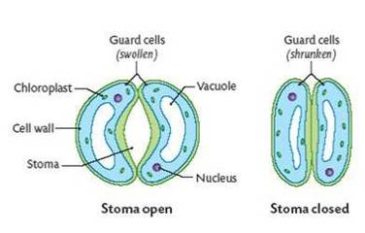
Structure of stomata
Transpiration, Dr.Rekha K, St.Mary’s College

Slide 5
Opening and closing of stomata-due to changes in TP in guard cells
Influenced by :
Light
CO₂ concentration
Water supply
pH of cell sap etc.
Transpiration, Dr.Rekha K, St.Mary’s College

Slide 6
Light
Open during day time and closes in night (photoactive stomata)
Succulent xerophytes-reverse (scotoactive)
Temperature
Close during high temp.
Water supply
Water deficiency in plants leads to stomatal closure
pH
Close during high pH
Co2-close during low CO₂
Transpiration, Dr.Rekha K, St.Mary’s College

Slide 7
Mechanism of stomatal movement
Opening and closing of stomata is guarded by guard cells
Opening completed in 2 phases:
Tension phase- guard cells increase in breadth
Motor phase- they bend outward
Transpiration, Dr.Rekha K, St.Mary’s College

Slide 8
Stomatal opening
Water potential –low
OP high
Water enters from epidermal cells
TP increases –stomata open
Stomatal closing
Water potential –high
OP low
Water releases into epidermal cells
TP decreases
Guard cells become flaccid –stomata close
Transpiration, Dr.Rekha K, St.Mary’s College

Slide 9
Theories of stomatal movement
1. starch-sugar interconversion theory
Formulated by Lloyd, elaborated by Sayre and Scarth
Transpiration is controlled by reversible starch-sugar interconversion, and by the effect of pH on enzyme which govern this interconversion
Day time- due to photosynthesis-low C02 con.in mesophyll cell,high pH, activation of hydrolysis of starch into sugar
Night time-reverse process
Transpiration, Dr.Rekha K, St.Mary’s College

Slide 10
Transpiration, Dr.Rekha K, St.Mary’s College

Slide 11
Demerits
Slow process-can not account for rapid transpiration
Transpiration takes place even in the absence of starch in guard cells eg.onion
Glucose not detected in guard cells during opening
Some guard cells lack chlorophyll, still stomata opens
In some plants stomata open at night and close during day time
Fails to explain extra effectiveness of blue light at the time of stomatal opening
Transpiration, Dr.Rekha K, St.Mary’s College

Slide 12
2. Theory of ATP driven H⁺-K⁺ transport and hormonal regulation
Advanced by Levitt (1974)
Opening and closing result from the exchange of ions between guard cells and neighbouring subsidiary cells
In light,
starch in guard cell convert into PEP
PEP+CO2 → OAA, enzyme-PEP carboxylase, active at high pH
OAA →malic acid
Malic acid → H⁺ + malate ions
H+ exchanged for K+ in the epidermal cells (ion exchange), active process requires ATP
Cl⁻ ions also enters to maintain pH
K⁺,malate ions,Cl⁻ increases OP , water enters into guard cells-stomata open
Transpiration, Dr.Rekha K, St.Mary’s College

Slide 13
In night
pH low,
Low pH and shortage of water activates ABA(abscisic acid)
Alters membrane permeability
Allows entry of Ca⁺⁺ into guard cells and release of K⁺, Cl⁻ malic acid formation, OP lowers, causes leakage of water, TP lowers, stomata close
Transpiration, Dr.Rekha K, St.Mary’s College

Slide 14
Antitranspirants
Substances that reduce transpiration without affecting growth and photosynthesis
Aspirin and ABA-cause partial closure of stomata
CO2 at higher concentration causes closure of stomata
Categories of antitranspirants
water-impermeable substance- . Colourless plastics, silicon oil, low viscosity waxes , form colourless and transparent film over the leaf surface
b. Substances that cause partial closure of stomata eg. Salicylic acid, phenyl mercuric acetate (PMA),CO2
c. Metabolic inhibitors –cause temporary closure of stomata (ABA), aspirin
Transpiration, Dr.Rekha K, St.Mary’s College

Slide 15
Guttation
Exudation of liquid drops from uninjured xylem endings
Common in tropical herbaceous plants grown under high humidity, high soil moisture, high water absorption and low transpiration
Occurs at night
Main cause root pressure
Occurs through hydathodes (water stomata)
Quality of exudate-pure water/ dilute solution of various organic and inorganic compounds
Transpiration, Dr.Rekha K, St.Mary’s College

Slide 16
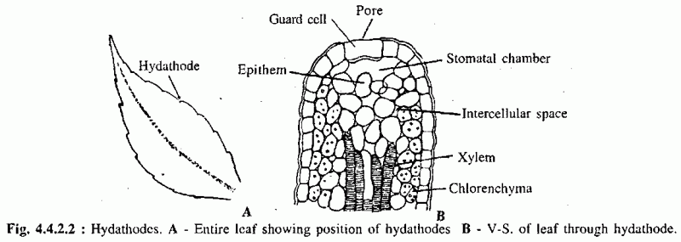
Hydathode
Transpiration, Dr.Rekha K, St.Mary’s College

Slide 17
Bleeding
Exudation of watery sap from incisions
4 types:
1. oozing out of xylem sap by root pressure
2. Oozing out of xylem sap by some local pressure within stem
3. Exudation of phloem sap by local pressure
4. Exudation of latex from laticiferous ducts or cortex
Transpiration, Dr.Rekha K, St.Mary’s College

Slide 18
REFERENCES
V. K. Jain. Fundamentals of Plant Physiology. S.Chand & Company Ltd., 2011.
V.Verma. Plant Physiology. Athena Academic, 2016.
Transpiration, Dr.Rekha K, St.Mary’s College

