Slide 1
Callus Culture
Whylgreen Jose
Assistant Professor
Department of Botany
St. Mary’s College Thrissur

Slide 2
Meaning of Callus Culture
Callus is formed by the proliferation of the parent tissue.
Cells are parenchymatous, amorphous and unorganised. Callus is formed as a result of injury at the cut ends of a stem or a root.
When tissues on culture produce unorganised mass of callus with no regular form then it is called callus culture.
First observed by Rechinger in 1893.
Callus culture,Whylgreen Jose,St.Mary’s College

Slide 3
MATERIALS
Callus may initiate from explants of any multicellular plant.
Explants from stem, root, leaf, flower, fruit or seed etc. may be taken for culture.
Callus formation has been recorded from storage parenchyma, pericyclic cells of roots, cambial cells of vascular bundles, provascular cells, secondary phloem, pith cells, mesophyll cells and cotyledons.
Callus culture,Whylgreen Jose,St.Mary’s College

Slide 4
The callus is sub-cultured because:
The nutrient may be ex­hausted,
(b) Agar may be desiccated,
(c) Cell metabolites may accumulate and cause toxicity
Callus culture,Whylgreen Jose,St.Mary’s College

Slide 5
Nutrient Medium of Callus Culture
Standard media, such as, Murashige and Skoog’s medium.
For initiation and maintaining callus kinetin is used.
For callus initiation usually an exogenous supply of hormone is required
According to hor­mone requirements callus culture may be of five types.
These are:
(a) Auxin (b) Cytokinin (c) Cultures requiring both auxin and cytokinin, (d) Gibberellin
Callus culture,Whylgreen Jose,St.Mary’s College

Slide 6
Callus growth can be monitored by:
Fresh weight measurement (most convenient)
Dry weight measurement (more accurate)
Mitotic index measurement (for cell divisional rate).
Callus culture,Whylgreen Jose,St.Mary’s College

Slide 7
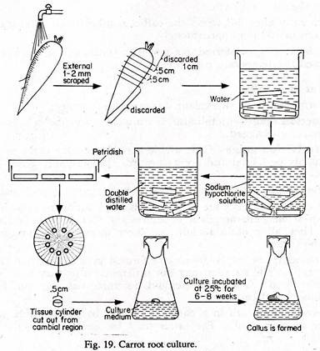
CARROT ROOT CULTURE
Callus culture,Whylgreen Jose,St.Mary’s College

Slide 8
DEVELOPMENT OF A CALLUS CULTURE
Callus formation from an explants occurs in three stages:
(a) Induction stage:
Metabolism is stimulated and the cells prepare to divide. Cell size remains unchanged.
(b) Cell division stage:
Cells divide actively and the cell size decreases. Cell division is mainly periclinal and occurs towards the periphery giving rise to wound cambial cells.
Callus culture,Whylgreen Jose,St.Mary’s College

Slide 9
(c) Differentiation:
Cells differentiate by expansion and maturation.
Rapidly growing calluses are more or less alike but as the growth rate decreases the calluses show their characteristic structures and forms.
But all calluses have some similarities.
They all contain nodular or sheet meristems in groups or scattered throughout the tissue
Callus culture,Whylgreen Jose,St.Mary’s College

Slide 10
NATURE OF CALLUS TISSUE:
Some cultures are hard, consists of compactly arranged small cells without intercellu­lar spaces, composed of lignified cells.
Other callus friable consists of large loosely arranged cells with intercellular spaces.
Friable callus is fragile and easily breaks up.
These are suitable for suspension culture, where the tissue can be dispersed by mechanical agitation
Callus culture,Whylgreen Jose,St.Mary’s College

Slide 11
The colour of the callus also varies and usually depends on the colour of the tissue from which it is taken.
The callus may be colourless or green containing chloro­phyll or yellow having carotenoids or flavonoids or it may be purple due to the presence of anthocyanin.
Callus may be uniformly or partially coloured.
Callus culture,Whylgreen Jose,St.Mary’s College

Slide 12
SIGNIFICANCE OF CALLUS CULTURE
Determine the total amount of nucleic acids (i.e., DNA and RNA) rapidly from callus culture.
By using tracer elements in callus culture the path of various metabolic pro­cesses has been determined)
Friable callus is suitable for cell suspension culture.
Callus culture,Whylgreen Jose,St.Mary’s College

Slide 13
REFERENCES
Dr. Mahipal Singh Shekhwat. Plant cell and tissue culture, Saras publishers
Razdan M.K. Plant tissue culture.Science publishers Inc.,USA
Callus culture,Whylgreen Jose,St.Mary’s College

