Slide 1
Optimum capital structure
Femy Moni Assistant Professor Department of Commerce St. Mary’s College
Thrissur – 680020
Kerala

Slide 2
Optimum Capital Structure
The optimum capital structure may be defined as “the capital structure or combination of debt and equity that leads to the value of firm”. optimum capital structure maximizes the value of the company and hence the wealth of its owners and minimizes the company’s cost of capital.
Optimum Capital Structure ,Femy Moni ,St.Mary’s College

Slide 3
Features
Profitability:-The most profitable capital structure is one that tends to minimize the cost of financing and maximize earning per share.
Flexibility:-The capital structure should be such that company can raise funds whenever needed
Conservation:-The debt content in the capital structure should not exceed the limit which the company can bear.
Solvency;-The capital structure should be such that firm does not have the risk of becoming insolvent.
Control:-The capital structure should be so devised that it involves minimum risk of loss of control of the company.
Optimum Capital Structure ,Femy Moni ,St.Mary’s College

Slide 4
Goals
If the return is higher than the fixed cost of funds, the company should prefer to raise funds having a fixed cost ,such as debentures, loans and preference share capital .It will increase EPS and market value of the firms.
When debt is used as a source of finance, the firm savers a considerable amount in payment of tax as a deductable expenses in computation of tax .Hence, the effective cost of debt is reduced , called tax leverage.
The firm should avoid undue financial risk attached with the use of increased debt financing .If the shareholders perceive high risk in using further debt-capital, it will reduce the market price of shares.
The capital structure should be flexible
Optimum Capital Structure ,Femy Moni ,St.Mary’s College

Slide 5
Essentials or requisites of optimum capital structure
clarity of objectives
Balance
Economy
Liquidity and solvency
Flexibility
Simplicity
Safety
Maximum return
Maximum control
Balanced leverage
Optimum Capital Structure ,Femy Moni ,St.Mary’s College

Slide 6
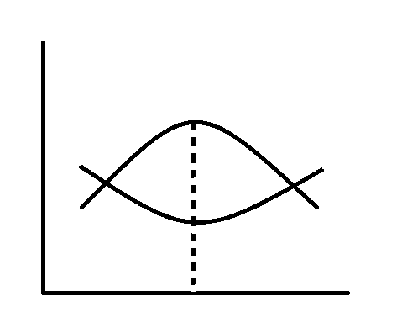
Graph of optimum capital structure
Y
Cost and Value
Cost
Value
0
X
Debt and Equity
Optimum Capital Structure ,Femy Moni ,St.Mary’s College

Slide 7
Theories of optimal capital structure
Net income Approach
Net Operating Income Approach
Traditional Approach
MM Approach Income Approach
This approach was suggested by Durand and he was in favor of financial leverage decision. According to him, a change in financial leverage would lead to a change in the cost of capital. In short, if the ratio of debt in the capital structure increases, Net Income Approach
This approach was suggested by Durand and he was in favor of financial leverage decision. According to him, a change in financial leverage would lead to a change in the cost of capital. In short, if the ratio of debt in the capital structure increases, the weighted average cost of the firm increases.
.
Optimum Capital Structure ,Femy Moni ,St.Mary’s College

Slide 8
Net Income Approach
This approach was suggested by Durand and he was in favor of financial leverage. According to him a change in financial leverage would lead to a change in the cost of capital.
Net Operating Income Approach
This approach is also suggested by Durand. Its opposite of Net income approach. If there are no tax this approach says that weighted average cost of capital remains constant. It believes in the fact that the market analysis a firm as a whole and discounts at a particular rate which has no relation to debt – equity ratio.
Optimum Capital Structure ,Femy Moni ,St.Mary’s College

Slide 9
Traditional Approach
This approach says that the cost of capital is a function of capital structure . The optimal capital structure implies that at a particular ratio of debt and equity the cost of capital is minimum and value of the firm is maximum
Modigliani Miller Approach
This theory has two propositions
Proposition 1 : It says that the capital structure is irrelevant to the value of the firm. The value of two identical firm would remain the same and value would not affect by the choice of finance adopted to finance the assets. Its when there are no taxes.
Optimum Capital Structure ,Femy Moni ,St.Mary’s College

Slide 10
Modigilani Miller Approach
Proposition 2 : It says that financial leverage boosts the value of the firm and reduces the weighted average cost of capital . Its when the tax information is available.
Optimum Capital Structure ,Femy Moni ,St.Mary’s College

Slide 11
Essentials of optimum capital structure
Balance
Economy
Liquidity and Solvency
Flexibility
Simplicity
Safety
Maximum return
Maximum Control
Balanced Leverage
Optimum Capital Structure ,Femy Moni ,St.Mary’s College

