Slide 1
FUNCTIONS
Dr. Sini Thomas M Assistant professor Department of economics St. Mary’s College, Thrissur

Slide 2
INTRODUCTION
Function is a technical term used to describe the relationship between independent and dependent variables.
Mathematically,
Dependent variable=f(independent variable)
Eg. Crop yield=f(fertilizer use)
Functions, Dr. Sini Thomas M, St. Mary’s college

Slide 3
Forms of Functions
Linear function:f(x)=ax+b
Quaderatic function: f(x)= ax²+bx+c
Polynomial function (of degree n)
f(x)=a_{n}x_{n+}a_{n-1}x_{n-1+……..+}a₀ (n= nonnegative
integer, a_{n} = 0)
Rational function or Function of ratio
f(x)=g(x)/h(x)
Power function
f(x)=ax^{n} (n= any real number)
Functions, Dr. Sini Thomas M, St. Mary’s college

Slide 4
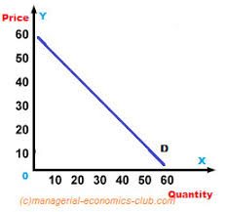
Demand Function
Relationship between price of the good (independent variable) and quantity of good demanded (dependent variable)
d_{x}=f(p_{x})
Functions, Dr. Sini Thomas M, St. Mary’s college

Slide 5
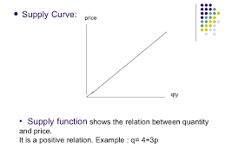
Supply Function
Relationship between price of the good (independent variable) and quantity of the good suppliedv(dependent variable)
S_{x}=f(p_{x})
Functions, Dr. Sini Thomas M, St. Mary’s college

Slide 6
Utility Function
Refers to the perceived value of a good
Relationship between the physical measure of money and the perceived value of money
It expresses the relation between utility derived and quantities of different goods consumed.
U=f(q_{1,}q₂)
Functions, Dr. Sini Thomas M, St. Mary’s college

Slide 7
Consumption Function
John Maynard Keynes
Relationship between real disposable income and consumer spending
C=a+bY
C=Consumer Expenditure
‘a’=autonomous consumption
Y=Income
b= MPC (Marginal Propensity to Consume)
Functions, Dr. Sini Thomas M, St. Mary’s college

Slide 8
Saving Function
Relationship between disposable income and saving
S=c+dY
S= saving
c=Autonomous saving
Y= Income
d=MPS (Marginal Propensity to Save)
Functions, Dr. Sini Thomas M, St. Mary’s college

Slide 9
Production Function
Relation between the production of a good or service and the inputs used
Q=f(x_{1,}x_{2,…………,Xn})
Cost Function
Relation between cost and its determinants such as level of output (Q), plant Size (S), input prices(P), technology (T), managerial efficiency (E) etc.
Functions, Dr. Sini Thomas M, St. Mary’s college

Slide 10
Revenue Function
Revenue Function expresses revenue earned as a function of the price of good and quantity of good sold.
R(x)=px
Profit function
Difference between the total revenue and total cost
P(x)=R(x)-C(x), II=TR- TC
Functions, Dr. Sini Thomas M, St. Mary’s college

