Slide 1
POVERTY-PERSPECTIVES AND DIMENSIONS
Jincy George
Assistant Professor
Department of Economics
St. Mary’s College,Thrissur

Slide 2
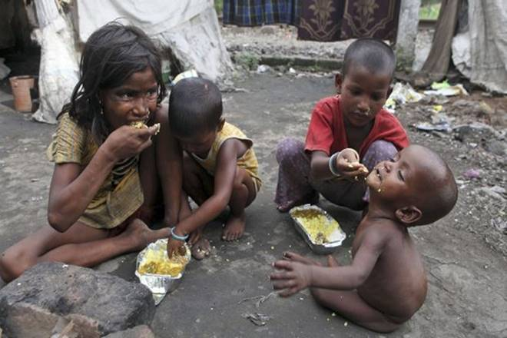
POVERTY
Poverty is the state of one who lacks a usual or socially acceptable amount of money or material possessions and is said to exist when people lack the means to satisfy their basic needs such as adequate and nutritious food, clothing and housing .
Poverty can be understood simply as a lacks of money or more broadly in terms of barriers to everyday human life.
poverty-perspectives and dimensions .Jincy george,st.mary’s college

Slide 3
DEFINITION
The world Bank observes that “poverty is pronounced deprivation in well-being ,and comprises many dimensions. it includes low incomes and the inability to acquire the basic goods and services necessary for survival with diginity. Poverty also encompasses low levels of health and education ,poor access to clean water and sanitation, Inadequate physical security, lack of voice and insufficient capacity and opportunity to better ones life”
poverty-perspectives and dimensions .Jincy george,st.mary’s college

Slide 4
CAUSES OF POVERTY
Overpopulation
The unequal distribution of resources in the world economy
Inability to meet high standards of living and costs of living
Inadequate education and employment opportunities
environmental degradation
certain economic and demographic trends, and
welfare incentives
Poverty –perspectives and dimensions,Jincy George .St.Mar’ys College

Slide 5
EFFECTS OF POVERTY
Precarious livelihoods
Excluded locations
Physical limitations
Gender relationships
Problems in social relationships
Lack of security
Abuse by those in power.
Poverty-perspectives and dimensions Jincy George,St.Mar’ys College

Slide 6
POVERTY LINE
Poverty line is the level of income to meet the minimum living condition. It is the amount of money needed for a person to meet his basic needs.
The Poverty line or poverty threshold is the minimum level of income deemed necessary to achieve an adequate standard of living in a given country.
In practice, like the definition of poverty ,the official or common understanding of the poverty line is significantly higher in developed countries than in developing countries
Poverty-perspectives and dimensions ,St.Mar’ys College

Slide 7
TYPES OF POVERTY
Absolute poverty: Extreme poverty which threatens people’s health or lives is known as absolute poverty. It is a level of poverty as defined in terms of the minimal requirements necessary to afford minimal standards of food,clothing,health care and shelter.
Relative poverty :It refers to lacking a usual or socially acceptable level of resources or income as compared with others within a society or country. It is a measure of income inequality rather than material deprivation or hardship.
Poverty-perspectives and dimensions,St.Mar’ys College

Slide 8
MEASURES OF POVERTY
Head count
Poverty gap
income shortfalls
human poverty index
multidimensional poverty index
Poverty-perspectives and dimensons,Jincy George,St.Mar’ys College

Slide 9
TACKLING POVERTY-
THE WORLD BANK APPROACH
Promoting opportunity which means expanding the economic opportunities and the asset base of the poor people through the process of economic growth.
Facilitating empowerment which means strengthening the participation of poor people in decision making ,eliminating various forms of discrimination and making state institutions more accountable and responsive to the poor people.
Enhancing security which means reducing poor people’s vulnerability to the various forms of insecurity that affect people’s lives.
Poverty –perspectives and dimensions,Jincy George,St.Mar’ys College

Slide 10
CONCLUSION
Poverty has become a great issue in our world. Though many organizations have been created to find solutions for this matter nobody could not save our world completely from poverty. The most common fact which we can realize when we consider on information about poverty is that poverty is mostly occurring in developing countries.
Poverty –perspectives and dimensions,Jincy George,St.Mar’ys College

Slide 11
REFERENCES
https://ipcig.org/pub/IPCPovertyInFocus9.pdf
https://www.oecd.org/dac/POST-2015%20multidimensional%20poverty.pdf
Poverty –perspectives and dimensions,Jincy George,St.Mar’ys College

