Slide 1
SUPPLY CHAIN MANAGEMENT
Blessy Varghese
Assistant Professor
Department of Management Studies
St Mary,s College,Thrissur

Slide 2
Definition
According to Global supply chain forum “Supply chain management is the integration of key business processes from end user through original suppliers that provides products, services, and information that add value for customers and other stakeholders”

Slide 3
SUPPLY CHAIN PARTICIPANTS
Manufacturers
Distributors
Logistics providers
Raw material
providers
Resellers
Financiers
End users

Slide 4
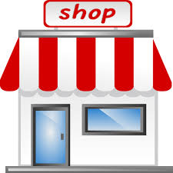
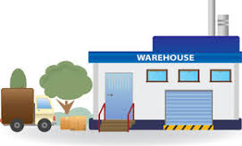
SUPPLY CHAIN FLOW
Distributors
Raw Materials
Manufacturer
Customer

Slide 5
OBJECTIVES OF SUPPLY CHAIN MANAGEMENT
The fundamental objective is to "add value“
Maximize supply chain profitability
Reduction of waste, cost and time
Improving the quality of customer service
reducing working capital
taking assets off the balance sheet
Accelerating cash-to-cash cycles
Increasing inventory turns

Slide 6
SUPPLY CHAIN PLANNING
Supply Chain Planning enables manufacturers to synchronize enterprise-wide production and supply with enterprise-wide demand.
Supply chain planning provides following benefits to manufacturers
Increased responsiveness to market changes
Improved visibility into aggregated demand as well as enterprise-wide production and supply
Reduced inventory levels
Improved customer service and on-time delivery performance
Optimized supply to meet demand profitably
Lowered inventory, distribution and transportation costs
Increased demand forecast accuracy with compressed planning cycle times

Slide 7
SUPPLY CHAIN MANAGEMENT PROCESS
Customer relationship management
Customer service management
Demand management
Customer order full fill management
Manufacturing flow management
Procurement management
Product development and commercialization
Returns management

Slide 8
SIX KEY TRENDS -
THAT EFFECTS SUPPLY CHAIN DESIGN
Demand planning
Globalization
Increased competition and price pressure
Outsourcing
Shortened and more complex life cycle
Collaboration between stakeholders

Slide 9
INNOVATIONS IN SUPPLY CHAIN MANAGEMENT
Vendor management Inventory (VMI)
The value of shares may fall due to lower rate of return on investment
Efficiency of management may deteriorate
It may encourage speculation
Inefficiency may be encouraged

Slide 10
SUPPLYCHAIN RELATIONSHIP
A Supply chain is a business relationship among several independent units that
work together for improving the overall efficiency and profitability
Principles of Supply chain Relationship
Co operation
Mutual help
Mutual trust
Dependence
Common goal
Sharing of information
Integration
Partnership
Flexibility

Slide 11
EMERGING TRENDS IN SUPPLY CHAIN MANAGEMENT
Vendor management Inventory ( VMI )
Collaborative Planning Forecasting and Replenishment ( CPFR )
Cross Docking
Radio Frequency Identification ( RFID)
Electronic Data Interchange ( EDI )

Slide 12
CONCLUSION
Supply chain Management comprises the transformation of goods from raw materials through to the delivery of the finished product; it also includes the management of key information flows. SCM involves the integration of these activities and aims to improve relationships between the various parties, while achieving a sustainable competitive advantage through high quality and lower cost products.

