Slide 1
Business Regulatory Framework
Nikhila Tomy
Assistant Professor
Department of Management Studies
St Mary’s College ,Thrissur

Slide 2
THE INDIAN CONTRACT ACT
Indian contract act is the main source of law regulating contracts in Indian law, as subsequently amended. It determines the circumstances in which promise made by the parties to a contract shall be legally binding on them.

Slide 3
CONTRACT
DEFINITION:
According to section2(h) of the Indian Contract Act, 1872 “An agreement enforceable by law is a contract”.
THE TWO ELEMENTS OF A CONTRACT:
An agreement
Enforceability of an agreement

Slide 4
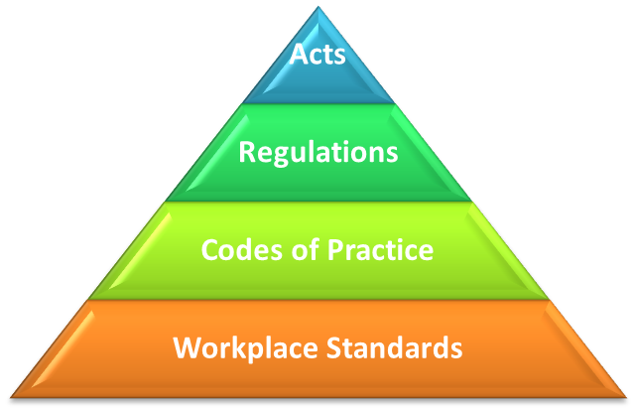
AGREEMENT
The term agreement is defined to section 2(e) of the Indian Cotract Act as “Every promise , forming the consideration for each other” is an agreement.
Agreement = Offer + Acceptance of Offer

Slide 5
ELEMENTS OF A CONTRACT
Offer and acceptance
Intention to create legal relationship.
Lawful consideration
Capacity of parties
Free consent

Slide 6
Lawful object
Agreement not expressely declared void.
Certainity of meaning
Possibility of performance
Legal formalities

Slide 7
CLASSIFICATION OF CONTRACTS

Slide 8
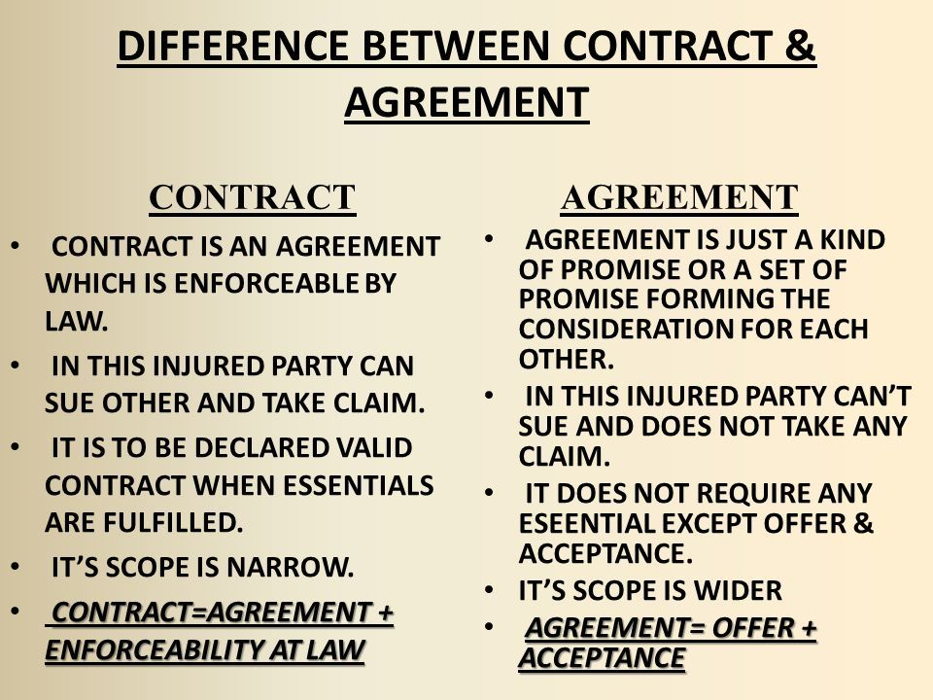

Slide 9
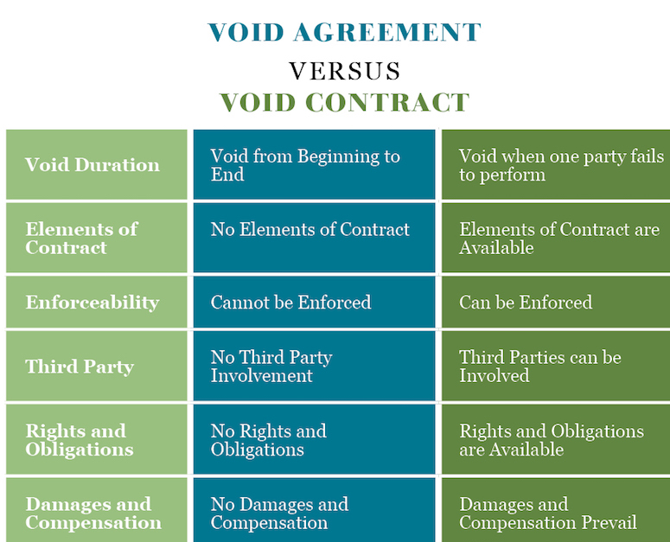
Business Regulatory Framework, Nikhila Tomy, St Mary's College,Thrissur

Slide 10
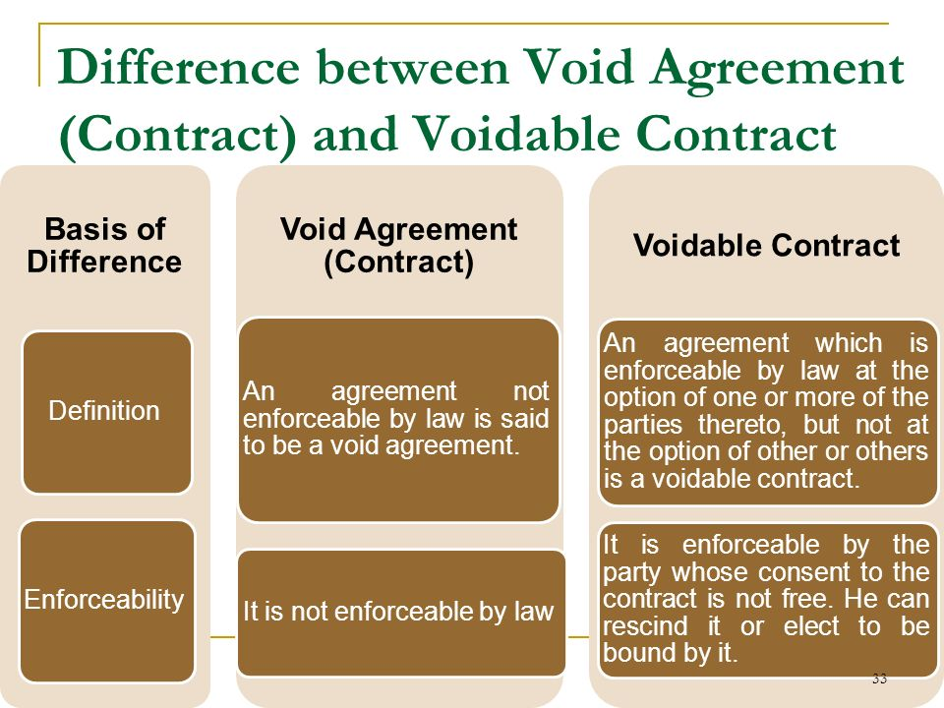
Business Regulatory Framework, Nikhila Tomy, St Mary's College,Thrissur

