Slide 1
INTRODUCTORY CONCEPTS OF JAVA
MANASY JAYASURYA
Assistant Professor
Dept. of Computer Science & Applications
St. Mary’s College Thrissur

Slide 2
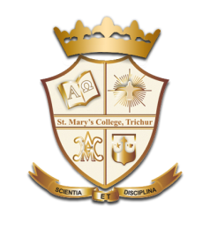
HISTORY OF JAVA
Java was originally designed for interactive television, but it was too advanced technology for the digital cable television industry at the time.
Initiated this project to develop a language for digital devices such as set-top boxes, televisions, etc.
It was suited for internet programming. Later, Java technology was incorporated by Netscape.
Currently, Java is used in internet programming, mobile devices, games, e-business solutions, etc.
Introductory Concepts Of Java, Manasy Jayasurya, St.Mary’s College

Slide 3
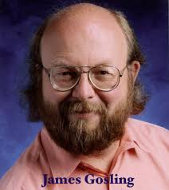
Continue…
James Gosling, Mike Sheridan, and Patrick Naughton initiated the Java language project in June 1991.
The history of java starts with Green Team.
The small team of sun engineers called Green Team.
Originally designed for small, embedded systems in electronic appliances like set-top boxes.
https://www.javatpoint.com/history-of-java
Introductory Concepts Of Java, Manasy Jayasurya, St.Mary’s College

Slide 4
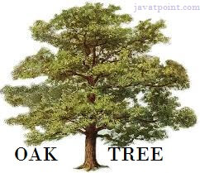
Continue…
Firstly, it was called "Greentalk" by James Gosling, and file extension was .gt
After that, it was called “Oak” and was developed as a part of the Green project.
Why Oak?
Oak is a symbol of strength and chosen as a national tree of many countries like U.S.A., France, Germany, Romania, etc.
In 1995, Oak was renamed as "Java" because it was already a trademark by Oak Technologies.
https://www.javatpoint.com/history-of-java
Introductory Concepts Of Java, Manasy Jayasurya, St.Mary’s College

Slide 5
Continue…
Why Java?
The suggested words were "dynamic", "revolutionary", "Silk", "jolt", "DNA", etc. James Gosling suggested the name Java, "Java was one of the top choices along with Silk".
Java is an island of Indonesia where first coffee was produced (called java coffee).
Java is just a name, not an acronym.
Initially developed by James Gosling at Sun Microsystems (which is now a subsidiary of Oracle Corporation) and released in 1995.
In 1995, Time magazine called Java one of the Ten Best Products of 1995.
Introductory Concepts Of Java, Manasy Jayasurya, St.Mary’s College

Slide 6
Java Version History
JDK Alpha and Beta (1995)
JDK 1.0 (23rd Jan 1996)
JDK 1.1 (19th Feb 1997)
J2SE 1.2 (8th Dec 1998)
J2SE 1.3 (8th May 2000)
J2SE 1.4 (6th Feb 2002)
J2SE 5.0 (30th Sep 2004)
Java SE 6 (11th Dec 2006)
Java SE 7 (28th July 2011)
Java SE 8 (18th March 2014)
Java SE 9 (21st Sep 2017)
Java SE 10 (20th March 2018)
Introductory Concepts Of Java, Manasy Jayasurya, St.Mary’s College

Slide 7
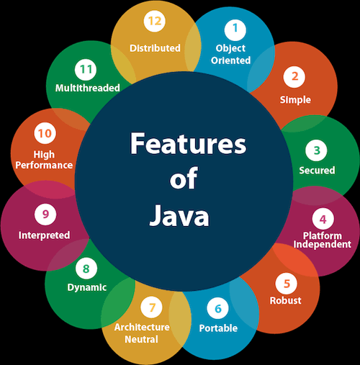
Features of Java
Simple
Object Oriented
Platform Independent
Secured
Robust
Architectural Neutral
Portable
High Performance
Distributed
Multi Threaded
Dynamic
Interpreted
https://www.javatpoint.com/history-of-java
Introductory Concepts Of Java, Manasy Jayasurya, St.Mary’s College

Slide 8
Simple
Java syntax is based on C++ (so easier for programmers to learn it after C++).
Java has removed many complicated and rarely-used features, for example, explicit pointers, operator overloading, etc.
There is no need to remove unreferenced objects because there is an Automatic Garbage Collection in Java.
Introductory Concepts Of Java, Manasy Jayasurya, St.Mary’s College

Slide 9
Object Oriented
Object-oriented means we organize our software as a combination of different types of objects that incorporates both data and behavior.
Object-oriented programming (OOPs) is a methodology that simplifies software development and maintenance by providing some rules.
Basic concepts of OOPs are:
Object
Class
Inheritance
Polymorphism
Abstraction
Encapsulation
Introductory Concepts Of Java, Manasy Jayasurya, St.Mary’s College

Slide 10
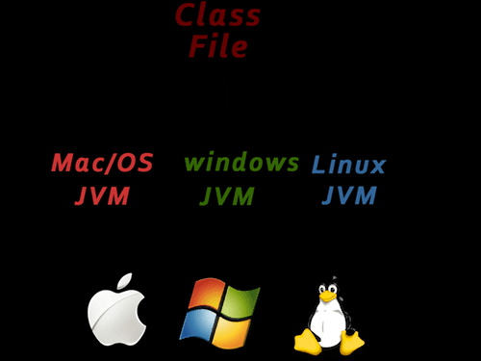
Platform Independent
There are two types of platforms software-based and hardware-based.
Java provides a software-based platform that runs on the top of other hardware-based platforms.
It has two components:
Runtime Environment
API(Application Programming Interface)
https://www.javatpoint.com/history-of-java
Introductory Concepts Of Java, Manasy Jayasurya, St.Mary’s College

Slide 11
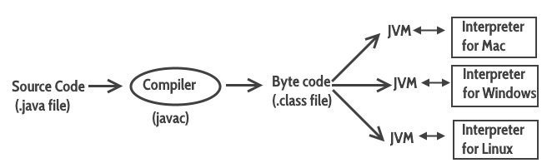
Continue…
Java code can be run on multiple platforms, for example, Windows, Linux, Sun Solaris, Mac/OS, etc.
Java code is compiled by the compiler and converted into bytecode.
This bytecode is a platform-independent code because it can be run on multiple platforms, i.e., Write Once and Run Anywhere(WORA).
https://www.javatpoint.com/history-of-java
Introductory Concepts Of Java, Manasy Jayasurya, St.Mary’s College

Slide 12
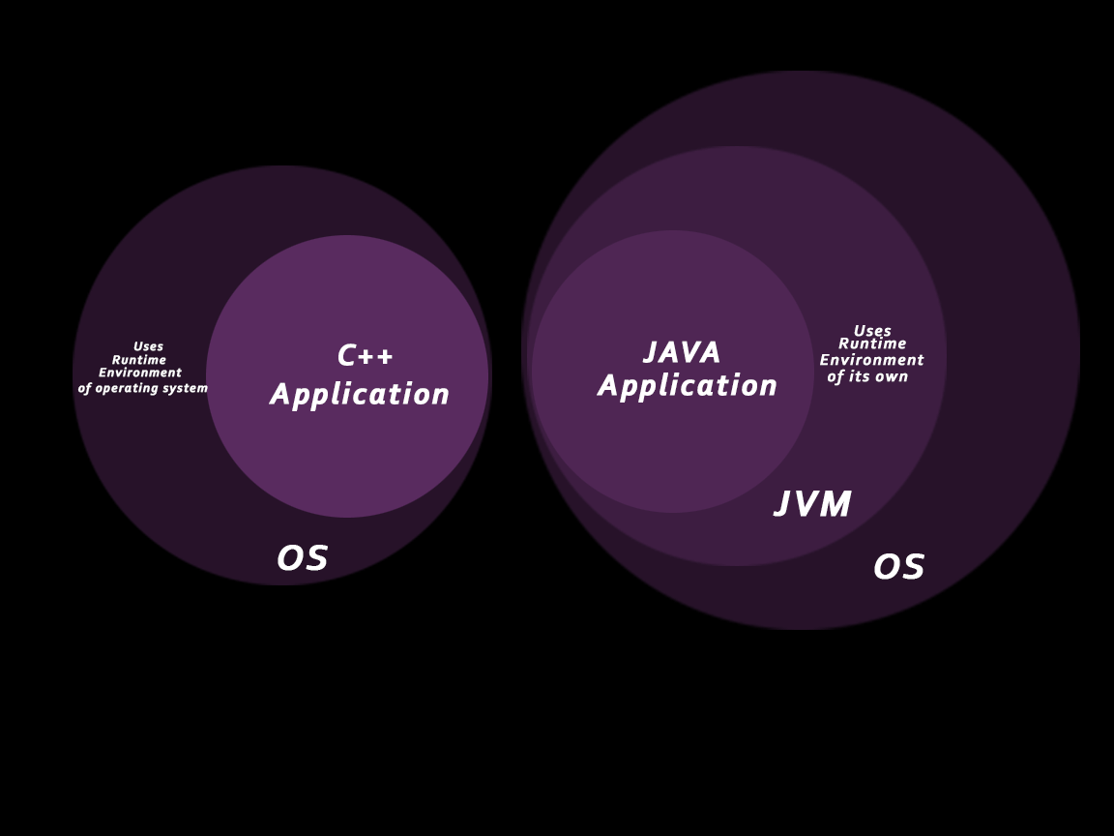
Secured
No explicit pointer
Java Programs run inside a virtual machine sandbox
Bytecode Verifier: It checks the code fragments for illegal code that can violate access right to objects.
Security Manager: It determines what resources a class can access such as reading and writing to the local disk.
https://www.javatpoint.com/history-of-java
Introductory Concepts Of Java, Manasy Jayasurya, St.Mary’s College

Slide 13
Robust
Robust simply means strong.
It uses strong memory management.
There is a lack of pointers that avoids security problems.
There is automatic garbage collection in java which runs on the Java Virtual Machine to get rid of objects which are not being used by a Java application anymore.
There are exception handling and the type checking mechanism in Java. All these points make Java robust.
Introductory Concepts Of Java, Manasy Jayasurya, St.Mary’s College

Slide 14
Architecture-neutral
Java is architecture neutral because there are no implementation dependent features, for example, the size of primitive types is fixed.
For Example : In C programming, int data type occupies 2 bytes of memory for 32-bit architecture and 4 bytes of memory for 64-bit architecture. However, it occupies 4 bytes of memory for both 32 and 64-bit architectures in Java.
Introductory Concepts Of Java, Manasy Jayasurya, St.Mary’s College

Slide 15
High Performance
Java is faster than other traditional interpreted programming languages because Java bytecode is "close" to native code.
It is still a little bit slower than a compiled language (e.g., C++). Java is an interpreted language that is why it is slower than compiled languages, e.g., C, C++, etc.
Introductory Concepts Of Java, Manasy Jayasurya, St.Mary’s College

Slide 16
Multi-Threaded
A thread is like a separate program, executing concurrently.
We can write Java programs that deal with many tasks at once by defining multiple threads.
The main advantage of multi-threading is that it doesn't occupy memory for each thread.
It shares a common memory area.
Threads are important for multi-media, Web applications, etc.
Introductory Concepts Of Java, Manasy Jayasurya, St.Mary’s College

Slide 17
Continue…
Distributed:
Java is distributed because it facilitates users to create distributed applications in Java. RMI and EJB are used for creating distributed applications. This feature of Java makes us able to access files by calling the methods from any machine on the internet.
Dynamic:
Java is a dynamic language. It supports dynamic loading of classes. It means classes are loaded on demand. It also supports functions from its native languages, i.e., C and C++.
Portable :
Java is portable because it facilitates you to carry the Java bytecode to any platform. It doesn't require any implementation.
Introductory Concepts Of Java, Manasy Jayasurya, St.Mary’s College

Slide 18
REFERENCE
https://www.javatpoint.com/history-of-java
Herbert Scheldt, Java Complete Reference, 8th Edition, Tata Mcgraw Hill Education Private Limited, ISBN : 1259002462
E Balaguruswamy, Programming in Java,: A Primer, 4th Edition, Tata Mcgraw Hill Education Private Limited, ISBN : 007014169X
Introductory Concepts Of Java, Manasy Jayasurya, St.Mary’s College

Slide 19
THANK YOU
Introductory Concepts Of Java, Manasy Jayasurya, St.Mary’s College

