Slide 1

Data Structures :Abstract DataType (ADT)
Praseetha E
Assistant Professor
Department of Computer Science&Applications
St. Mary’s College
Thrissur-680020
Kerala

Slide 2

Abstract Data Type (ADT)
To process data with a computer, we need to define the data type and the operation to be performed on the data.
The definition of the data type and the definition of the operation to be applied to the data is part of the idea behind an abstract data type (ADT)
ADT means to hide how the operation is performed on the data.
In other words, the user of an ADT needs only to know that a set of operations are available for the data type, but does not need to know how they are applied.
Data Structures,Praseetha E,St.Mary’s College

Slide 3
Simple ADTs
Many programming languages already define some simple ADTs as integral parts of the language.
For example, the C language defines a simple ADT as an integer. The type of this ADT is an integer with predefined ranges.
C also defines several operations that can be applied to this data type (addition, subtraction, multiplication, division and so on).
C explicitly defines these operations on integers and what we expect as the results. A programmer who writes a C program to add two integers should know about the integer ADT and the operations that can be applied to it.
Data Structures,Praseetha E,St.Mary’s College

Slide 4
Complex ADTs
Although several simple ADTs, such as integer, real, character, pointer and so on, have been implemented and are available for use in most languages, many useful complex ADTs are not.
As we will see in this session, we need a list ADT, a stack ADT, a queue ADT and so on. To be efficient, these ADTs should be created and stored in the library of the computer to be used.
Data Structures,Praseetha E,St.Mary’s College

Slide 5
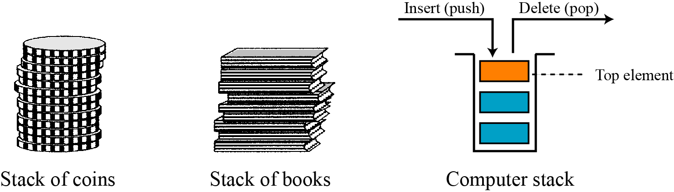
Stack
A stack is a restricted data structure in which all additions and deletions are made at one end, the top.
If we insert a series of data items into a stack and then remove them, the order of the data is reversed. This reversing attribute is why stacks are known as last in, first out (LIFO) data structures.
Fig: Three representations of stacks
Data Structures,Praseetha E,St.Mary’s College

Slide 6
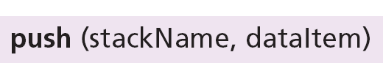
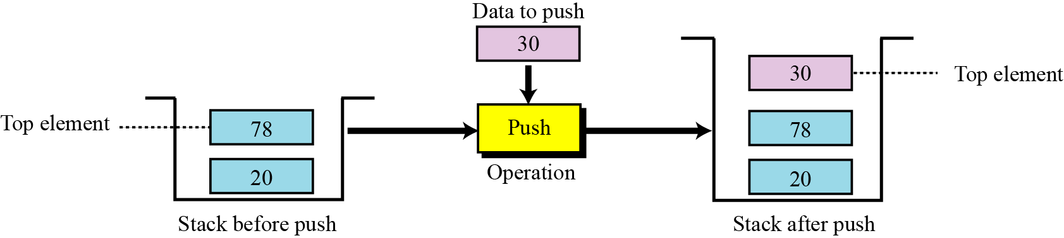
Operations on stack
There are two basic operations can be applied to a stack:
Push operation
Pop operation
The push operation
The following shows the format.
Fig :Push operation
Data Structures,Praseetha E,St.Mary’s College

Slide 7
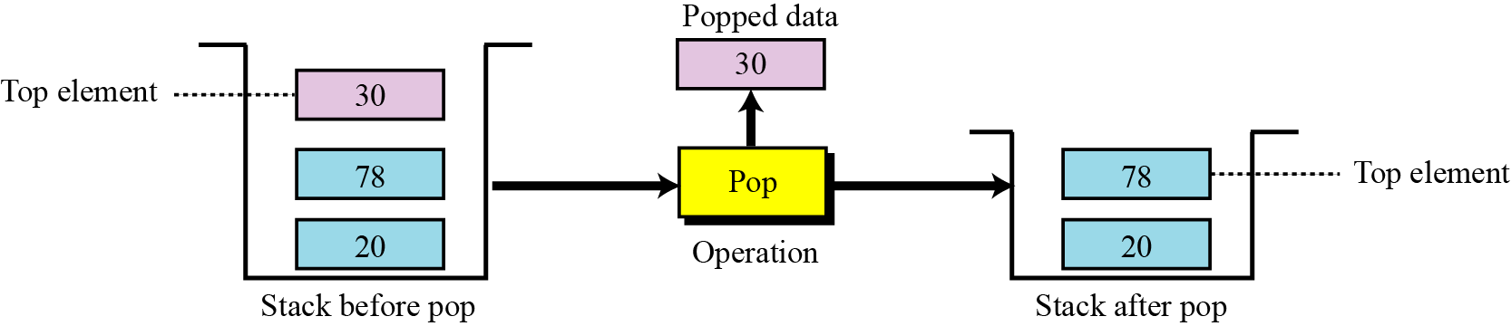
The pop operation
The pop operation deletes the item at the top of the stack.
The following shows the format.
Fig :Pop operation
Data Structures,Praseetha E,St.Mary’s College

Slide 8
Stack: Applications
Parsing
Recursive Function
Expression Evaluation
Expression Conversion
    Infix to Postfix
    Infix to Prefix
    Postfix to Infix
    Prefix to Infix
Towers of hanoi
Data Structures,Praseetha E,St.Mary’s College

Slide 9
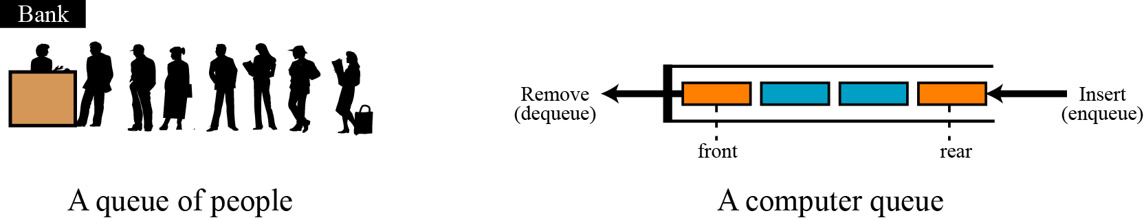
Queue
A queue is a linear list in which data can only be inserted at one end, called the rear, and deleted from the other end, called the front.
These restrictions ensure that the data is processed through the queue in the order in which it is received. In other words, a queue is a first in, first out (FIFO) structure.
Fig: Two representation of queues
Data Structures,Praseetha E,St.Mary’s College

Slide 10

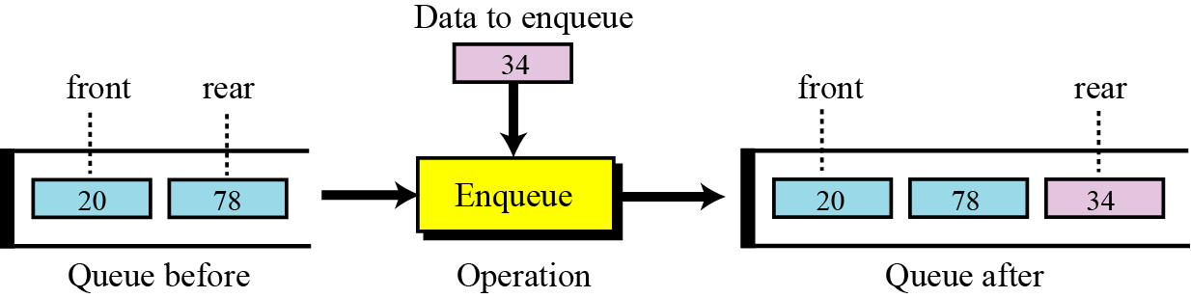
Operations on queue
There are two basic operations that can be applied to a queue:
Enqueue operation
Dequeue operation
The enqueue operation
The following shows the enqueue operation:
Fig: The enqueue operation
Data Structures,Praseetha E,St.Mary’s College

Slide 11
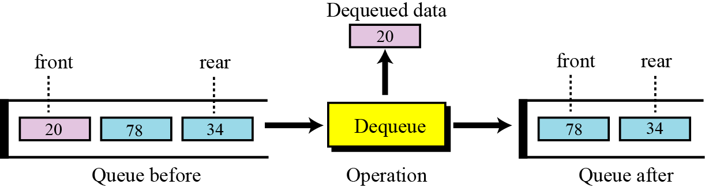
The dequeue operation
The dequeue operation deletes the item at the front of the queue.
The following shows the enqueue operation:
Fig: The dequeue operation
Data Structures,Praseetha E,St.Mary’s College

Slide 12
Queue :Applications
Queue is used when things don’t have to be processed immediately, but have to be processed in First In First Out order.
When a resource is shared among multiple consumers. Examples include CPU scheduling, Disk Scheduling.
When data is transferred asynchronously (data not necessarily received at same rate as sent) between two processes. Examples include IO Buffers, pipes, file IO, etc.
Data Structures,Praseetha E,St.Mary’s College

Slide 13
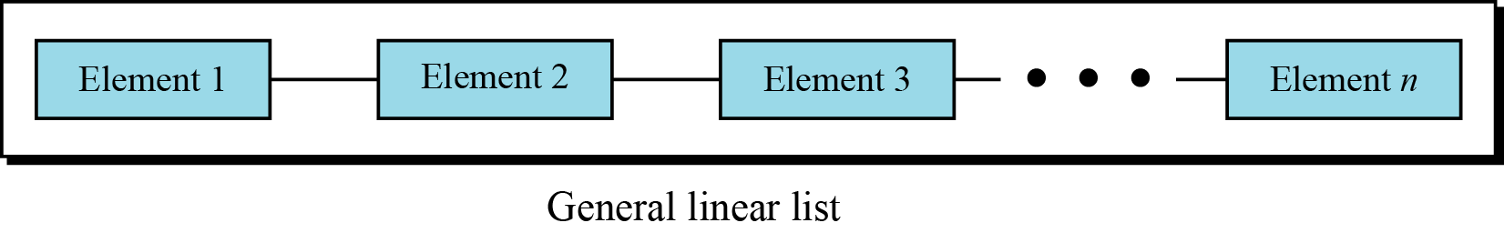
Linked list
Linked list is a list in which operations, such as insertion and deletion, can be done anywhere in the list-at the beginning, in the middle or at the end. Fig. shows a general linked list.
Fig: Linked list
Data Structures,Praseetha E,St.Mary’s College

Slide 14
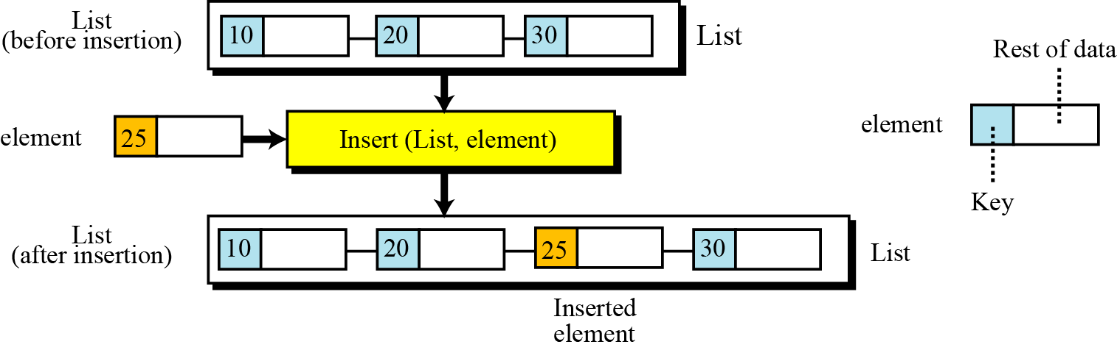
Operations on Linked list
There are two basic operations that can be applied to a linked list:
Insert operation
Delete operation
The insert operation
Since in a general linked list, insertion can be done in any position. To determine where the element is to be placed, searching is needed.
Fig:The insert operation
Data Structures,Praseetha E,St.Mary’s College

Slide 15
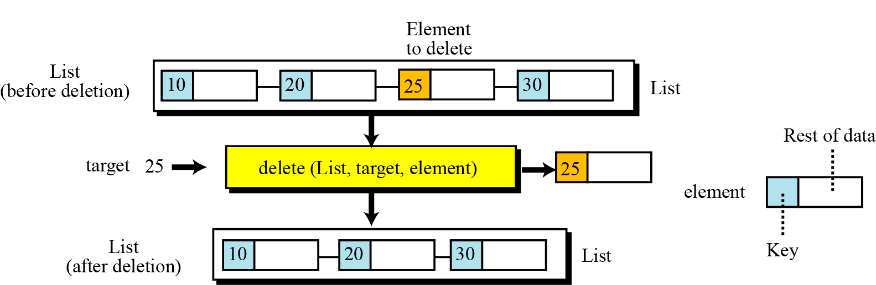
The delete operation
Deletion from a linked list also requires that the list be searched to locate the data to be deleted. After the location of the data is found, deletion can be done.
The following shows the Eg:
Fig: The dequeue operation
Data Structures,Praseetha E,St.Mary’s College

Slide 16
Linked list :Applications
  Implementation of stacks and queues
  Implementation of graphs : Adjacency list representation of graphs is most popular which is uses linked list to store adjacent vertices.
  Dynamic memory allocation : We use linked list of free blocks.
  Performing arithmetic operations on long integers
  Manipulation of polynomials by storing constants in the node of linked list
  Representing sparse matrices
Data Structures,Praseetha E,St.Mary’s College

Slide 17
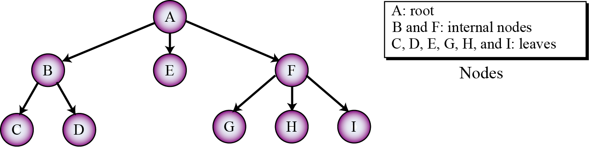
Tree
A tree consists of a finite set of elements, called nodes (or vertices) and a finite set of directed lines, called arcs, that connect pairs of the nodes.
Fig: Tree representation
Data Structures,Praseetha E,St.Mary’s College

Slide 18
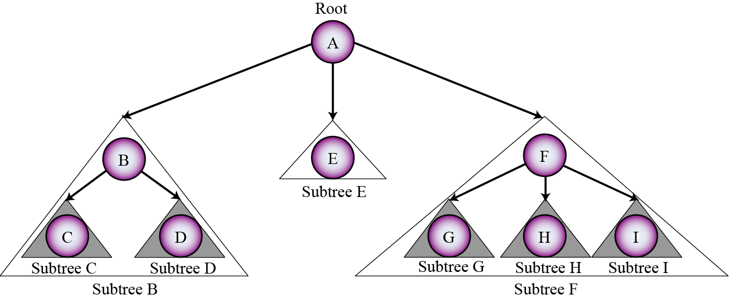
Each node in a tree may have a subtree. The subtree of each node includes one of its children and all descendents of that child.
Figure shows all subtrees for the above tree
Fig: Subtrees
Data Structures,Praseetha E,St.Mary’s College

Slide 19
Operations on tree:
There are three basic operations that can be applied on a tree:
Insert operation
Delete operation
Traversal operation
Data Structures,Praseetha E,St.Mary’s College

Slide 20
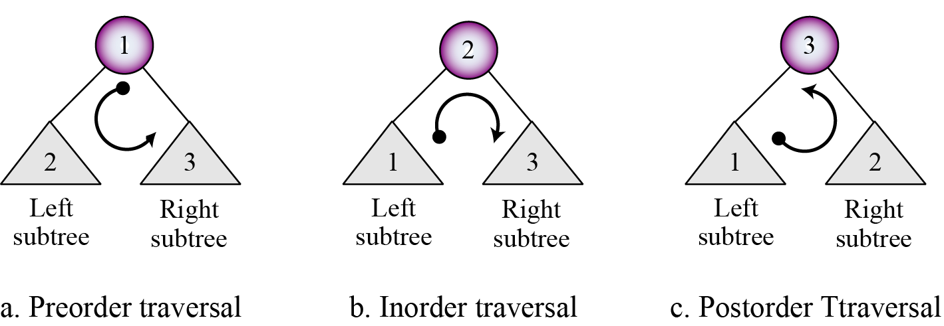
Tree traversals
A tree traversal requires that each node of the tree be processed once and only once in a predetermined sequence.
There are 3 approaches used in traversing a tree :
Fig: Tree representation
Data Structures,Praseetha E,St.Mary’s College

Slide 21
Tree :Applications
Heap is a tree data structure which is implemented using arrays and used to implement priority queues.
B-Tree and B+ Tree : They are used to implement indexing in databases.
Syntax Tree: Used in Compilers.
Expression evaluation
Data Structures,Praseetha E,St.Mary’s College

Slide 22
Expression tree
An arithmetic expression can be represented in three different formats: infix, postfix and prefix.
In an infix notation, the operator comes between the two operands.
In postfix notation, the operator comes after its two operands.
In prefix notation it comes before the two operands. These formats are shown below for addition of two operands A and B.
Data Structures,Praseetha E,St.Mary’s College

Slide 23
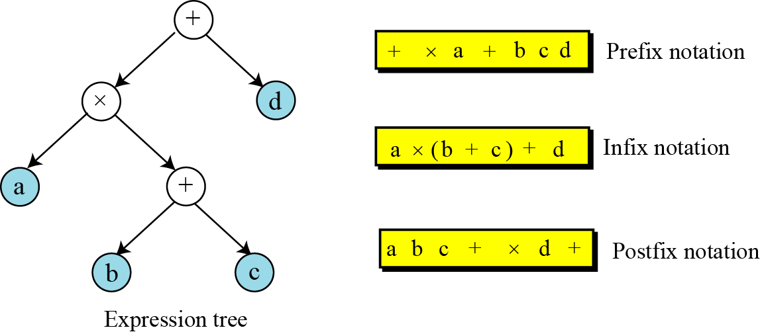
Fig: Expression tree
Data Structures,Praseetha E,St.Mary’s College

Slide 24
Reference :
“Data Structures and Program Design in C” by Kruse Robert L
“Data Structure Using C” by A K Sharma
“Data structures” by Seymour Lipschutz
Data Structures,Praseetha E,St.Mary’s College

