Slide 1
BRESENHAM’S
LINE DRAWING ALGORITHM
RASMI M
Assistant Professor
Department of Computer Science and Applications
St. Mary’s College Thrissur

Slide 2
INTRODUCTION
Developed by Jack Bresenham.
Raster line-generating algorithm.
Scan conversion takes place using only incremental integer calculations.
Bresenham’s Line Drawing Algorithm, Rasmi M, St.Mary’s College

Slide 3
Accurate and efficient than DDA line drawing algorithm.
Guarantees connected (gap-less) lines where each point is drawn exactly 1 time.
Also known as the midpoint line algorithm.
Bresenham’s Line Drawing Algorithm, Rasmi M, St.Mary’s College

Slide 4
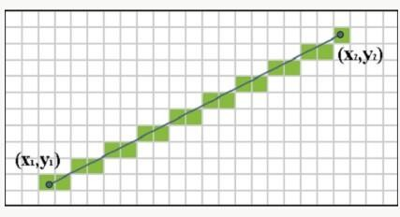
The computer has to select pixels to draw a line.
It has to select two points and then draw a line between them.
It also needs some parameters for computations.
Group of pixels look like a matrix having x and y axis.
Bresenham’s Line Drawing Algorithm, Rasmi M, St.Mary’s College

Slide 5
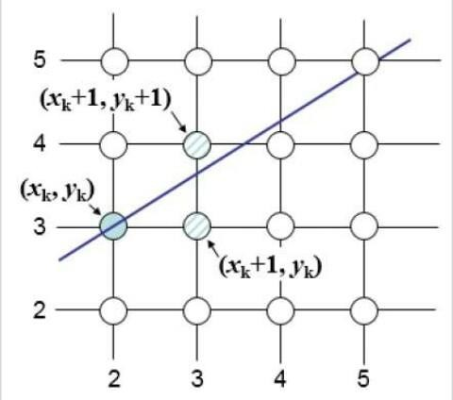
P
We need a decision parameter to decide which pixel to choose.
Bresenham’s Line Drawing Algorithm, Rasmi M, St.Mary’s College

Slide 6
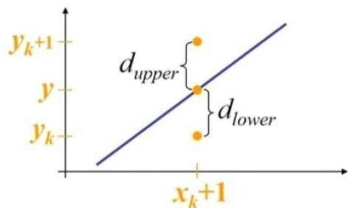
DERIVATION
Starting from the left endpoint (x₀,y₀) of a given line, we step to each successive column and plot the pixel whose scan-line y value is close to the line path.
At the sample position x_{k+1} the vertical separations from the line are labelled d_{upper} and d_{lower}.
Bresenham’s Line Drawing Algorithm, Rasmi M, St.Mary’s College

Slide 7
The y coordinate on the line at x_{k}+1 is calculated as
y=(mx+c)
We know that the slope m=Δy/Δx
Then,
d_{lower}^{= y-yk}
d_{upper}=(y_{k}+1)-y
Replacing the value of y ;
d_{lower}=m(x_{k}+1)+c-y_{k}
d_{upper}=(y_{k}+1)-m(x_{k}+1)-c
Bresenham’s Line Drawing Algorithm, Rasmi M, St.Mary’s College

Slide 8
Now we substract
d_{lower}-d_{upper}=2m(x_{k}+1)-2y_{k}+2c-1 .
Replacing m;
Δx(d_{lower}-d_{upper})=Δx(2Δy/Δx(x_{k}+1)-2y_{k}+2c-1)
=2Δy.x_{k}-2Δx.y_{k}+b
(b=-2y_{k}+2c-1)
P_{k} is the decision parameter. So,
P_{k} ^{=Δx (}d_{lower}⁻d_{upper}⁾
Bresenham’s Line Drawing Algorithm, Rasmi M, St.Mary’s College

Slide 9
The sign of p_{k} depends on d_{lower}-d_{upper}.
If p_{k}<0(-ve),then we choose the lower pixel.
If p_{k}>0(+ve),then we choose the upper pixel.
P_{k} determines which pixel is to be choosen.
Now, for p_{k}+1
p_{k}+1=2Δy.x_{k}+1-2Δx.y_{k}+1+b
So,
p_{k+1}-p_{k}=2Δy(x_{k+1}-x_{k})-2Δx(y_{k}+1-y_{k})
p_{k+1}=p_{k}=2Δy-2Δx(y_{k}+1-y_{k})
The term y_{k+1}-y_{k},is either 0 or 1 depending upon the sign of the parameter p_{k}.
Bresenham’s Line Drawing Algorithm, Rasmi M, St.Mary’s College

Slide 10
The first decision parameter p₀ is calculated as
p₀=2Δy-Δx
BRESENHAM’S LINE DRAWING ALGORITHM
Input the two line endpoints and store the left end point in (x₀,y₀).
Load (x₀,y₀) into the frame buffer that is plot the first point.
Calculate the constants x,y,2Δy-2Δx and obtain the starting value for the decision parameter as
p₀=2Δy-Δx
Bresenham’s Line Drawing Algorithm, Rasmi M, St.Mary’s College

Slide 11
At each x_{k} ,along the line, starting at k=0, perform the following test:
If pk<0, the next point to plot is (x_{k}+1,y_{k}) and
p_{k}+1=p_{k}+2Δy
Otherwise, the next point to plot is (x_{k}+1,y_{k}+1) and
p_{k+1}=p_{k}+2Δy-2Δx
Repeat step 4 Δx times.
Bresenham’s Line Drawing Algorithm, Rasmi M, St.Mary’s College

Slide 12
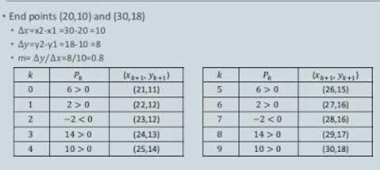
EXAMPLE
Bresenham’s Line Drawing Algorithm, Rasmi M, St.Mary’s College

Slide 13
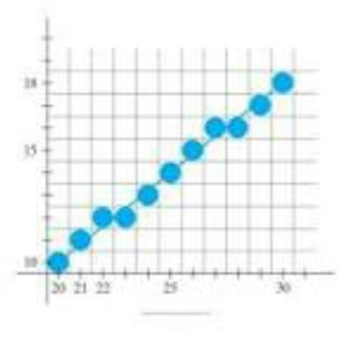
Bresenham’s Line Drawing Algorithm, Rasmi M, St.Mary’s College

Slide 14
REFERENCE
Donald Hearn and M Pauline Baker, Computer Graphics, PHI, New Delhi.
2. Zhigang Xiang and Roy Plasock, Computer Graphics, Schaum’s Outlines.
3. Deborah Morley, Understanding Computer Today And Tomorrow, Introductory Edition.
Bresenham’s Line Drawing Algorithm, Rasmi M, St.Mary’s College

