Slide 1
BISECTION METHOD
SUNITHA A C
Assistant Professor
Department of Computer Science and Applications
St. Mary’s College Thrissur

Slide 2
INTRODUCTION
One of the simplest and most reliable iterative method for the solution of non linear equations.
Also known as binary chopping or half-interval method.
Based on the repeated application of the intermediate value theorem.
Bisection Method, Sunitha A C, St.Mary’s College

Slide 3
The Bisection Method is given an initial interval [a,b] that contains a root (We can choose a and b such that f(a) and f(b) are of opposite sign)
The Bisection Method will cut the interval into 2 halves and check which half interval contains a root of the function
The Bisection Method will keep cut the interval in halves until the resulting interval is extremely small.
The root is then approximately equal to any value
in the final interval.
Bisection Method, Sunitha A C, St.Mary’s College

Slide 4
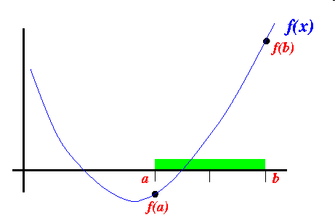
Graphical Representation
Suppose the interval [a,b] is as follows:
Bisection Method, Sunitha A C, St.Mary’s College

Slide 5
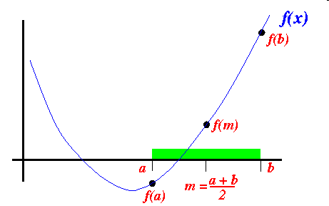
We cut the interval [a,b] in the middle: m = (a+b)/2
Bisection Method, Sunitha A C, St.Mary’s College

Slide 6
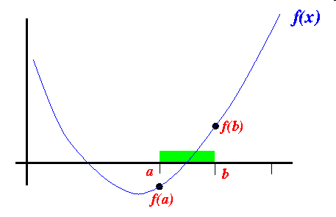
Because sign of f(m) ≠ sign of f(a) , we proceed with the search in the new interval [a,b]:
Bisection Method, Sunitha A C, St.Mary’s College

Slide 7
Let $x_{1}$=$a$ and $x_{2}$=$b.$
Let us also define another point $x_{0 }$to be the midpoint between $a$ and $b.$
That is $x_{0}=\frac{x_{1}+x_{2}}{2}$
Now,there exists the following three conditions:
If $f\left(x_{0}\right)=0,$we have a root at $x_{0}$.
If $f\left(x_{0}\right)f\left(x_{1}\right)$<0,there is a root between $x_{0}$ and $x_{1}$.
If $f\left(x_{0}\right)f\left(x_{2}\right)$<0,there is a root between $x_{0}$ and $x_{2}$.
Bisection Method, Sunitha A C, St.Mary’s College

Slide 8
Example execution:
We will use a simple function to illustrate the execution of the Bisection Method
Function used:
f(x) = x³ – 5x+1
Bisection Method, Sunitha A C, St.Mary’s College

Slide 9
We will use the starting interval [0,1] since:
The interval [0,1] contains a root because: sign of f(0) ≠ sign of f(1)
f(0) = 0³−5×0+1 = 1
f(1) = 1³−5×1+1 = -3
Bisection Method, Sunitha A C, St.Mary’s College

Slide 10
Iteration 1
Let $x_{1}=0 and x_{2}=1$
then $x_{0}$= $\frac{{ x}_{1}\text{+}x_{2}}{2}$
= $\frac{0+1}{2}$
= 0.5
$f\left(0.5\right)=−1.375 and f(x_{1}$)$f(x_{0}$)˂0
Thus, the root lies in the interval (0,0.5)
Bisection Method, Sunitha A C, St.Mary’s College

Slide 11
Iteration 2
Let $x_{1}=0 and x_{2}=0.5$
then $x_{0}$= $\frac{{ x}_{1}\text{+}x_{2}}{2}$
= $\frac{0+0.5}{2}$
$=0.25$
$f\left(0.25\right)=−0.234375 and f(x_{1})$)$f\left(x_{0}\right)$˂0
Thus, the root lies in the interval (0,0.25)
Bisection Method, Sunitha A C, St.Mary’s College

Slide 12
Sequence of intervals is as follows:
Iteration | $$x_{1}$$ | $$x_{2}$$ | $$x_{0}$$ | $$f(x_{0})$$
1 | 0 | 1 | 0.5 | ˂
2 | 0 | 0.5 | 0.25 | ˂
3 | 0 | 0.25 | 0.125 | ˃
4 | 0.125 | 0.25 | 0.1875 | ˃
5 | 0.1875 | 0.25 | 0.21875 | ˂
Hence,the root lies in (0.1875,0.21875).The approximate root is taken as the midpoint of this interval,that is 0.203125.
Bisection Method, Sunitha A C, St.Mary’s College

Slide 13
ADVANTAGES
Simple and easy to implement
One function evaluation per iteration
The size of the interval containing the zero is reduced after each iteration
No knowledge of the derivative is needed
DISADVANTAGES
Slow to converge
Good intermediate approximations may be discarded
Bisection Method, Sunitha A C, St.Mary’s College

Slide 14
REFERENCE
Numerical Methods for Scientific and Engineering Computation,M.K.Jain,S.R.K.Iyengar,R.K.Jain,New Age International Publishers
2. Numerical Methods,E.Balagurusamy,Tata McGraw-Hill
Bisection Method, Sunitha A C, St.Mary’s College

