Slide 1
Drama: Major Theatre Types
Ceena Jose. K
Assistant Professor
Department of English
St. Mary’s College Thrissur

Slide 2
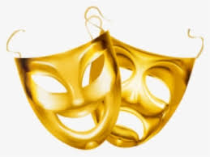
What is Drama?
The word ‘Drama’ is derived from the Greek word dran meaning ‘to act’’ or ‘to do’
Generally defined as a literary composition meant to be enacted on the stage by actors, before an audience
https://www.google.co.in/search?q=drama+mask+png+pics
Drama:majorTheatreTypes,Ceena Jose.K,St.Mary’s College

Slide 3
Types of Theatre
The Absurd
The Epic
Street Theatre
Theatre of Cruelty
The Poor Theatre
Feminist Theatre
Ritualistic Theatre
Angry Theatre
Drama:majorTheatreTypes.Ceena Jose.K,St.Mary’s College

Slide 4
The Absurd Theatre
Theatre of the post- World War II era
The term ‘absurd’ is derived from the Latin absurdum
Emerged out of the perspective of Cultural paranoia, abnormality and distortion
Portrays a world that has become unfixed, where reality is an illusion, where men find themselves odd everywhere
Examples:
The Birthday Party by Pinter,
The Chairs by Ionesco,
Waiting for Godot by Beckett
Drama:majorTheatreTypes,Ceena Jose.K,St.Mary’s College

Slide 5
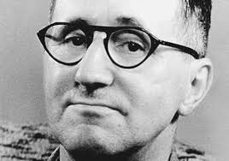
The Epic Theatre
A different theatre, from the existing ones, pioneered by Betrolt Brecht
Transports the audience to a heightened state of social and political awareness
Uses alienation techniques, like masks, music, dance, placards etc…
Significant Plays by Brecht:
Mother Courage and her Children
The Good Women of Setswan
The Three Penny Opera
The Caucasian Circle
https://www.google.co.in/=brecht+png+images
Drama:majorTheatreTypes,Ceena Jose.K,St.Mary’s College

Slide 6
The Street Theatre
Also known as Guerilla Theatre, it is the Dramatization of social and political issues, enacted outside on a street, a park or a market place
The actors make use of their own voice , simple costumes and props
Badal Sircar is the ambassador of street theatre movements in India
Notable Indian Street Theatre plays are:
Om Swaha (1979)
Pagla Ghota (1967)
Mulgi Jhali Ho (1983)
Drama:majorTheatreTypes,Ceena Jose.K,St.Mary’s College

Slide 7
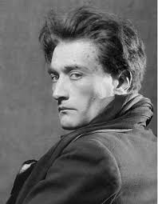
The Theatre of Cruelty
A theatrical idea conceived by Antonin Artaud
Complex combination of surrealism,
symbolism, ritualism and improvization
La Cenci (1935) was the first performance
of this theatre
https://www.google.co.in/search?q=antonin+artaud+png+pics
Drama:majorTheatreTypes,,Ceena Jose.K,St.Mary’s College

Slide 8
The Poor Theatre
Began with the publication of Towards a Poor Theatre(1968) by Jerzy Grotowski
Focuses on the actor’s voice and body skills
Discards extraneous or unecessary elements that undermine the actor’s talent
Emphasized the actor - audience relationship
Drama:majorTheatreTypes,Ceena Jose.K,St.Mary’s College

Slide 9
The Feminist Theatre
Originated as a means of self-expression andself-exploration of women
Challenges the male dominated domain of theatre
Women’s Theatre Group Monstrous Regiment, Theatre of Black Women, Burnt Bridges, The Spider Woman theatre etc… are the major uprisings under this theatre
Major plays:
The Conduct of Life
The Heidi Chronicles
The Secret Garden
Viet Rock
Drama:majorTheatreTypes,Ceena Jose.K,St.Mary’s College

Slide 10
The Ritualistic Theatre
Ceremonial dramas, using the stylized enactments constructed by selecting the essence of the situation
Major role for, dance, music, speech,mask, costumes actorsand audience
Revives the rituals of the classical period
A powerful healing tool, creating harmony within the individual, society and nature
The Balcony (1956) by Genet is a significant example
Drama:majorTheatreTypes,Ceena Jose.K,St.Mary’s College

Slide 11
The Angry Theatre
The term attributed to a group of playwrights of working class origin, during the post World War II period
Look Back in Anger (1956) by John Osborne heralded the new theatre
Depicted the oppressiveness, hypocrisy and stultifying values of the society
Also known as Kitchen Sink Drama, Dustbin Drama and Committed Theatre
Arnold Wesker, Harold pinter, Shelagh Delany, Edard Bond were the major propagators
Drama:majorTheatreTypes,Ceena Jose.K,St.Mary’s College

Slide 12
REFERENCE
Sreerekha, N., ed. Reading Drama. Delhi: Oxford University Press, 2015.
Prasad, B., A Background to the Study of English Literature. Delhi: Trinity Press 1999.
Drama:majorTheatreTypes,Ceena Jose.k,St.Mar’ys College

