Slide 1
GLUCONEOGENESIS
Dr. Deepa G Muricken
Assistant Professor
Department of Biochemistry
St. Mary’s College, Thrissur

Slide 2
Glucose Metabolism
Glycogen
Breakdown
Synthesis
Pentose phosphate pathway
Glucose
Glucose 6 phosphate
Ribose 5 phosphate
Glycolysis
Gluconeogenesis
Pyruvate
Fermentation
Amino acids
Lactate, Alcohol
Acetyl Co A
TCA Cycle
Gluconeogenesis, Deepa G Muricken, St. Mary’s College Thrissur

Slide 3
Gluconeogenesis
Glucose production from non carbohydrate sources
Prolonged fast leads to hepatic glycogen depletion
Glucose formed from precursors like lactate, pyruvate, glycerol, keto acids
Gluconeogenesis occurs in all animals, plants, fungi and microorganisms
Site of synthesis:
90% occurs in Liver and 10% in kidney during overnight fast.
Prolonged fasting , kidney become major glucose producing organs.
Occurs in both mitochondria and cytosol
Gluconeogenesis, Deepa G Muricken, St. Mary’s College Thrissur

Slide 4
(Continues)
The overall gluconeogenesis pathway reaction is:
2 pyruvate + phosphate + 4 ATP + 2 NADH + 2H⁺ → glucose-6-phosphate + 4 ADP + 4 Pi + 2NAD⁺
The pathway end product, glucose -6-phosphate, can be converted into other six carbon sugars needed for cell biosynthesis.
Substrates for gluconeogenesis
Glycerol
Released during hydrolysis of triacylglycerols in adipose tissue
Glycerol is phosphorylated to glycerol phosphate by glycerol kinase and oxidized to dihydroxyacetone phosphate by glycerol phosphate dehydrogenase.
Gluconeogenesis, Deepa G Muricken, St. Mary’s College Thrissur

Slide 5
(Continues)
Lactate
Released by exercising skeletal muscle and by the cells lack mitochondria
Lactate is taken up by liver and reconverted to glucose by Cori cycle
Aminoacids
Catabolism of glucogenic aminoacids produce pyruvate, α KG, succinyl Co-A, fumarate or oxalo acetate and are precursors of glucose
Gluconeogenesis, Deepa G Muricken, St. Mary’s College Thrissur

Slide 6
Unique reactions of Gluconeogenesis
Among the ten reactions in glycolysis, seven are reversible. These seven reactions are same in both cycles but occur in reverse direction.
Three irreversible reactions are circumvented by four alternate reactions resulting in synthesis of glucose.
A. Carboxylation of Pyruvate
Pyruvate is carboxylated to oxaloacetate by pyruvate carboxylase. Requires Biotin as coenzyme. Reaction occurs in mitochondria
Pyruvate carboxylase is allosterically activated by acetyl Co A .
Gluconeogenesis, Deepa G Muricken, St. Mary’s College Thrissur

Slide 7
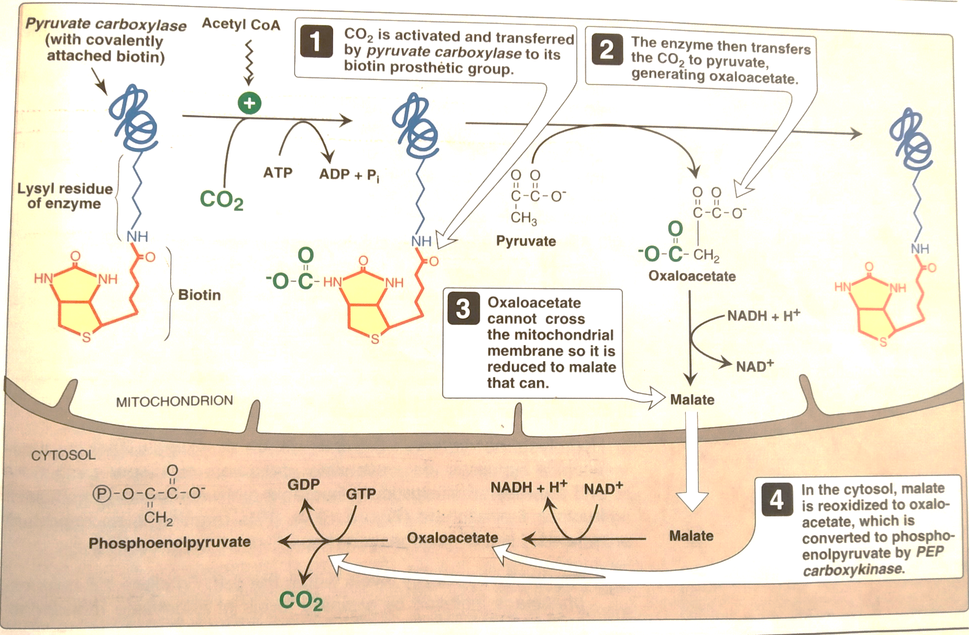
(Continues)
Activation and transfer of CO2 to pyruvate , followed by transport of OAA to cytosol and subsequent decarboxylation. Adapted from Biochemistry Lippincott’s Illustrated Reviews
Gluconeogenesis, Deepa G Muricken, St. Mary’s College Thrissur

Slide 8
(Continues)
B. Transport of OAA to cytosol
Reconversion of OAA to phosphoenol pyruvate by PEP carboxykinase. This enzyme is found in both cytosol and mitochondria.
PEP generated is transported to cytosol by specific transporter.
In mitochondria OAA is reduced to malate by malate dehydrogenase.
Malate is transported to cytosol since OAA is unable to cross mitochondrial inner membrane.
In cytosol malate is reoxidised to OAA by cytosolic malate dehydrogenase
Gluconeogenesis, Deepa G Muricken, St. Mary’s College Thrissur

Slide 9
(Continues)
C. Decarboxylation of cytosolic oxaloacetate
OAA is decarboxylated and phosphorylated to PEP by PEP carboxykinase. Reaction is driven by the hydrolysis of GTP.
PEP is acted on by glycolytic reversal pathway until it forms fructose 1,6 bisphosphate.
D. Dephosphorylation of fructose 1.6.bisphosphate
This hydrolysis is performed by fructose 1,6 bisphosphatase and forms fructose 6 phosphate. The enzyme is inhibited by elevated levels of AMP and high levels of ATP stimulate the reaction.
Enzyme is inhibited by fructose 2,6,bisphosphate.
This reaction bypasses PFK-1 reaction in glycolysis.
Gluconeogenesis, Deepa G Muricken, St. Mary’s College Thrissur

Slide 10
(Continues)
E. Dephosphorylation of Glucose 6 phosphate
Glucose 6 phosphate is hydrolysed to glucose and surpasses hexokinase reaction by Glucose 6 phosphatase.
Liver and Kidney are only two organs which release Glucose from glucose 6 phosphate.
This reaction occurs in glycogenolysis and gluconeogenesis
Summary
Cleavage of six high energy phosphate bonds and oxidation of two NADH results in formation of Glucose from pyruvate
Gluconeogenesis, Deepa G Muricken, St. Mary’s College Thrissur

