Slide 1

RECOMBINANT PROTEIN : AN OVERVIEW
Dr. Deepa G Muricken
Assistant Professor
Department of Biochemistry
St. Mary’s College Thrissur

Slide 2
INTRODUCTION
Recombinant protein is a manipulated form of protein, which is generated in various ways to produce large quantities of proteins
Modify gene sequences and manufacture useful commercial products.
The formation of recombinant protein is carried out in specialized vehicles known as vectors.
Many of notable proteins are generated from recombinant DNA, using biomolecular engineering
In many cases, recombinant human proteins have replaced the original animal-derived version used in medicine.
Recombinant protein, Deepa G Muricken, St. Mary’s College Thrissur

Slide 3
Examples of Human recombinants
Human growth hormone (rHGH)
human insulin (BHI): Humulin from Lilly and Novolin from Novo Nordisk among others largely replaced bovine and porcine insulin for human therapy.
Follicle-stimulating hormone (FSH) as a recombinant gonadotropin preparation replaced Serono's Pergonal which was previously isolated from post-menopausal female urine
Factor VIII:
Erythropoietin
Glucocerebrosidase:
Interferon (IF)
Animal recombinants
Bovine somatotropin (bST)
Porcine somatotropin (pST)
Bovine Chymosin
Viral recombinants
Envelope protein of the hepatitis B virus
HPV Vaccine proteins
Recombinant protein, Deepa G Muricken, St. Mary’s College Thrissur

Slide 4
WHY RECOMBINANTS ????
INSTEAD OF OTHER SOURCES
Eg: Insulin can be isolated from different sources like bovine, porcine, hog, sheep etc. They have similar structure but slight different in sequences.
Can cause allergy in some people.
Have to do animal slaughter to isolate insulin.
Very less amount of insulin production
Requires more time.
All these problems are solved by recombinant insulin production
Recombinant protein, Deepa G Muricken, St. Mary’s College Thrissur

Slide 5
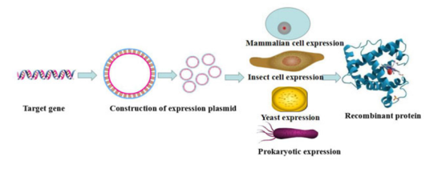
PRODUCTION OF RECOMBINANT PROTEIN
Recombinant protein, Deepa G Muricken, St. Mary’s College Thrissur

Slide 6
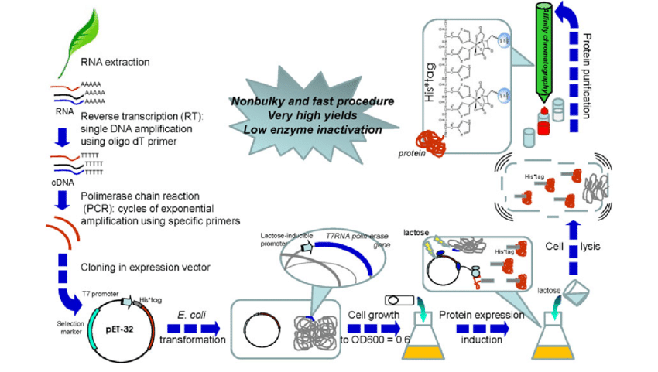
Recombinant protein, Deepa G Muricken, St. Mary’s College Thrissur

Slide 7
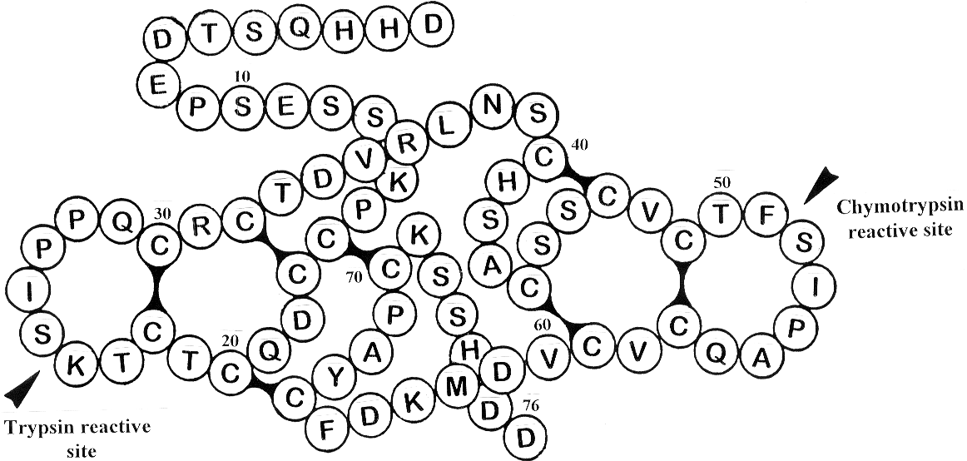
PRODUCTION OF RECOMBINANT BOWMAN BIRK INHIBITOR IN E.coli
The BBIs of horse gram (Dolichos biflorus)
1
D
T
S
Q
H
H
D
E
E
P
S
S
R
v
R
V
S
H
D
M
D
M
D
D
Recombinant protein, Deepa G Muricken, St. Mary’s College Thrissur

Slide 8
The Bowman-Birk Inhibitors are considered as universal cancer chemopreventive agents
It is still unknown whether the anti-tumoral and radio-protective activities of BBIs are correlated to the inhibitory activity of trypsin/chymotrypsin or other enzymes or to the capability of interacting with other macromolecules.
Bowman-Birk Inhibitor Concentrate (BBIC) achieved Investigational New Drug status from FDA in 1992
Recombinant protein, Deepa G Muricken, St. Mary’s College Thrissur

Slide 9
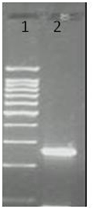
Cloning of HGI-III gene in pRSETC
BamHI
NdeI
NdeI
NdeI
HindIII
HindIII
PT7
HGI-III
PT7
HGI-III
MCS
MCS
NdeI Digestion
Ligation
pRSET-rHGI
pRSET-rHGI
3157 bps
3025bps
F1 origin
F1 origin
Ampicillin
Ampicillin
ATG GAT CAT CAT CAG TCA ACT GAT GAG CCC TCT GAG TCT TCA AAA CCA TGC TGT GAT CAG TGC GCA TGC ACA AAG TCA ATC CCT CCT CAA TGC CGC TGT ACG GAC GTT AGG CTG AAT TCG TGC CAT TCA GCT TGC AGT TCT TGT GTT TGC ACA TTT TCG ATT CCT GCA CAG TGT GTT TGT GTT GAC ATG AAG GAC TTC TGC TAC GCA CCT TGC AAA TCT TCA CAT GAT GAT
PROTEIN SEQUENCE
M D H H Q S T D E P S E S S K P C C D Q C A C T K S I P P Q C R C T D V R L N S C H S A C S S C V C T F S I P A Q C V C V D M K D F C Y A P C K S S H D D
Recombinant protein, Deepa G Muricken, St. Mary’s College Thrissur

Slide 10
Functional expression and purification of recombinant HGI (rHGI)
rHGI was expressed in BL21 (DE3)pLys S cells , induced with IPTG
Cell free extracts of pRSET-rHGI.
Recombinant protein, Deepa G Muricken, St. Mary’s College Thrissur

Slide 11
PURIFICATION STRATEGIES
Cell lysis: rupture cell wall / plasma membrane,
--> release contents (organelles, proteins…)
1. Physical means
2. Sonication
3. Osmotic shock
Recombinant protein, Deepa G Muricken, St. Mary’s College Thrissur

Slide 12
Purification strategy depends on:
Solubility
Charge
Molecular weight
Affinity
Main Types of Molecular Interactions
Hydrogen Bonds
Hydrophobic Interactions (waxy residues: Ileu, Leu, Val, Phe, Trp)
Ionic Interactions (charged residues: Asp⁻ Glu⁻ S⁻ Lys⁺ Arg⁺ His⁺)
Recombinant protein, Deepa G Muricken, St. Mary’s College Thrissur

Slide 13
Characteristic | Procedure
Solubility: | Salting in Salting out eg: Ammonium sulphate precipitation
Ionic charge: | Ion exchange chromatography Electrophoresis Isoelectric focusing
Polarity: | Adsorption chromatography Paper chromatography Reverse-phase chromatography Hydrophobic interaction chromatography
Molecular size: | Dialysis Gel electrophoresis Gel filtration chromatography Ultracentrifugation
Binding specificity: | Affinity chromatography
Recombinant protein, Deepa G Muricken, St. Mary’s College Thrissur

Slide 14
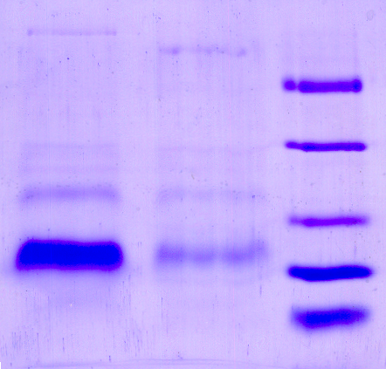
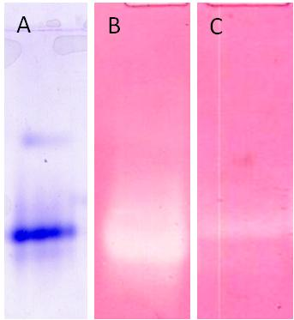
AFFINITY CHROMATOGRAPHY
Different types of affinity chromatography: His Tag, GST fusion protein, Maltose binding protein, specific affinities like antigen- antibody reactions, enzyme – substrate interactions etc.
kDa
1 2
43
29
20
14
6,5
Trypsin sepharose affinity chromatography profile of rHGI. (−• −) TIU/mL, (−▲−) A ₂₃₀. Inset: Native PAGE (10 % T, 2.7 % C) of rHGI at pH 8.3. The gels were stained for A: protein; B: trypsin and C: chymotrypsin by APNE zymography
SDS-PAGE (15%T, 2.7%C) profile of purified HGIs.
Recombinant protein, Deepa G Muricken, St. Mary’s College Thrissur

Slide 15
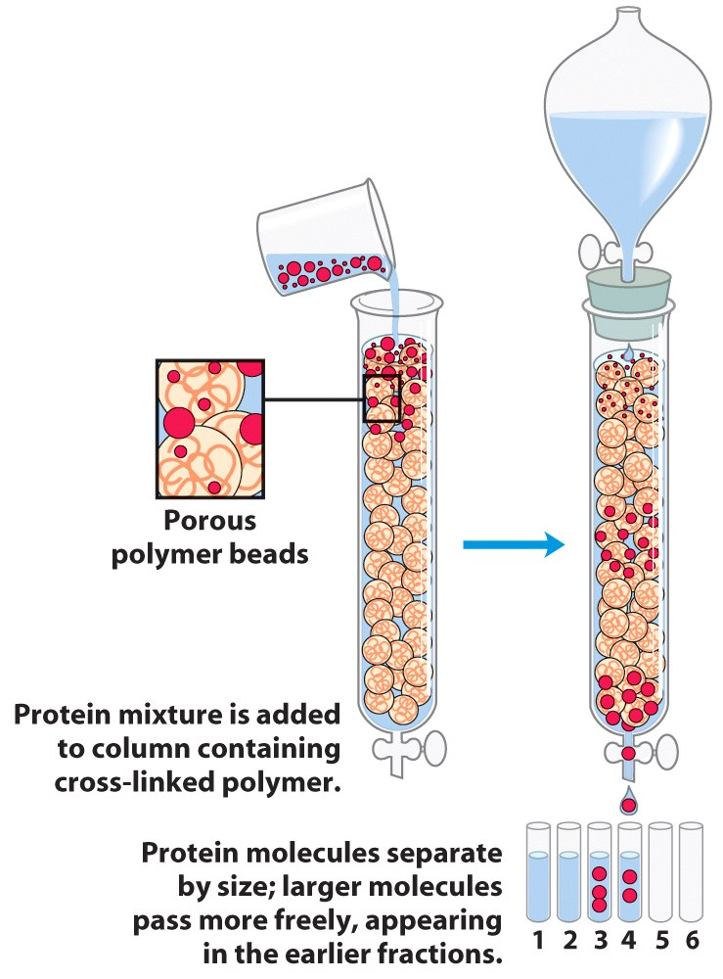
Gel Filtration Chromatography
An elution profile
Gel-filtration of the protein mixture. 5 ml of protein mixture was loaded onto a Sephadex G-50 column equilibrated with buffer (50 mM Tris HCl, pH 7.5). The column was eluted with buffer at ~1 ml/min, collecting 2.5 ml fractions. The absorbance of each fraction was measured at 230 nm and 280 nm.
Recombinant protein, Deepa G Muricken, St. Mary’s College Thrissur

Slide 16
Ion exchange chromatography
Ion exchange resins contain charged groups.
If these groups are acidic in nature they interact with positively charged proteins and are called cation exchangers
If these groups are basic in nature, they interact with negatively charged molecules and are called anion exchangers.
+
CH₂-COO⁻
+
Positively charged (basic) protein or enzyme
CH₂-COO⁻
+
CM cellulose
cation exchanger
Negatively charged (acidic) protein or enzyme
CH₂-CH₂ -NH⁺(CH₂CH₂)
-
CH₂-CH₂ -NH⁺(CH₂CH₂)
-
-
-
DEAE cellulose
anion exchanger
Recombinant protein, Deepa G Muricken, St. Mary’s College Thrissur

Slide 17
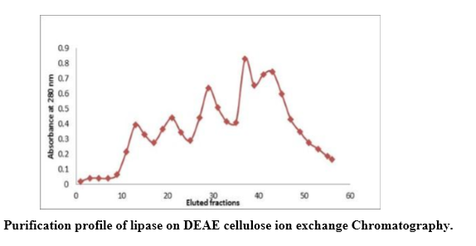
Ion exchange chromatography
To elute our protein of interest, add increasingly higher amount of salt (increase the ionic strength). Na⁺ will interact with the cation resin and Cl⁻ will interact with our positively charged protein to elute off the column.
CH₂-COO⁻
+
+ Increasing [NaCl] of the elution buffer
+
CH₂-COO⁻
+
+
CM cellulose
cation exchanger
CH₂-COO⁻
Na⁺
Na⁺²
Cl⁻
Cl⁻
+
CH₂-COO⁻
Na⁺
+
Cl⁻
+
CM cellulose
cation exchanger
Na⁺²
Cl⁻
+
Recombinant protein, Deepa G Muricken, St. Mary’s College Thrissur

Slide 18
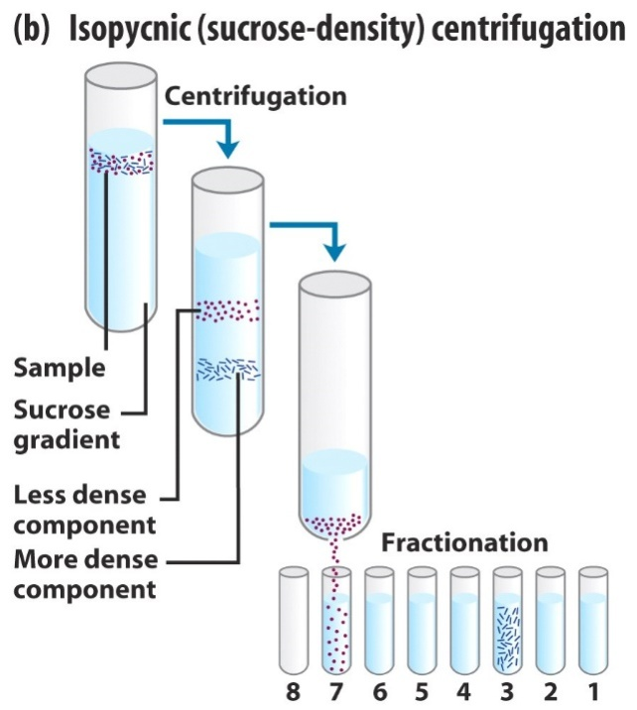
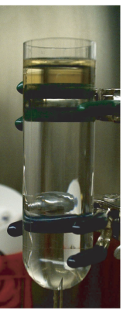
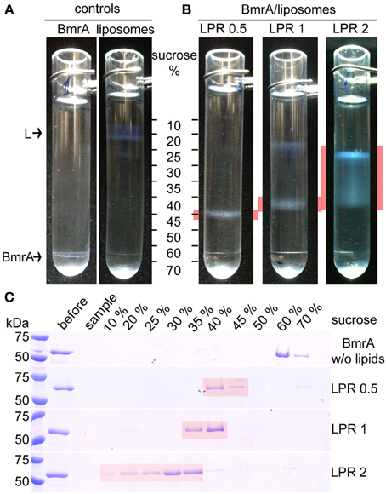
Centrifugation
Separate proteins by size or density
Differential centrifugation - separates large from small particles
Isopycnic (sucrose-density) centrifugation - separates particles of different densities
Purification of viral coat protein
Recombinant protein, Deepa G Muricken, St. Mary’s College Thrissur

Slide 19
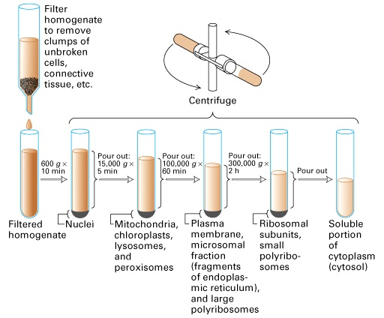
Differential Centrifugation
Recombinant protein, Deepa G Muricken, St. Mary’s College Thrissur

Slide 20
Final purification methods
Initial methods included fractionation methods like salt precipitation, precipitation using organic solvents, membrane filtration etc.
Secondary fractionation included ion exchange chromatography, gel filtration, adsorption, affinity methods etc.
The protein intended for drugs and similar uses has to be extremely pure and should be free from even traces of other proteins from the source.
Polishing steps has to be performed in final round like HPLC gel filtration, reverse phase HPLC, ion exchange HPLC etc.
Recombinant protein, Deepa G Muricken, St. Mary’s College Thrissur

Slide 21
HPLC Profile of Size-exclusion BIOSEP-SEC-S 3000 column
Size-exclusion chromatography of seed HGI-III and rHGI. The purified proteins were dissolved in 0.1M Tris-HCl, pH 7.5 and loaded on to a BIOSEP-SEC-S 3000 column
Recombinant protein, Deepa G Muricken, St. Mary’s College Thrissur

Slide 22
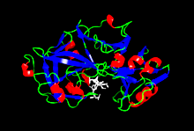
Applications
Recombinant protein, Deepa G Muricken, St. Mary’s College Thrissur

Slide 23
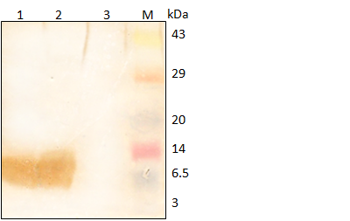
Applications (continued)..
3. Can perform desired changes for a protein either to study its structure or its function.
4. Synthesis of drugs
5. Synthesis of hormones
6. Production of vaccines
7. Production of carrier molecules
8. Monoclonal antibody production
9. Therapeutic Proteins – Preclinical Studies
10. Production of biosimilar
Recombinant protein, Deepa G Muricken, St. Mary’s College Thrissur

Slide 24
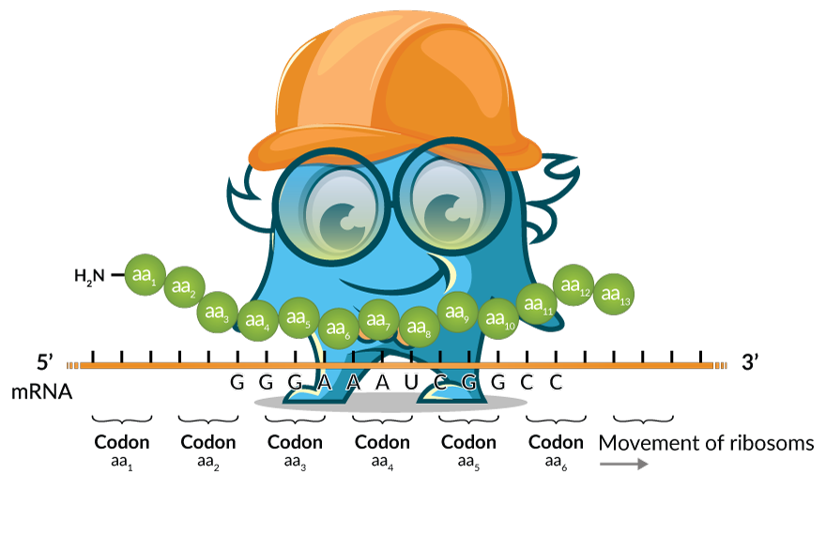
THANK YOU

