Slide 1
Dramatic Relief in Macbeth
Jency James
Assistant Professor
Department of English
St. Mary’s College
Thrissur-680020
Kerala

Slide 2
Five Stages or Divisions in a Play
The Exposition-opening situation ,in which the audience is shown the cause of the beginnings of the action of drama
The Rising Action-events move up to a situation which arises directly from the causes shown in the Exposition.
The Crisis or Climax-dramatic action at it’s highest point
The Falling Action-uncertainty and suspense are lessened, the problem is nearing situation
The Catastrophe-final ending/ solution of the problem
Dramatic Relief,Jency James,St.Mary’s College

Slide 3
Shakespeare’s Stage
Stage was a projected platform from one side and on three sides artists were surrounded by the audience
Stage was not a thing apart from the audience and so the audience felt direct and personal touch with the players.
Actors were like the members of the family
Asides and soliloquies seemed to be natural on the Elizabethan stage because the actor was in the midst of the audience and speaking to them, not to himself
Dramatic Relief,Jency James,St.Mary’s College

Slide 4
Shakespeare’s Audience
Audience would have been composed of butchers, tanners, seamen, bakers, glovers, wig makers, servants, iron workers and countless tradesmen and their families.
The groundlings who included all people who weren’t rich and who paid much to sit in “Gentlemen’s Room” or “Lord’s Room” formed his audience.
Was far more boisterous
Audience expected to see a good acting with a simple speech and pompous costumes because they wanted to escape from every day reality
Dramatic Relief,Jency James,St.Mary’s College

Slide 5
Greatest Tragedies of Shakespeare
His great tragedies are also called “Tragedies of Character” or
“ Tragedies of Destiny”
Each hero is a strong personality and possesses noble qualities, but has one weakness which is termed as Tragic Flaw
Hamlet-incapable of action(procrastination)
Othello-suspicion
King Lear-lack of prudence
Macbeth-vaulting ambition
Dramatic Relief,Jency James,St.Mary’s College

Slide 6
Dramatic Relief
Dramatic relief or comic relief is the inclusion of a humorous character, scene or a witty dialogue in an otherwise serious atmosphere to relieve tension.
Technique of the Romantic drama where the mind can rest and pause a while.
Since the audience was easily carried away by the emotions of the characters, an attempt to bring down the tension to a lower pitch was very much necessary and the comic scenes in between tragedies provided relief
Dramatic Relief,Jency James,St.Mary’s College

Slide 7
Dramatic Relief in Macbeth
Contemplation of the serene majesty and repose of Macbeth’s castle by Banquo and Duncan (Act I ,scene vi)-The tumult of the battle scene seems to have left far behind and bloody thought raging in Macbeth’s bosom seems to hush into silence
Porters Scene(Act II ,scene ii)-Macbeth and Lady Macbeth could keep their countenances for their own safety and the audience could be released from the atmosphere of tragic gloom and terror
Innocent prattle of Lady Macduff and her son(Act 1v ,scene vi)-
charged with the most fateful significance, for immediately
afterwards the murderers appear and kill both mother and son. This scene intensifies the tragic effect
Dramatic Relief,Jency James,St.Mary’s College

Slide 8
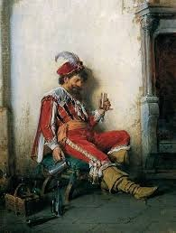
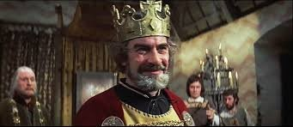
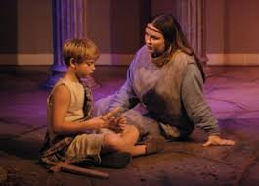
Images of Dramatic Relief in Macbeth
Porter “devil pottering” himself
https://goo.gl/images/7pyjXR
Duncan enjoying the peaceful atmosphere in Macbeth’s Castle
https://goo.gl/images/rswJXm
<- https://goo.gl/images/Fhj7ss
Conversation wrapped in warmth and love between Lady Macduff and her son
Dramatic Relief,Jency James,St.Mary’s College

Slide 9
Significance of Porter’s Scene
Provides relief which is so necessary after the horrifying experiences of the previous scenes.
Contrasts by it’s very banality to the heightened language and strange emotions the audience has passed through in the earlier scenes
Macbeth and Lady Macbeth are given enough time to wash their hands and change their clothes
Porter’s speech gives us some clues about the date of composition of the play… “here’s a farmer that hanged himself on the expectation of plenty
Dramatic Relief,Jency James,St.Mary’s College

Slide 10
Conclusion
Comic relief helps the audience forget the tragic background of darkness and terror as happened in the scene of Duncan’s arrival to Macbeth’s castle and his appreciation of serene atmosphere prevailed in the castle.
Gives the audience an emotional break from the tension and heavy mood of the tragic plot as happened in Porter’s Scene.
Functions as an element of contrast to intensify the tragedy to come as it is evident in the soothing conversation between Lady Macduff and her son
Dramatic Relief,Jency James,St.Mary’s College

