Slide 1
COMPOSTING
Prasanna R Kovath
Assistant Professor
Department of Biotechnology
St.Mary’s College Thrissur

Slide 2
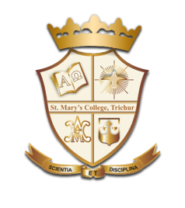
COMPOSTING
Compost is organic matter that has been decomposed in a process called composting.
This process recycles various organic materials otherwise regarded as waste products and produces a soil conditioner (the compost).
Compost is rich in nutrients
composting requires making a heap of wet organic matter such as leaves, grass, and food scraps, and waiting for the materials to break down into humus after a period of months
Composting,Prasanna R Kovath,St.Mary’s College

Slide 3
REQUIREMENTS FOR COMPOSTING
Carbon : for energy; the microbial oxidation of carbon produces the heat.
Nitrogen : to grow and reproduce more organisms to oxidize the carbon.
Oxygen : for oxidizing the carbon, the decomposition process.
Water : in the right amounts to maintain activity without causing anaerobic conditions
Composting,Prasanna R Kovath,St.Mary’s College

Slide 4
MICROORGANISMS IN COMPOSTING
Bacteria
Actinobacteria
Fungi
Mould
Yeast
Protozoa
Rotifiers
Earthworms
Composting,Prasanna R Kovath,St.Mary’s College

Slide 5
PHASES OF COMPOSTING
Mesophilic phase : decomposition is carried out under moderate temperatures by mesophilic microorganisms.
Thermophilic phase : decomposition is carried out by various thermophilic bacteria under high temperatures.
Maturation phase : As the supply of high-energy compounds dwindles, the temperature starts to decrease, and the mesophiles once again predominate
Composting,Prasanna R Kovath,St.Mar’ys College

Slide 6
VERMICOMPOSTING
vermicomposting is the process by which worms are used to convert organic materials (usually wastes) into a humus-like material known as vermin-compost.
Superior to most composts as an inoculant in the production of compost.
Rich in nitrate and contain minerals like phosphorous, potassium,calcium,magnesium which are excellent fertilizers and soil conditioners.
Composting,Prasanna R Kovath,St.Mar’ys College

Slide 7
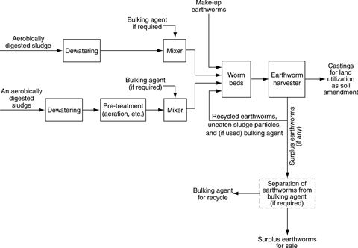
Composting,Prasanna R Kovath,St.Mar’ys College

Slide 8
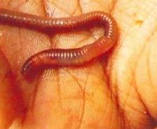
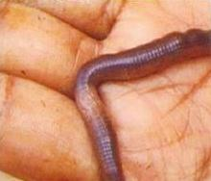
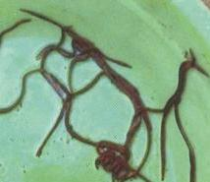
EARTHWORMS USED FOR COMPOSTING
African earthworm (Eudrillus euginiae)
Tiger worm or Red wrinkle (Eisenia foetida)
Asian worms (perinonyx ecavatus)
Composting,Prasanna R Kovath,St.Mary’s College

Slide 9
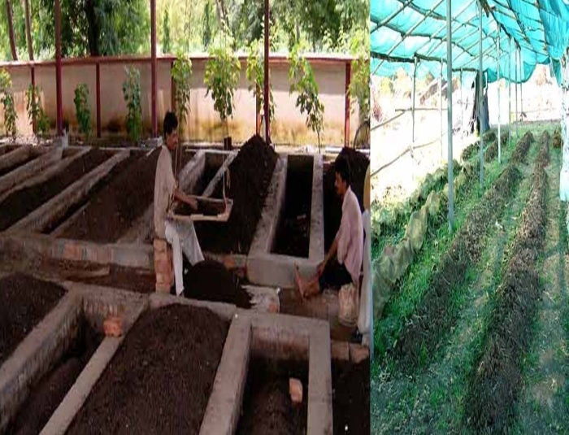
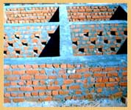
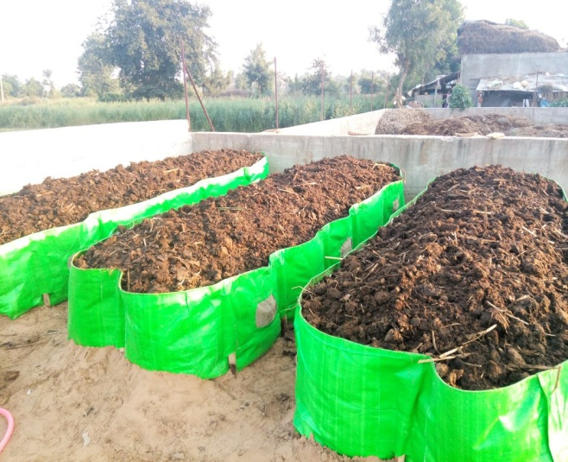
DIFFERENT TYPES OF VERMICOMPOSTING
Bed Method:
Beds of organic matter are prepared. This is an easy practice and is widely used.
Pit Method:
Cemented pits are made and are filled with organic matter. However, this method is not preferred because of water logging and poor aeration.
Poetic Forms & Genres,Ceena Jose.k,St.Mar’ys College

Slide 10
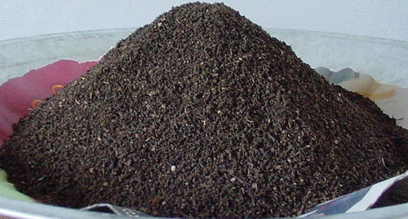
PRECAUTIONS : VERMICOMPOSTING
The compost pit should be protected from direct sunlight and a certain temperature has to be maintained
Water should be regularly sprayed on the pit in order to maintain the moisture level
The worms should be protected from natural predators
Composting,Prasanna R Kovath,St.Mar’ys College

Slide 11
COMPARISON:NUTRITIONAL VALUE
Nutrient (%) | Vermicompost | Farm Yard Manure
Nitrogen | 1.6 | 0.5
Phosphorus | 0.7 | 0.2
Potassium | 0.8 | 0.5
Calcium | 0.5 | 0.9
Magnesium | 0.2 | 0.2
Iron (ppm) | 175.0 | 146.5
Manganese (ppm) | 96.5 | 69.0
Zinc (ppm) | 24.5 | 14.5
Copper (ppm) | 5.0 | 2.8
C:N (ratio) | 15.5 | 31.3
Composting,Prasanna R Kovath,St.Mary’s College

Slide 12
ADVANTAGES
It is a natural fertilizer
It is not hazardous for the soil
It improves soil aeration and texture
Water retention ability is improved
It improves the nutrient status of the soil
This method is cost effective
Composting,Prasanna R Kovath,St.Mar’ys College

Slide 13
DISADVANTAGES
Composting takes a lot of time to process (3 months)
It produces bad smell
There is a need spend time on maintenance as constant monitoring is required
This technique requires a lot of laborers and is pretty hard to implement in urban areas
Composting,Prasanna R Kovath,St.Mar’ys College

Slide 14
REFERENCE
www.homeguides.sfgate.com
www.planetnatural.com
www.biogas.ifas.ufl.edu
www.ecomena.org
www.sciencedirect.com
www.agritech.tnau.ac.in
Composting,Prasanna R Kovath,St.Mar’ys College

