Slide 1
Oedipus Rex: Sophocles
Anu Chandramohan
Assistant Professor
Department of English
St. Mary’s College Thrissur

Slide 2
GREEK DRAMA
3 types: Comedy, Satyre and Tragedy
Use of Masks were prominent as it enabled actors to play severalroles on stage.
The theatre of Dionysus: God of wine and Procreation was the subject of most of the plays.
Dramas were usually about the events that occurred when the Gods spoke to and interacted with men
Oedipus Rex, Anu Chandramohan, St. Mary’s College

Slide 3
Origin of Greek Theatre
Most important events in ancient Greece were performed outdoors; dramas were no exception
Three week-long festivals were set aside each year for the purpose of dramatizing stories of the Greeks’ lives: one in March, another in January, and another at varying times throughout the year
Oedipus Rex, Anu Chandramohan, St.Mary’s College

Slide 4
The structure of most Greek tragedies presents a tight, formal arrangement of parts, including:
The Prologue [opening scene]
The Parados [first of the Chorus’s lyric songs]
A regular alternation of scenes in Dialogue and Choral Odes
The Exodos [concluding scene]
Oedipus Rex, Anu Chandramohan, St.Mary’s College

Slide 5
TRILOGY
Group of three plays on a related subject or theme.
“Oedipus the King” is the first play of a Trilogy including:
“Oedipus at Colonus” and “Antigone,” a play about Oedipus’ daughter.
Oedipus Rex, Anu Chandramohan, St.Mary’s College

Slide 6
Characters
Oedipus - native of Thebes; subject of a terrible prophecy that has him killing his father and marrying his mother; sent away, but returns triumphant
Jocasta - Queen of Thebes; marries Oedipus after the death of her husband, the King
Creon - Jocasta's brother
Oracle at Delphi - predicts Oedipus’ fate
Antigone & Ismene - Oedipus’ daughters
Chorus - Theban citizens; comment on events as they unfold
Oedipus Rex, Anu Chandramohan, St.Mary’s College

Slide 7
Themes
The themes, or underlying messages, of Oedipus Rex are crucial to the plays’ long-lasting appeal.
The themes explored in this tragedy include:
The quest for identity
The nature of innocence and guilt
Blindness and sight (all forms)
Fate versus Free Will
The Abuse of power
Oedipus Rex, Anu Chandramohan, St.Mary’s College

Slide 8
Oedipal Complex
Defined as the Freudian Theory that all young children around age 3+ have a strong attachment to the parent of the opposite gender and wish to kill/destroy the same gender parent so they can take their place.
In Neo-Freudian psychology, the Electra complex, as proposed by Carl Jung his Theory of Psychoanalysis, is a girl's psychosexual competition with her mother for possession of her father.
Oedipus Rex, Anu Chandramohan, St.Mary’s College

Slide 9
Sophocles:
His attitudes and messages are:
There is no security in life
Man must accept his limitations
Good fortune is transient
No man is perfect
Oedipus Rex, Anu Chandramohan, St.Mary’s College

Slide 10
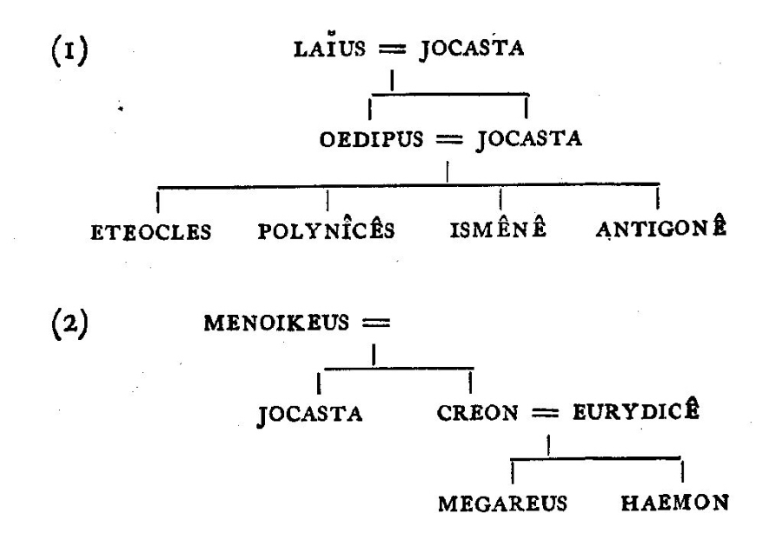
Oedipus Family Tree
Oedipus Rex, Anu Chandramohan, St.Mary’s College

Slide 11
REFERENCE
www.universityofcalicut.info/SDE/worldclassicsintranslation.pdf
Oedipus Rex, Anu Chandramohan, St.Mary’s College

