Slide 1
ORGANS OF IMMUNE SYSTEM
Tisha Liza Tomy
Assistant Professor
Department of Biotechnology
St. Mary’s College Thrissur

Slide 2
LYMPHOID ORGANS
Primary Lymphoid
Bone marrow
Thymus
Secondary Lymphoid
Lymph nodes
Spleen
MALT
Organs of Immune System, Tisha Liza Tomy,St.Mary’s College

Slide 3
PRIMARY LYMPHOID ORGANS
Lymphoid stem cells undergo proliferation, differentiation and maturation into T and B cells.
Acquire antigen specific reception.
After maturation T and B cells migrate to secondary lymphoid organs
In mammals - Thymus, Bone marrow
In Birds -Thymus, Bursa of Fabricius
Major sites of Lymphopoiesis T cell - Thymus, B cell - Bone marrow
Control Peripheral Lymphoid Organs.
Organs of Immune System, Tisha Liza Tomy,St.Mary’s College

Slide 4
T-cells
T cells arise in the thymus, and in many mammals—humans and mice for example
B cells originate in bone marrow.
Organs of Immune System, Tisha Liza Tomy,St.Mary’s College

Slide 5
THYMUS
The thymus is the site of T-cell development and maturation.
It is a flat, blobbed organ situated above the heart.
Each lobe is surrounded by a capsule and is divided into lobules, which are separated from each other by strands of connective tissue called trabeculae.
Organs of Immune System, Tisha Liza Tomy,St.Mary’s College

Slide 6
The T in T lymphocytes stands for thymus, the place where they mature.
T cells move through the body and constantly watch the surfaces of all cells for changes.
When coming into contact with a non-self body, T cells turn into so-called T effector cells, which trigger and regulate different defense reactions.
This type of cells includes T killer cells, which can destroy cells infected with a pathogen.
In childhood, the thymus tissue also produces two hormones – thymosin and thymopoietin – which regulate the maturation of defense cells in the lymph nodes.
Organs of Immune System, Tisha Liza Tomy,St.Mary’s College

Slide 7
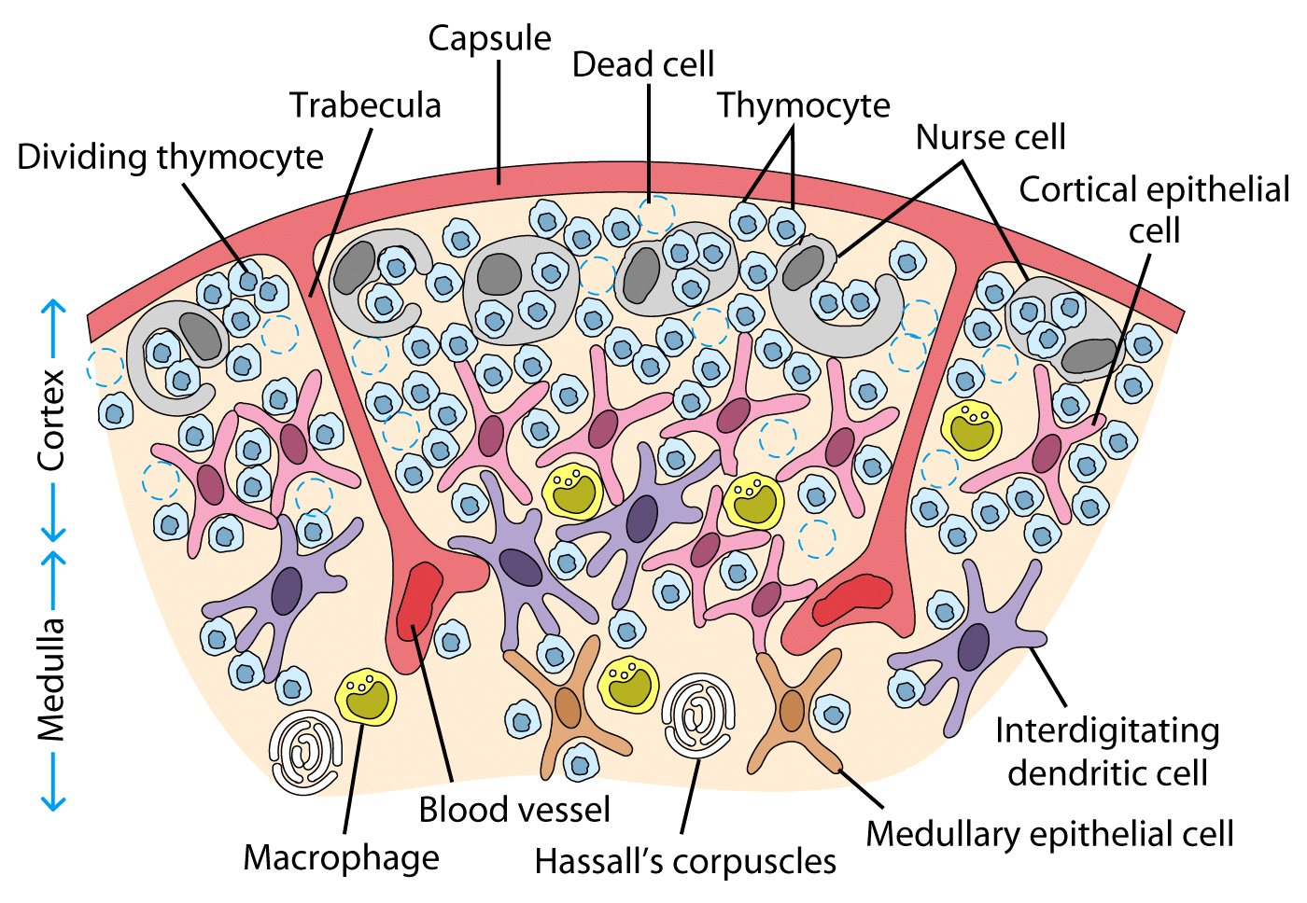
Organs of Immune System, Tisha Liza Tomy,St.Mary’s College

Slide 8
BONE MARROW
Bone marrow is a sponge-like tissue situated inside of the bones.
Most defense cells are produced and then also multiply here.
They then migrate from the bone marrow into the bloodstream and reach other organs and tissues, where the defense cells mature and specialize.
At birth, many bones contain red bone marrow, which actively builds defense cells.
During the course of life, more and more red bone marrow turns into fat tissue.
Adults only have red bone marrow in a few bones, for example in the ribs, in the breast bone and in the pelvic bone.
Organs of Immune System, Tisha Liza Tomy,St.Mary’s College

Slide 9
SECONDARY LYMPHOID ORGANS
LYMPH NODE:
The lymphatic system of lymph nodes and vessels is important for continually exchanging substances between the blood and the tissue in the body.
Fluid constantly leaves the blood, and defense cells and proteins migrate into the surrounding tissue. Most of the fluid is later taken back into the blood vessels.
The rest of it is removed by the drainage system of the lymph vessels, which forms a fine net of thin-walled vessels in the body.
The lymph nodes filter and clean the lymph fluid (lymph) on its way to the larger lymph vessels.
The lymph finally travels to a vein called the superior vena cava, where it enters the blood stream.
Organs of Immune System, Tisha Liza Tomy,St.Mary’s College

Slide 10
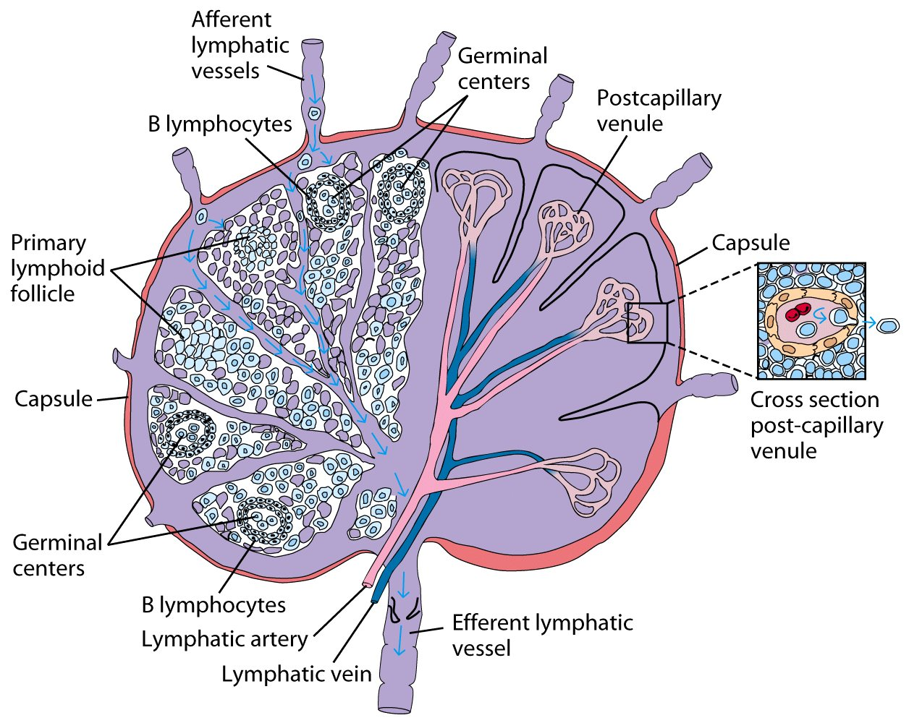
Organs of Immune System, Tisha Liza Tomy,St.Mary’s College

Slide 11
SPLEEN
The spleen is situated in the left upper abdomen, beneath the diaphragm
It has a variety of tasks in the defense system.
In the unborn child, the spleen mainly produces blood and defense cells.
After birth this organ is mainly responsible for removing blood cells and for specific defense functions.
Organs of Immune System, Tisha Liza Tomy,St.Mary’s College

Slide 12
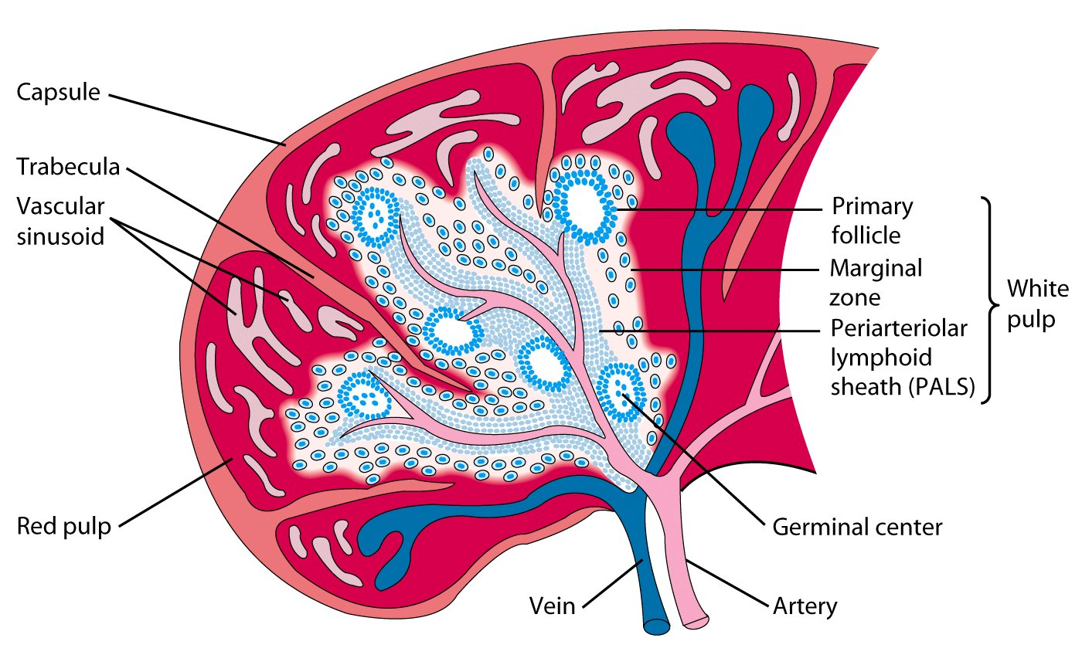
Organs of Immune System, Tisha Liza Tomy,St.Mary’s College

Slide 13
MALT
Lymphoid tissues below epithelium
Presence of B cells
Ag presented through unique cell (M cell)
Preferentially responds with IgA antibody
Organs of Immune System, Tisha Liza Tomy,St.Mary’s College

Slide 14
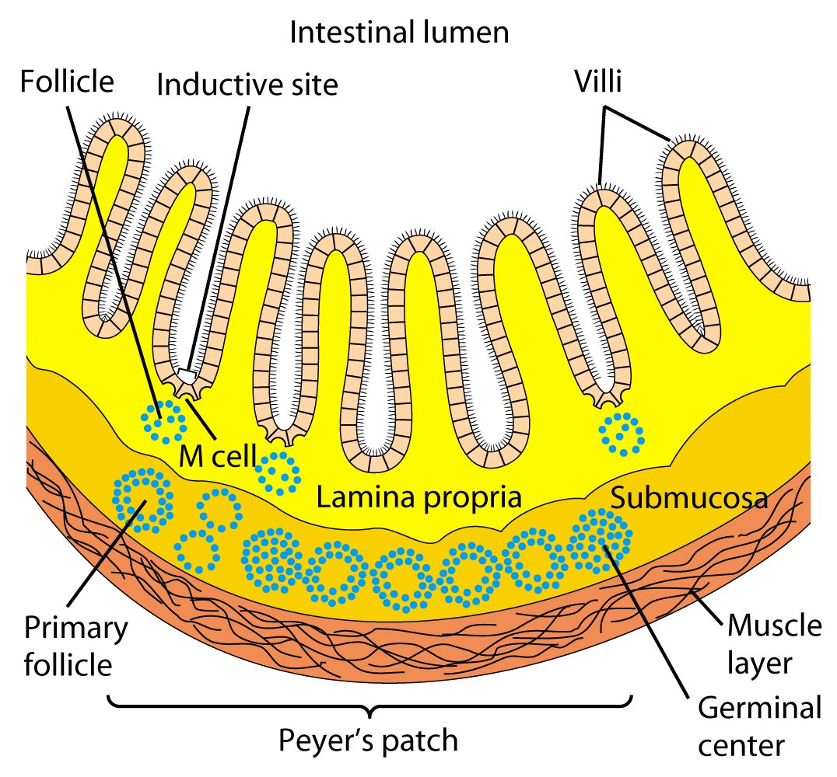
Organs of Immune System, Tisha Liza Tomy,St.Mary’s College

Slide 15
REFERENCE
https://www.ncbi.nlm.nih.gov/books/NBK279395/
https://www.sciencedirect.com/topics/medicine-and-dentistry/organs-of-the-immune-system
www.uvm.edu/~bwilcke/organs.pp
www.longwood.edu/staff/buckalewdw/Immlec/Imm4.ppt
https://fac.ksu.edu.sa/sites/default/files/immnity_organ
Organs of Immune System, Tisha Liza Tomy,St.Mary’s College

