Slide 1
STAINING TECHNIQUES
Prasanna R Kovath
Assistant Professor
Department of Biotechnology
St. Mary’s College, Thrissur

Slide 2
SIMPLE STAINING TECHNIQUES
can be performed with basic dyes .
positively charged dyes are attracted to the negatively charged materials of the microbial cytoplasm.
Examples of simple stain are Methylene blue, Safranin, Malachite green, Basic fuchsin and crystal violet etc.
useful in preliminary studies of morphological characters of cell that is its size, shape and arrangement.
also called as monochrome staining or positive staining.
Staining Techniques,Prasanna.R.Kovath,St.Mary’s College Thrissur

Slide 3
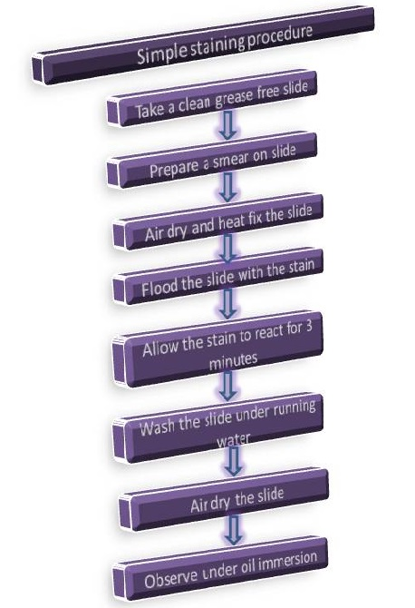
Staining Techniques,Prasanna R Kovath,St.Mary’s College Thrissur

Slide 4
DIFFERENTIAL STAINING TECHNIQUES
Distinguishes two kinds of organisms
Gram stain technique
This differential technique separates bacteria into two groups, Gram‐positive bacteria and Gram‐negative bacteria.
Acid‐fast technique
This technique differentiates species of Mycobacterium from other bacteria.
Staining Techniques,Prasanna R Kovath,St.Mary’s College Thrissur

Slide 5
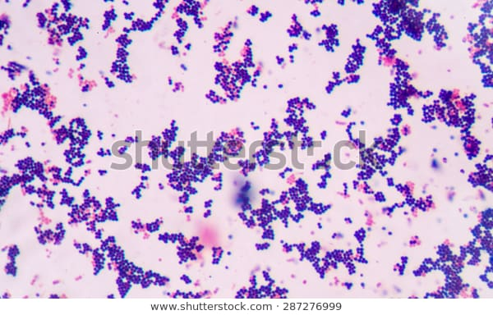
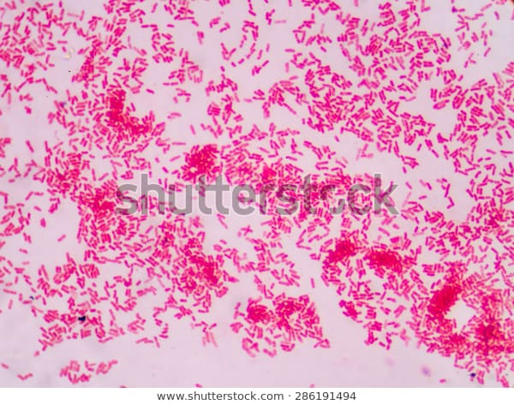
GRAM STAINING
The Gram stain procedure distinguishes between Gram positive and Gram negative groups by coloring these cells red or violet.
Gram positive bacteria stain violet due to the presence of a thick layer of peptidoglycan in their cell walls.
Gram negative bacteria stain red as they have a thinner peptidoglycan wall.
Staining Techniques,Prasanna R Kovath,St.Mary’s College Thrissur

Slide 6
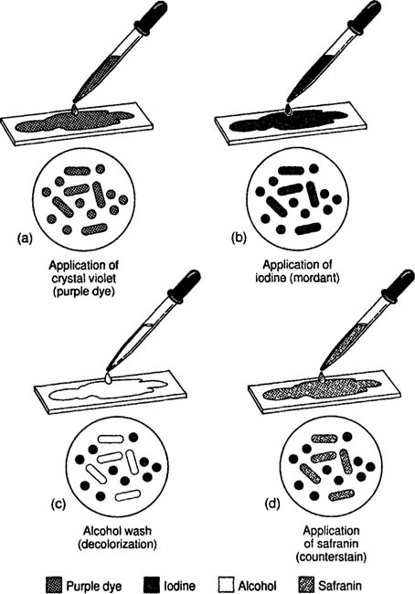
The Gram stain procedure used for differentiating bacteria into two groups.
Staining Techniques,Prasanna R Kovath,St.Mar’ys College

Slide 7
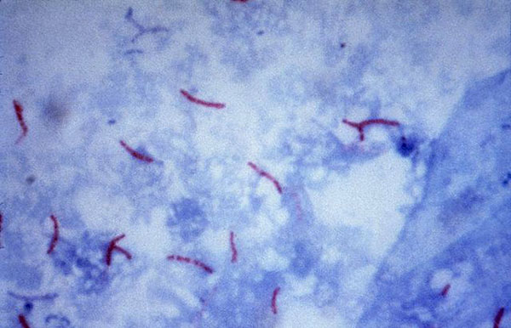
ACID FAST STAINING/ZIEHL NEELSEN STAINING
First introduced by Dr. Paul Ehrlich.
Acid-fast organisms contain large amounts of lipid substances within their cell walls called mycolic acids. These acids resist staining by ordinary methods.
Reagents used are – carbol fuchsin, acid alcohol, and methylene blue
Acid-fast bacilli are bright red after staining.
Staining Techniques,Prasanna R Kovath,St.Mary’s College

Slide 8
OTHER STAINING METHODS
Capsule Staining
Endospore Staining
Negative Staining
Staining Techniques,Prasanna R Kovath,St.Mar’ys College

Slide 9
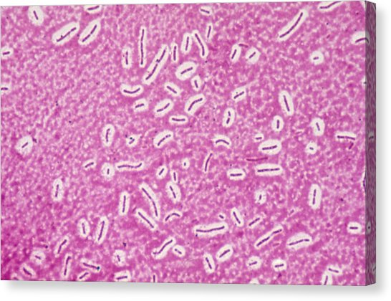
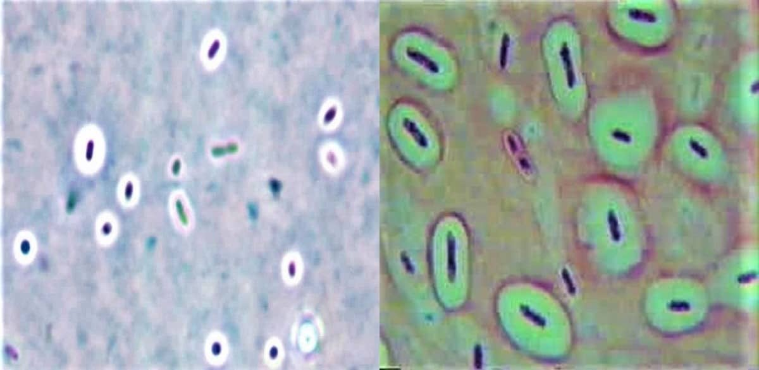
CAPSULE STAINING
uses acidic and basic dyes to stain background & bacterial cells respectively.
Stains used are Nigrosine, congo red,crystal violet, safranin, basic fuchsin and methylene blue.
Two commonly used methods are :
India ink method
Anthony’s stain method
Staining Techniques,Prasanna R Kovath,St.Mary’s College

Slide 10
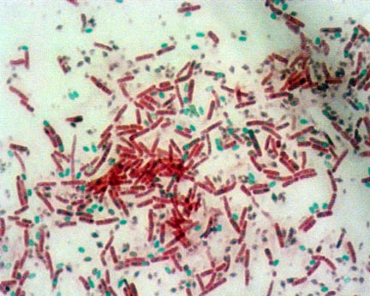
ENDOSPORE STAINING
used to visualize bacterial endospores.
Stains used are :malachite green. safranin
Endospores will stain green. Parent cells will stain red.
Staining Techniques,Prasanna R Kovath,St.Mar’ys College,Thrissur

Slide 11
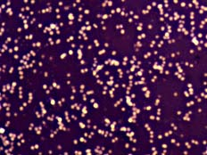
NEGATIVE STAINING
The main purpose of Negative staining is to study the morphological shape, size and arrangement of the bacteria cells that is difficult to stain.
Also be used to stain cells that are too delicate to be heat-fixed.
Requires an acidic dye such as India Ink
or Nigrosin.
Staining Techniques,Prasanna R Kovath,St.Mar’ys College

Slide 12
REFERENCE
www.generalmicroscience.com
www.cliffsnotes.com
www.serc.carleton.edu
www.shutterstock.com
www.wikipedia.org
www.microbeonline.com
www.render.fineartamerica.com
www.austincc.edu
www.microbiologyinfo.com
Staining Techniques,Prasanna R Kovath,St.Mar’ys College

