Slide 1
TRANSACTIONS: Essential English Language Skills
Greeshma K P
Assistant Professor
Department of English
St Mary’s College, Thrissur

Slide 2
Phonetics
Is a fundamental branch of linguistics.
It deals with the study of speech sounds.
In English the relation between system of writing and the system of pronunciation is arbitrary.

Slide 3
26 letters in English Alphabet :: 44 speech sounds because each symbol has a distinct sound.
44 sounds can be classified as vowels and consonants.
Vowels are 20 in number.
12 are pure vowels and 8 are diphthongs.
There are 24 consonants in English Language.

Slide 4
Speech sounds
44
Vowels
20
Consonants
24

Slide 5
Vowels
20
Pure vowels
12
Diphthongs
8

Slide 6
Vowels (20)
Sounds during the production of which air escapes through the mouth freely.
Of the 20 vowels in English,12 are called monopthongs or pure vowel and the rest are diphthongs.
Pure vowels consist of a single sound.

Slide 7
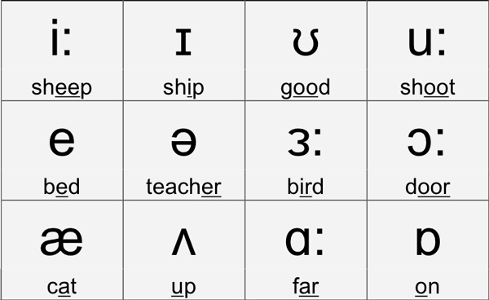
Pure Vowels(12)

Slide 8
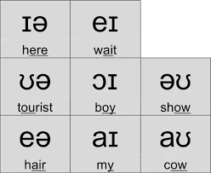
Diphthongs(8
Diphthongs are a combination of two pure vowels.

Slide 9
Consonants
Sounds produced by completely or partially stopping the flow of air breathed out through the mouth are called consonants.
There are 24 consonants in English. 21 are represented by the letters of English alphabet.

Slide 10
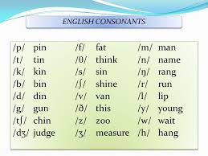

Slide 11
Word Stress
English is an accent based language, in a word not all the syllables are pronounced with equal emphasis.
An understanding of the phonetic alphabet alone is not enough for the correct pronunciation of English words. One should also know where to stress in a word.
A stress is marked above the accented syllable as shown in the brackets ('father).

Slide 12
Rules in Determining Word Stress
Words with same spelling and same sound can have difference in their pronunciation.
If the word is a noun or adjective the stress falls on the first syllable. If the word is a verb the stress is on the second syllable.
Eg:- Absent(noun) - /’ab-sənt/
Absent (verb) - /ab-‘sent/

Slide 13
2. Words with weak prefix are stressed on the root word.
Eg:- a’go, be’low, re’duce
3. Words ending in –ion have the stress on the syllable before the final syllable.
Eg :- examination – e-xa-mi-‘na-tion

Slide 14
4. Words that end in –ic, -ical, -ically, -ian are stressed on the syllable before the suffix
Eg:- arti’ficial
5. Words ending with the suffix –eer and –ee are stressed on the suffix.
Eg:- engi’neer, Pay’ee

Slide 15
L1 Interference
When one learns a second language after acquiring a first language, features of the first language interfere with those of the second language. This is called L1 Interference or negative transfer.
We tend to speak English as we speak our mother tongue; therefore we tend to make mistakes due to its influence.

Slide 16
The key areas of L1 interference in Malayalam/English learners are:-
1. Pronouncing silent letters
Eg;- /bridədʒ/ instead of /bridʒ/
2. Pronunciation of double letters
Eg;- brilliant
3. Pronouncing words without stress shift
4. Pronouncing ‘-es/s’ and ‘-ed’ morphemes

Slide 17
5. Strong articulation of weak function class words
6. Intrusive ‘y’ eg;- /kya:t/ instead of /kæt/
7. Phonetic fossil
8. Problem with /z/ sound
Eg;- /su:/ instead of /zu:/
9. Wrong pronunciation of some numbers and other common mispronunciations
Eg;- twenty, twelve etc.

Slide 18
REFERENCE
www.universityofcalicut.info/SDE/sde433.pdf

