Slide 1
Biomolecules
Sreesaila N P
Assistant Professor
Department of Biotechnology
St. Mary’s College Thrissur

Slide 2
BIOMOLECULES
Chemicals or molecules present in living organisms
Biomolecules are compounds of carbon with a variety of functional groups.
Chemicals of living organisms organized around carbon
Carbon bonds with hydrogen, oxygen, nitrogen, etc.,
Cellular pool – different biomolecules, compounds, ions
Biomolecules, Sreesaila N P, St Mary’s college

Slide 3
Carbon bonding
Free rotation around each single bond.
Rotation restricted to large/highly charged groups
Double bond is shorter and rigid
Covalently linked carbon atoms can form linear, branched chain or cyclic structures in biomolecules.
Bonding versatility - molecular mechanism during origin and evolution
No other chemical element can form such varieties of compounds like CARBON.
Most biomolecules are derivatives of hydrocarbons
Biomolecules, Sreesaila N P, St Mary’s college

Slide 4
Types of BIOMOLECULES
Micro molecules
18 – 800 dalton
Acid soluble
Minerals, gases, water, sugars, amino acids.
Macromolecules
10000 dalton
Acid insoluble pool
Carbohydrates, nucleic acids, lipids, proteins
Biomolecules, Sreesaila N P, St Mary’s college

Slide 5
Types of BIOMOLECULES
Inorganic :
Minerals
Water
Gases
Organic :
Carbohydrates
Nucleic acids
Proteins
Amino acids
Lipids
Enzymes
Vitamins
Biomolecules, Sreesaila N P, St Mary’s college

Slide 6
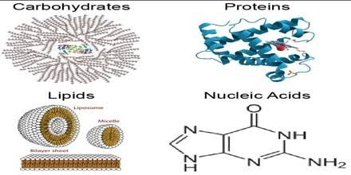
Biomolecules are made up of sub units
Each are having their own characteristics and structures
Eg: Protein is made up of amino acid sub units.
Protein functions as enzymes, structure, transport pigment etc.,
Biomolecules, Sreesaila N P, St Mary’s college

Slide 7
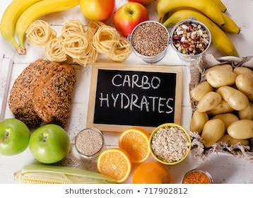
Carbohydrates
C, H, O ratio 1:2:1
Monosaccharide, disaccharide, oligosaccharide and poly saccharide.
Energy source.
Brain functioning
Biomolecules, Sreesaila N P, St Mary’s college

Slide 8
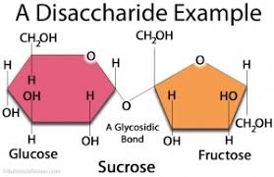
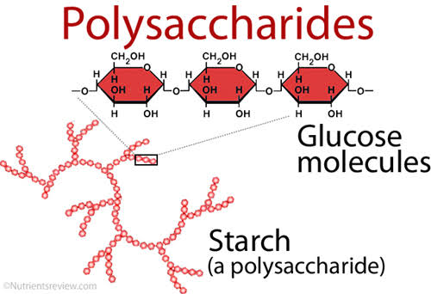
Structure of CARBOHYDRATES
Biomolecules, Sreesaila N P, St Mary’s college

Slide 9
DERIVATIVES OF MONOSACCHARIDES
1. Deoxy sugars – DNA
2. Amino sugars – Glucosamine( forms chitin, hyaluronic acid)
3. Sugar acid – Ascorbic acid
4. Sugar alcohols – Glycerol, Mannitol
Biomolecules, Sreesaila N P, St Mary’s college

Slide 10
Structural forms of CARBOHYDRATE
Monosaccharides – monomer of carbohydrates
Eg; GLUCOSE
Disaccharides – two monosaccharides
Eg; MALTOSE ( GLUCOSE + GLUCOSE)
Polysaccharides – many monomers
Eg; STARCH, GLYCOGEN, CELLULOSE
(energy storage form in plants, in animals and plant cell wall component respectively)
Biomolecules, Sreesaila N P, St Mary’s college

Slide 11
Uses of CARBOHYDRATES
Cells use them for energy and growth.
Make up the walls of the plant cell (glycoprotein and glycolipids).
Animals store the glucose to glycogen.
Animals store glycogen in liver cells.
Exoskeleton of some insects
Endergonic reactions.
Precursers of many organic compounds
Biomolecules, Sreesaila N P, St Mary’s college

Slide 12
REFERENCE
Lehninger’s Principles of biochemistry, sixth edition, 2009.
2. “ The Role of carbohydrates in nutrition” Carbohydrates in human nutrition. FAO food and nutrition paper-66. Food and agriculture organization of the United states
Biomolecules, Sreesaila N P, St Mary’s college

