Slide 1
Ways With Words Literatures in English
Greeshma K P
Assistant Professor
Department of English
St Mary’s College, Thrissur

Slide 2
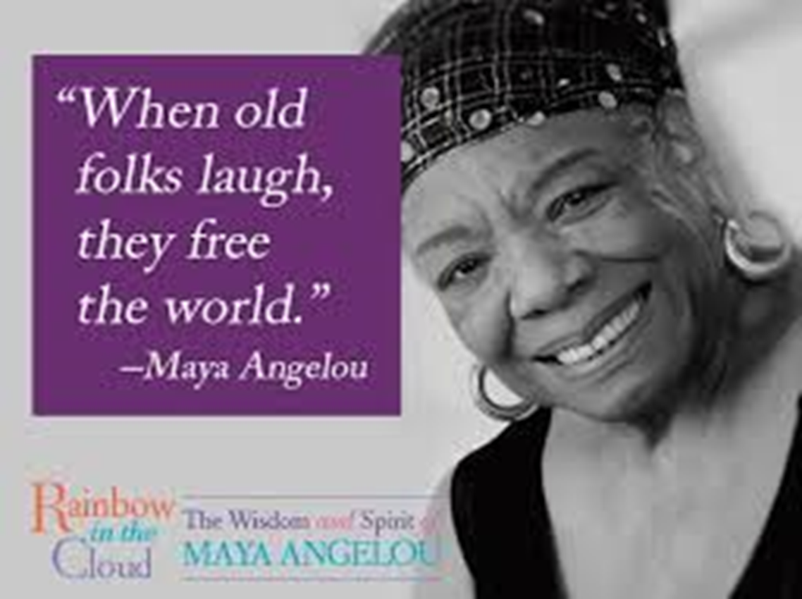
https://www.biography.com/people/geoffrey-chaucer-9245691

Slide 3
Maya Angelou
Maya Angelou was born on April 4, 1928 as Marguerite Ann Johnson in St. Louis, Missouri, America.
She was a spokesperson for the blacks and the women.
As a civil rights activist Angelou worked with Martin Luther king and Malcolm X

Slide 4
She was the first black woman poet to read her poem (on the pulse of morning) at the inauguration of president Bill Clinton in 1993.
Angelou's most famous autobiography, 'I Know Why The Caged Bird Sings' (1969) describes a shattering movement in her life.
Maya Angelou was nominated for the national booker award in 1970 , and for the Pulitzer price in 1971

Slide 5
The poem describes about old people, who no longer practice simpering and feel free to laugh as they wish.
They don't bother the people around them, their laugh is an act of liberation.
Their only weakness are slow movements and inability to hold their head steadily.
And finally their experience of the world has made peace with all that has occurred in their lives.

Slide 6
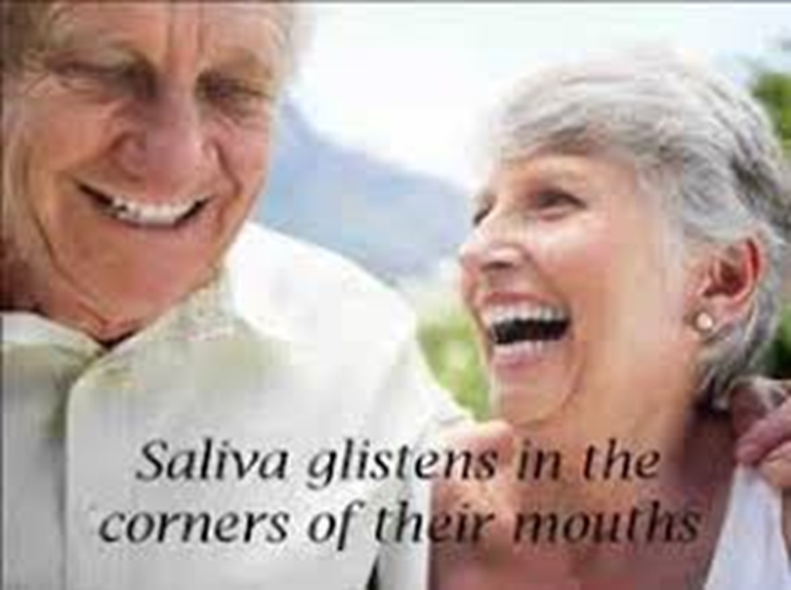
They teach how to laugh free and welcome death which will release them from all impediments.

Slide 7
Poetical View
The poem is written in free verse.
There is no fixed rhyme structure.
There is considerable variation in the line length. Large part is written in short lines using run on lines (enjambment).

Slide 8
Figures of Speech
Simile
‘Old folks allow their bellies to jiggle like slow tambourines’
When the old folks laugh their entire body shakes, bellies goes up and down or from side to side like tambourines jiggles. Tambourine is a musical instrument, which is played by shaking or hitting on it, so the poet compared the old folks bellies with tambourine.

Slide 9
Metaphor
'The hollers rise up and spill over any way they want'
It is the celebration of the old age. Here their laugh is compared to a liquid being poured into a container and then spilling over the edges of the container and even their laugh will free the world that means it will even affect those who are around him.

Slide 10
“dear and painless” ::Death
certainty of the death
Death is important to old people, with it comes their relief from frailty.
'Dear' shows us that they have accepted their fate and are thus at peace. And they want dear death to take them to a painless world.Life for them is a mere inconvenience.

Slide 11
POETIC forms
THE ELEGY
a sad poem, usually written to praise and express sorrow for someone who is dead
The purpose of this kind of poem is to express feelings rather than tell a story
Examples:
In Memory of W.B. Yeats - W.H. Auden
Lycidas – John Milton

Slide 12
REFERENCE
www.universityofcalicut.info/SDE/sde429.pdf

