Slide 1
Biopesticides
Sreesaila N P
Assistant Professor
Department of Biotechnology St. Mary’s College Thrissur

Slide 2
WHAT ARE BIOPESTICIDES ??
Derived from natural materials as animals, plants, bacteria, and certain minerals.
Eg ;Canola oil and Baking soda.
1401 biopesticide productive registered till now
Biopesticides ,Sreesaila N P, St. Mary's College

Slide 3
Classes of Biopesticides
Biochemical
Microbial
Plant Incorporated Protectants (PIPs)
Biopesticides ,Sreesaila N P, St. Mary's College

Slide 4
Biochemical Biopesticides
Naturally occurring- control pests by non – toxic mechanisms.
Includes Insect Sex Pheromones, various Scented Plant Extracts – attract pests to trap.
Sometimes difficult to determine – substance meets criteria for the classification as biochemical pesticides.
Biopesticides ,Sreesaila N P, St. Mary's College

Slide 5
Microbial pesticides
Consists of microorganism – active ingredient
Eg; bacterium, fungus, virus, protozoan
Control many kinds of pests
Each one specific to target pests.
eg; fungi controls certain weeds and some fungi kills the specific insects
Bacillus thuringiensis (Bt) widely used species.
Biopesticides ,Sreesaila N P, St. Mary's College

Slide 6
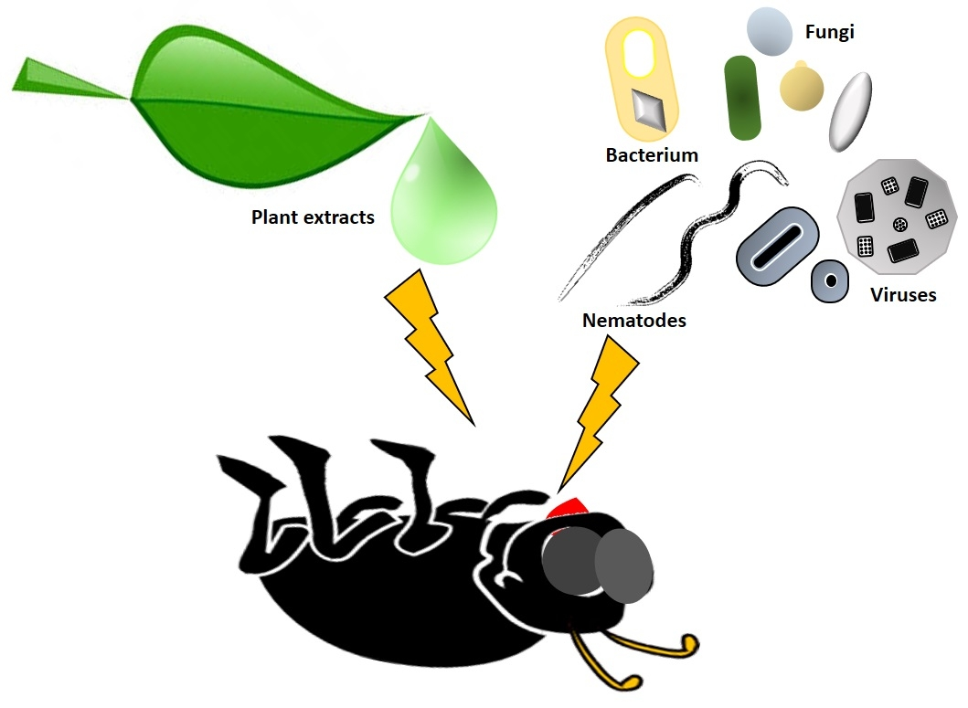
Bacillus thuringiensis
Each strain produces different mix of proteins – specifically kills one or few related species of insect larvae.
Control on larvae of Moth, Flies and Mosquitoes.
Bt produces protein – binds to gut receptor – causing insect larvae to starve- die.
Biopesticides ,Sreesaila N P, St. Mary's College

Slide 7
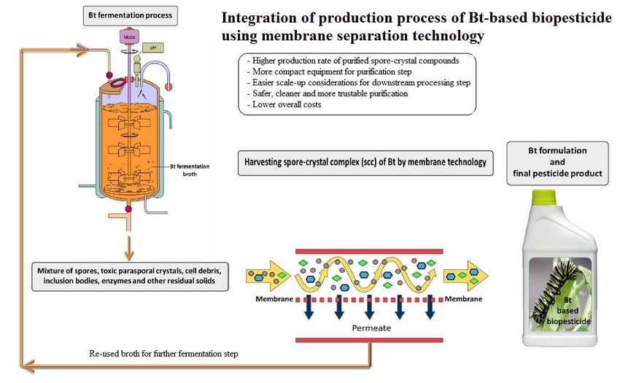
Biopesticides ,Sreesaila N P, St. Mary's College

Slide 8
Plant Incorporated Protectants (PIPs)
Plants produce from genetic material – incorporated to the plant.
Gene of Bt pesticidal protein, introduce into plants genetic material
Plant- manufactures the substance – kills the pest.
Biopesticides ,Sreesaila N P, St. Mary's College

Slide 9
Bactericide and Fungicide
Chromobacterium subtsugae – white flies, stink bug, cucumber beetle
Neem oil / Azadiractin – many insects
Beauveria bassiana – white flies, mites.
Streptomyces lydicus – soil pathogens
Coniothyrium minitans – Sclerotinia sp.
Pseudomonas fluorescence – fire blight
Biopesticides ,Sreesaila N P, St. Mary's College

Slide 10
RNAi
Spray on insecticides
Monsanto , Bayer
RNA modified to maintain its effectiveness on target sp.
Used in roundup herbicide.
Variety on potato beetles.
Biopesticides ,Sreesaila N P, St. Mary's College

Slide 11
Advantages
Inherently less toxic than conventional pesticides.
Affects only to target pets and closely related organisms.
Not broad spectrum oriented
Effective in very small quantities
Decompose quickly.
Avoiding pollution problems.
Can be used as a component of integrated pest management program.
Crop yields remain high. Amenable to small scale, local production in developing countries.
Increased public awareness of environment and food safety
Products are available in even small markets
Biopesticides ,Sreesaila N P, St. Mary's College

Slide 12
REFERENCE
Regulating Biopesticides. Environment Protection Agency of the USA (2012). Accessed on 20 April 2012.
National pesticide information center November 21, 2013. Plant incorporated protectants (PIPs)/Genetically modified plants.
Biopesticides ,Sreesaila N P, St. Mary's College

