Slide 1
COMMUNITY HEALTH
Deepa Francis
Assistant Professor
Department of Social Work
St. Mary’s College
Thrissur-680020
Kerala

Slide 2
Community Health,Deepa Francis,St.Mary’s College

Slide 3
Community health
All the personal health and environmental services in any human community ,irrespective of whether such services were public or private ones.
Definition:
The WHO defines community health as:“Environmental, social, and economic resources to sustain emotional and physical well being among people in ways that advance their aspirations and satisfy their needs in their unique environment”
Community Health,Deepa Francis,St.Mary’s College

Slide 4
Concepts of prevention
To promote health
To preserve
To restore
To minimize suffering and illness.
Objective of preventive medicine is to intercept or oppose the cause and there by the disease process.
Levels of prevention
Primordial prevention
Primary prevention
Secondary prevention
Tertiary prevention
Community Health,Deepa Francis,St.Mary’s College

Slide 5
Primordial prevention
Receiving special attention in the prevention of chronic diseases.
Prevention of development of risk factors
Discouraging children from adopting harmful lifestyles.
Primary prevention
Action taken prior to the onset of disease ,which removes the possibility that a disease will ever occur.
Intervention in the pre pathogenesis phase of a disease.
Measures designed to promote health and well being.
Holistic approach
Community Health,Deepa Francis,St.Mary’s College

Slide 6
Secondary prevention
Action which halts the progress of a disease at its incipient stage and prevents complications.
Early diagnosis and adequate treatment
Domain of clinical medicine.
Health programmes by the Govt.
Drawback: loss of productivity
More expensive and less effective than primary prevention
Community Health,Deepa Francis,St.Mary’s College

Slide 7
Tertiary prevention
Intervention in the late pathogenesis phase.
All measures available to reduce or limit impairments and disabilities ,minimize suffering caused by existing departures from good health and to promote the patient’s adjustment to irremediable conditions.
Tertiary prevention extends the concept of prevention into fields of rehabilitation.
Rehabilitation.-psycho social, vocational and medical components
Community Health,Deepa Francis,St.Mary’s College

Slide 8
BIO PSYCHO SOCIAL MODEL OF HEALTH AND ILLNESS
The bio psycho social model proposed by George Engel
Health, wellness, and disease are dependent upon the interaction between three factors: biological or physiological factors, psychological or mental factors, and social factors.
Community Health,Deepa Francis,St.Mary’s College

Slide 9
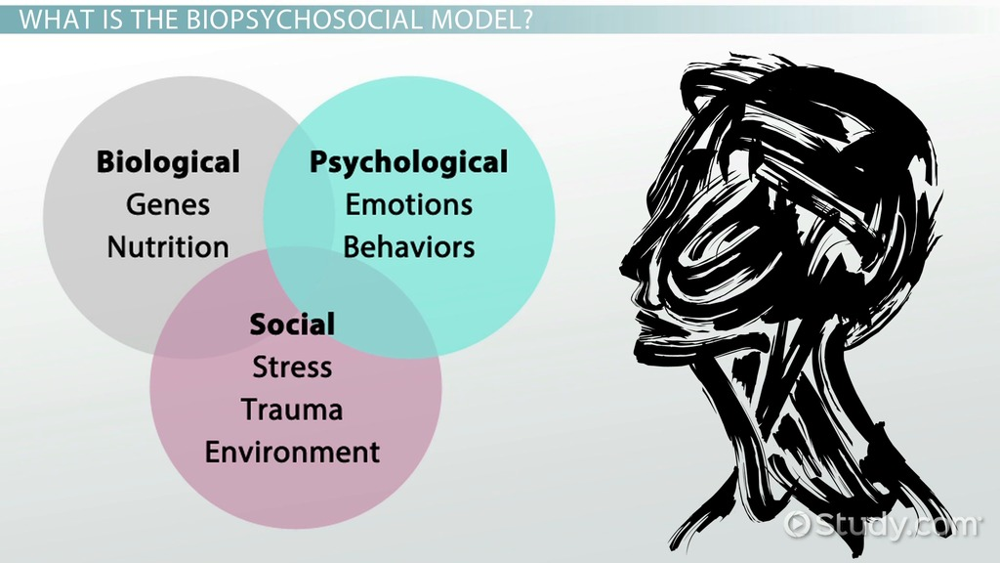
Community Health,Deepa Francis,St.Mary’s College

Slide 10
Conclusion
Community health is of great importance as it focused on health promotion and disease prevention. It is the responsibility of health care policy makers to plan health strategies that enhance the health at different geographical areas with equal opportunities of health care services to all.
Community Health,Deepa Francis,St.Mary’s College

