Slide 1
Dihedral Groups
Diana Mary George
Assistant Professor
Department of Mathematics
St. Mary’s College
Thrissur-680020
Kerala

Slide 2
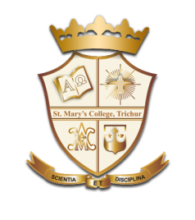
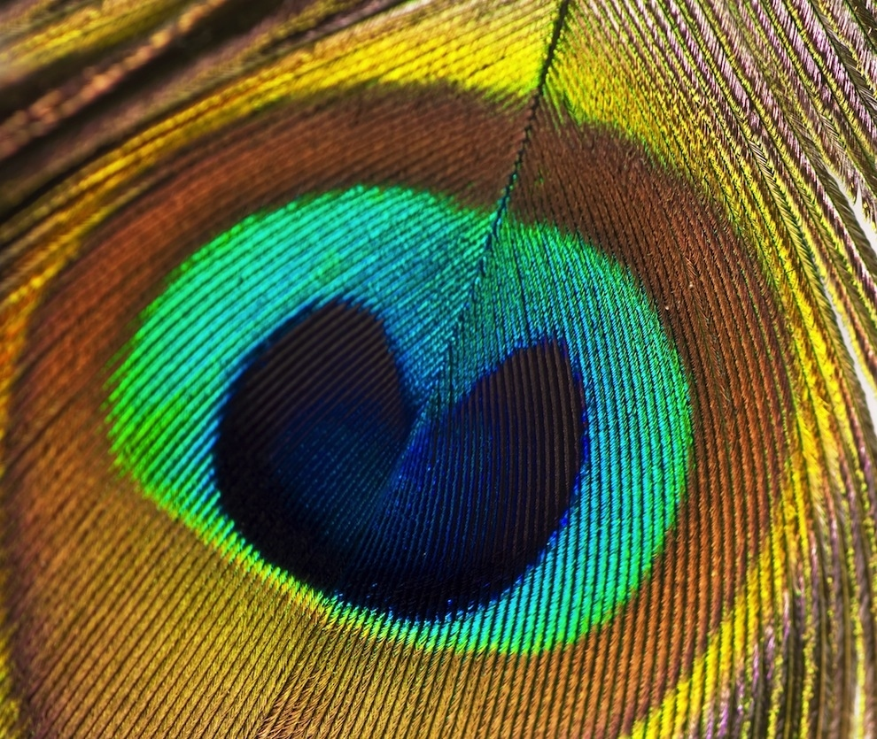
Symmetry in everyday language refers to a sense of harmonious and beautiful proportion and balance.
Dihedral Groups,Diana Mary George,St.Mary’s College

Slide 3
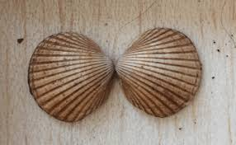
Types Of Symmetry
Line Symmetry
Rotational Symmetry
Dihedral Groups,Diana Mary George,St.Mary’s College

Slide 4
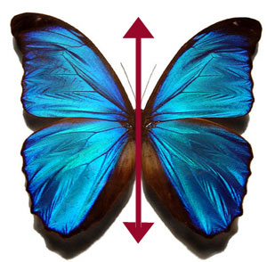
Line Symmetry
An object has line symmetry or reflective symmetry when it is the same on both sides of a line drawn down the middle.
Dihedral Groups,Diana Mary George,St.Mary’s College

Slide 5
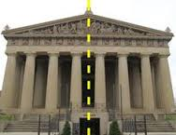
Dihedral Groups,Diana Mary George,St.Mary’s College

Slide 6
Plane Or Reflectional Symmetry
A figure which does not change upon undergoing a reflection has reflectional symmetry.
Dihedral Groups,Diana Mary George,St.Mary’s College

Slide 7
Dihedral Groups,Diana Mary George,St.Mary’s College

Slide 8
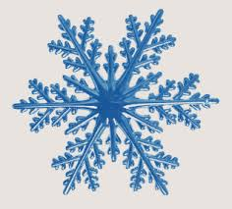
Rotational Symmetry
An object is said to have rotational symmetry if it remains the same after being rotated around a central point.
Dihedral Groups,Diana Mary George,St.Mary’s College

Slide 9
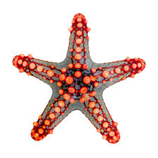
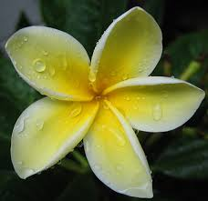
Dihedral Groups,Diana Mary George,St.Mary’s College

Slide 10
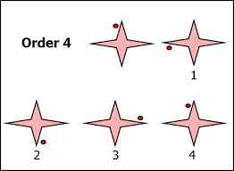
Order Of Rotational Symmetry
The number of positions a figure can be rotated to, without bringing in any changes to the way it looks originally, is called its order of rotational symmetry.
Dihedral Groups,Diana Mary George,St.Mary’s College

Slide 11
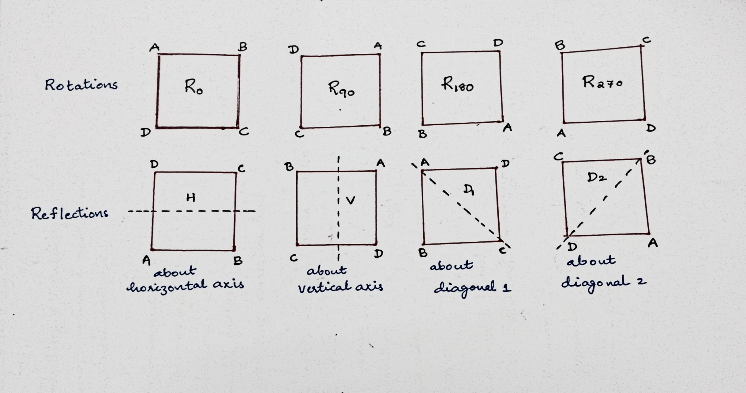
SYMMETRIES OF A SQUARE
Dihedral Groups,Diana Mary George,St.Mary’s College

Slide 12
Composition Of Motions
*
=
*
=
Dihedral Groups,Diana Mary George,St.Mary’s College

Slide 13
*
Dihedral Groups,Diana Mary George,St.Mary’s College

Slide 14
Observations
Dihedral Groups,Diana Mary George,St.Mary’s College

Slide 15
Applications
Dihedral Groups,Diana Mary George,St.Mary’s College

