Slide 1
Lifestyle Diseases & Its Management
Lt.Anu D.Alappat
Assistant Professor
Department of Physical Education
St. Mary’s College Thrissur

Slide 2
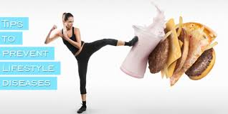
Lifestyle diseases
Diseases caused by sedentary Lifestyle
Diseases caused due to lack of Exercises
Lifestyle Diseases & Its Management, Lt.Anu D.Alappat,St.Mary’s College,Tcr

Slide 3
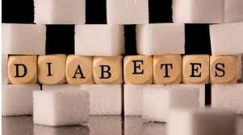
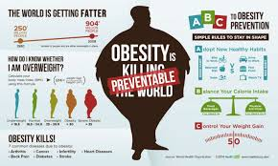
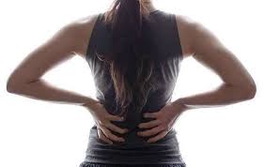
Main Life Style Diseases
Diabetics
Obesity
Osteoporosis
Back Pain
Lifestyle Diseases & Its Management, Lt.Anu D.Alappat,St.Mary’s College,Tcr

Slide 4
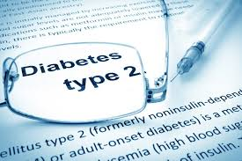
Diabetes
A Metabolic diseases caused by defective utilization of sugar by the body..
Types of Diabetes
Type 1
Type 2
Type 1 is the insulin dependent diabetes mellitus.
Type 2 is the non insulin dependent mellitus.
Lifestyle Diseases & Its Management, Lt.Anu D.Alappat,St.Mary’s College,Tcr

Slide 5
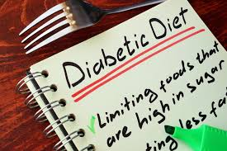
Causes of Diabetes
Lack of exercise
High blood Pressure
Aging
Overweight
Heredity
Food selection
Drug abuse
Management
Regular Exercise
Avoid overeating
Periodical glucose check up
Medical treatment
Lifestyle Diseases & Its Management, Lt.Anu D.Alappat,St.Mary’s College,Tcr

Slide 6
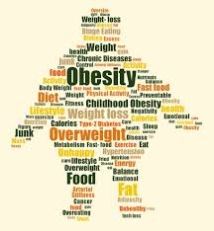
Obesity
Diseased condition caused by excessive amount of adipose tissue in the body.
Condition of the body in which there is excessive deposit of fat.
Defined as excessive enlargement of body’s total quantity of fat.
Lifestyle Diseases & Its Management, Lt.Anu D.Alappat,St.Mary’s College,Tcr

Slide 7
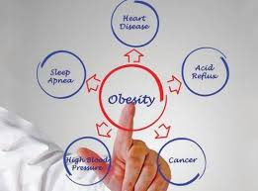
Causes of Obesity
Lack of exercise
Over eating
Aging
Mind set up
Heredity
Food selection
Drug abuse
Management
Regular Exercise
Eat balanced diet & fibre rich food
Avoid fast food &junk food
Medical treatment
Lifestyle Diseases & Its Management, Lt.Anu D.Alappat,St.Mary’s College,Tcr

Slide 8
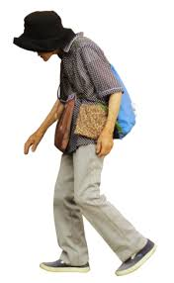
Osteoporosis
Disease caused by decreased bone density.
Bone becomes very thin & brittle.
Lead to fracture of bones
Known as silent disease.
Lifestyle Diseases & Its Management, Lt.Anu D.Alappat,St.Mary’s College,Tcr

Slide 9
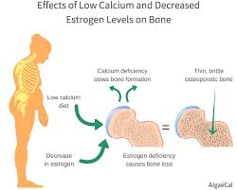
Causes of Osteoporosis
Lack of exercise
Deficiency of calcium
Aging
Weak muscle
Vitamin D deficiency
Management
Exercise for strengthen muscle
Calcium intake
Lifestyle Diseases & Its Management, Lt.Anu D.Alappat,St.Mary’s College,Tcr

Slide 10
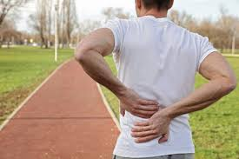
Back Pain
Back bones are delegate and sensitive bones of human body.
Back bones are not meant for acrobatics.
Less range of motion is possible at back bones.
Lifestyle Diseases & Its Management, Lt.Anu D.Alappat,St.Mary’s College,Tcr

Slide 11
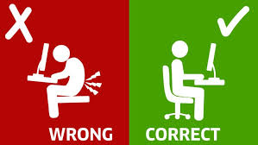
Causes of Back Pain
Weak posture muscles
Diseases in Joints.
Structural deformities
Malnutrition
Bad posture
Management
Regular Exercise
Give rest & relaxation to back muscles.
Strengthen ligaments & muscles at back.
Balanced Diet.
Lifestyle Diseases & Its Management, Lt.Anu D.Alappat,St.Mary’s College,Tcr

Slide 12
REFERENCE
Shirley,Telles; Nagarathna,H.R. & Desiraju, T. (1993) “Physiological changes through activities”.Indian Journal of Medical Sciences.
Kamalesh M.L.(1983).”Psychology of physical education & sports”.Metropolitan Books com.Pvt Ltd.
Lifestyle Diseases & Its Management, Lt.Anu D.Alappat,St.Mary’s College,Tcr

