Slide 1
Yoga For Stress Relief
Lt.Anu D.Alappat
Assistant Professor
Department of Physical Education
St. Mary’s College Thrissur

Slide 2
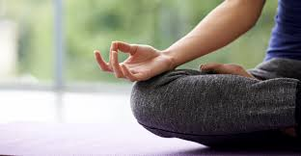
Definition
YOGA
Yoga is defined as a technique
for gaining control over the mind.
STRESS
Stress is defined as the imbalance between demand & resources.
Yoga for stress relief, Lt.Anu D.Alappat,St.Mary’s College

Slide 3
Stress relief- Pranayama
Pranayama is Breathing. Pranayama is the practice of controlling the breath, which is the source of our prana. Pranayama is a combination of systematic exhalation and inhalation.
Yoga for stress relief, Lt.Anu D.Alappat,St.Mary’s College

Slide 4
Stress relief- Pranayama
Chandra bhedana
In this we inhale through left nostril & Exhalation through right nostril This is cooling Pranayama.
Technique:
Sit in Vjrasana
Adopt Nasika Mudra
Close right nostril with thumb & inhale through left nostril
Close left nostril with little finger & open right nostril
Exhale through right nostril.
Yoga for stress relief, Lt.Anu D.Alappat,St.Mary’s College

Slide 5
Stress relief- Pranayama
Suryabhedana
In this we inhale through right nostril & Exhalation through left nostril. This is heating pranayama.
Technique:
Sit in Vjrasana
Adopt Nasika Mudra
Close left nostril with little finger & inhale through right nostril
Close right nostril with thumb & open left nostril
Exhale through left nostril.
Yoga for stress relief, Lt.Anu D.Alappat,St.Mary’s College

Slide 6
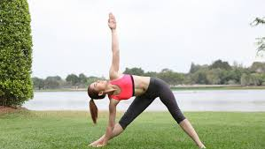
Stress relief Asanas - standing posture
Trikonasana
This asana improves our mental equilibrium and will make us more comfortable. It also reduces anxiety and stress. Thereby, it helps us to beat acidity & stress related stomach ailments .
Yoga for stress relief, Lt.Anu D.Alappat,St.Mary’s College

Slide 7
Stress relief Asanas - standing posture
Ardha Chakrasana
Ardha Chakrasana gives a good stretch to the entire body, improves balance, strengthens back and lower limbs, expands chest and shoulders, aids digestive system, relieves menstrual pain, improves coordination. It is a stress-reliever.
Yoga for stress relief, Lt.Anu D.Alappat,St.Mary’s College

Slide 8
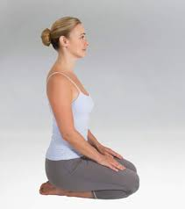
Stress relief Asanas - sitting posture
Vajrasana
This asana calms our mind and relaxes each and every nerves in our body. Slow and rhythmic breathing in this asana takes ourselves into a meditative state. By practicing this asana for people who face a high level of stress and for those whose jobs involve a lot of stress and pressure it gives more relief to the mind and to the body.
Yoga for stress relief, Lt.Anu D.Alappat,St.Mary’s College

Slide 9
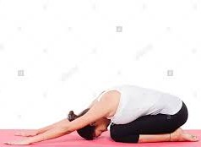
Stress relief Asanas - sitting posture
Sasangasana (Rabbit Pose)
By performing Sasangasana, it smoothens working of the thyroid gland and keep all hormones under control. It brings fresh blood supply to the crown of the head and relieves the stress. It also increases awareness of body and breathing.
Yoga for stress relief, Lt.Anu D.Alappat,St.Mary’s College

Slide 10
Stress relief Asanas – Prone Position
Bhujangasana (cobra pose)
By performing Bhujangasana our lungs will fully expand and collect a larger amount of oxygen. This helps the heart for smooth blood circulation. By this we will feel fitter and more energetic. So fatigue is relieved and you we can cope with stress more easily.
Yoga for stress relief, Lt.Anu D.Alappat,St.Mary’s College

Slide 11
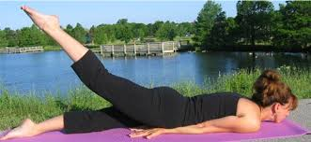
Stress relief Asanas – Prone Position
Ardha Salabhasana
By practicing this asana, it reduces abdominal fat and alleviates constipation. It also helps to remove backache and bronchial problems. Thus it reduces stress and it is best for stress management.
Yoga for stress relief, Lt.Anu D.Alappat,St.Mary’s College

Slide 12
REFERENCE
Prabhavananda,Swami.,(2002).Patanjali Yoga Sutras,Chennai:Sri.ramakrisha Math.
Saraswathi, Sathyananda Swami.,(2005) Yoga Nidra,Bhihar: Yoga publication Trust.
Patel, C.,(1973). “Yoga and biofeedback in the management of hyperextension.Lancet,Nov.19,1973.
Yoga for stress relief, Lt.Anu D.Alappat,St.Mary’s College

