Slide 1
H-Convexity in $R^{n}$
Parvathy K. S.
Associate Professor
Department of Mathematics
St. Mary’s College Thrissur

Slide 2
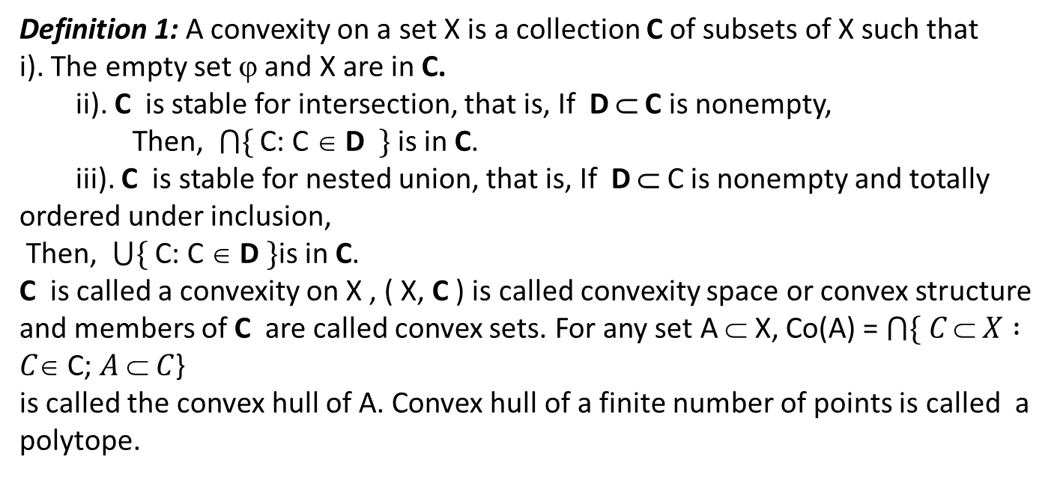
CONVEXITY- DEFINITIONS
Definition 1: A convexity on a set X is a collection C of subsets of X such that
i). The empty set ϕ and X are in C.
ii). C is stable for intersection, that is, If D ⊂ C is nonempty,
Then, $\bigcap{\{}$ C: C ∈ D $\}$is in C.
iii). C is stable for nested union, that is, If D ⊂ C is nonempty and totally ordered under inclusion,
Then, $\bigcup{\{}$ C: C ∈ D $\}$is in C.
C is called a convexity on X , ( X, C ) is called convexity space or convex structure and members of C are called convex sets. For any set A ⊂ X, Co(A) = $\bigcap{\{ C}⊂ X :C∈$C; $A  C$}
is called the convex hull of A. Convex hull of a finite number of points is called a polytope.
H-Convexity in $R^{n}$,Parvathy K S. St.Mary’s College

Slide 3
HALF SPACES
In geometry, a half-space is either of the two parts into which a plane divides the three-dimensional Euclidean space. More generally, a half-space is either of the two parts into which a hyperplane divides an affine space
H-Convexity in $R^{n}$,Parvathy K S. St.Mary’s College

Slide 4
The concept of half spaces is generalized as in the following definition.
Definition 2: [8] Let (( X, C )) be a convexity space, C ∈ C is said to be a half space if its compliment is convex.
H-Convexity in $R^{n}$,Parvathy K S. St.Mary’s College

Slide 5
Arity of Convex Structures
Definition 3: [] Let ( X, C ) be a convexity space. C is said to be of arity ≤ n if its convex sets are determined by polytopes. That is, a set C is convex if and only if Co(F) ⊂ C for each subset F of cardinality at most n.
H-Convexity in $R^{n}$,Parvathy K S. St.Mary’s College

Slide 6
Separation Axioms $S_{1}$ and $S_{2}$
Definition 4: [] A convexity space X is said to have the separation property
S₁ : If all singletons are convex.
S₂ : If any two distinct points are separated by half spaces. That is,
for any x₁, x₂ ∈ X, x₁ ≠ x₂, there is a half space H of X such that
x₁ ∈ H and x₂ ∉ H .
H-Convexity in $R^{n}$,Parvathy K S. St.Mary’s College

Slide 7
Separation Axioms $S_{3}$ and $S_{4}$
S₃ : If any convex set C and any point not in C can be separated by half spaces.
That is, if C ⊂ X and x ∈ X \ C, then there is a half space H of X such that
C ⊂ H and x ∉ H.
S₄ : If any two disjoint convex sets can be separated by half spaces. That is,
if C₁ and C₂ are disjoint convex subsets of X, then there is a half space H
such that C₁ ⊂ H and C₂ ⊂ X \ H.
H-Convexity in $R^{n}$,Parvathy K S. St.Mary’s College

Slide 8
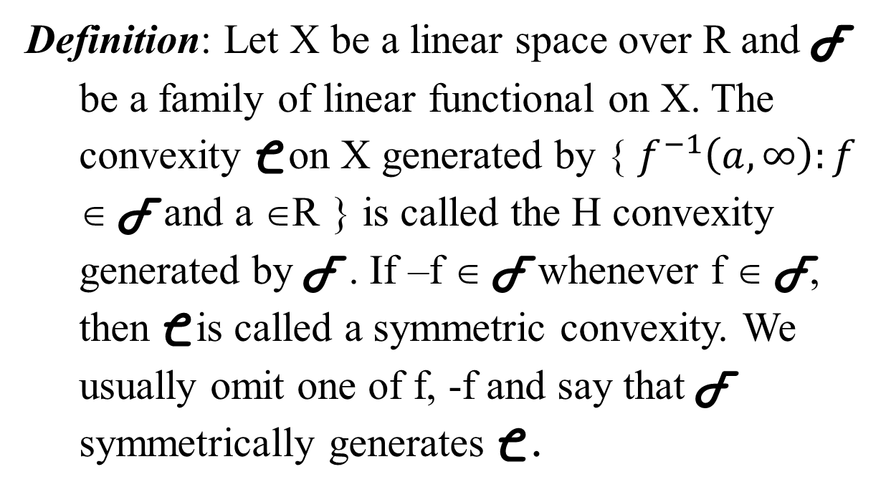
Symmetric H Convexity
Definition: Let X be a linear space over R and F be a family of linear functional on X. The convexity C on X generated by { $f^{−1}\left(a, ∞\right):f$ ∈ F and a ∈R } is called the H convexity generated by F . If –f ∈ F whenever f ∈ F, then C is called a symmetric convexity. We usually omit one of f, -f and say that F symmetrically generates C .
H-Convexity in $R^{n}$,Parvathy K S. St.Mary’s College

Slide 9
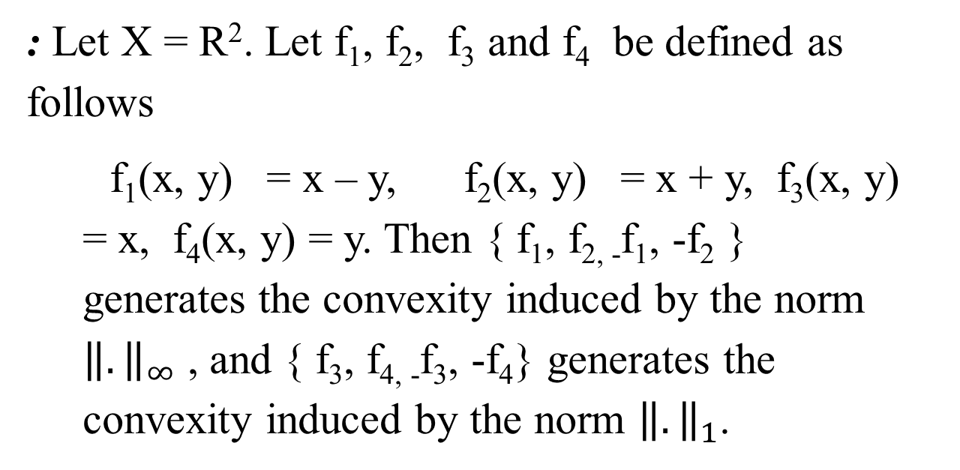
Example
: Let X = R². Let f₁, f₂, f₃ and f₄ be defined as follows
f₁(x, y) = x – y, f₂(x, y) = x + y, f₃(x, y) = x, f₄(x, y) = y. Then { f₁, f_{2, -}f₁, -f₂ } generates the convexity induced by the norm ${\left\|.\right\|}_{∞}$ , and { f₃, f_{4, -}f₃, -f₄} generates the convexity induced by the norm ${\left\|.\right\|}_{1}$.
H-Convexity in $R^{n}$,Parvathy K S. St.Mary’s College

Slide 10
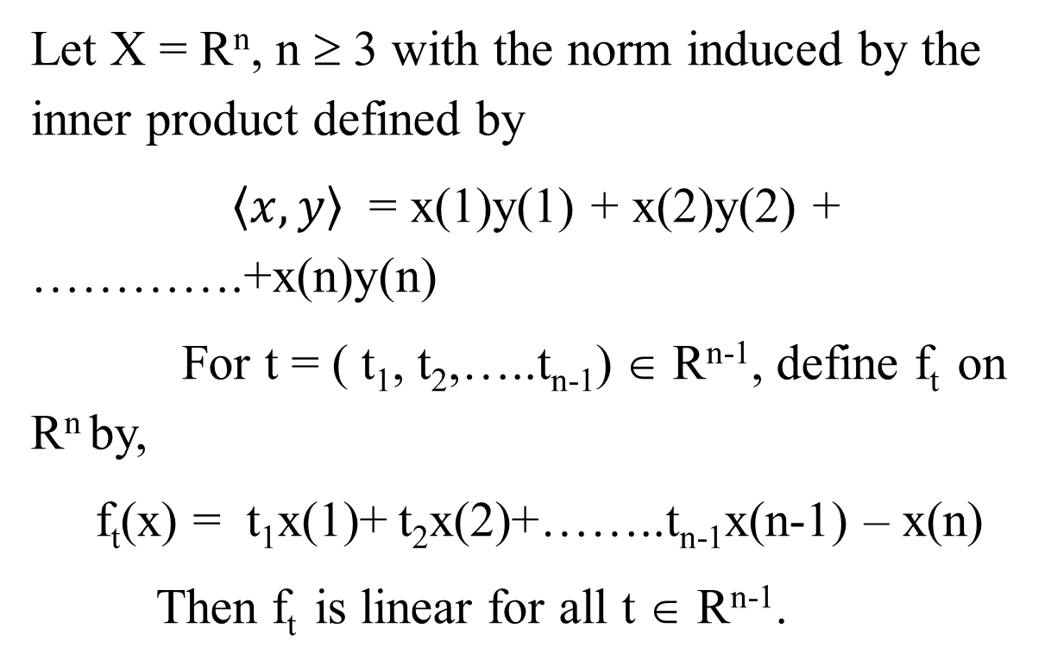
A Convexity of Infinite Arity
Let X = R^{n}, n ≥ 3 with the norm induced by the inner product defined by
$〈x,y〉$ = x(1)y(1) + x(2)y(2) + ………….+x(n)y(n)
For t = ( t₁, t₂,…..t_{n-1}) ∈ R^{n-1}, define f_{t} on R^{n} by,
f_{t}(x) = t₁x(1)+ t₂x(2)+……..t_{n-1}x(n-1) – x(n)
Then f_{t} is linear for all t ∈ R^{n-1}.
H-Convexity in $R^{n}$,Parvathy K S. St.Mary’s College

Slide 11
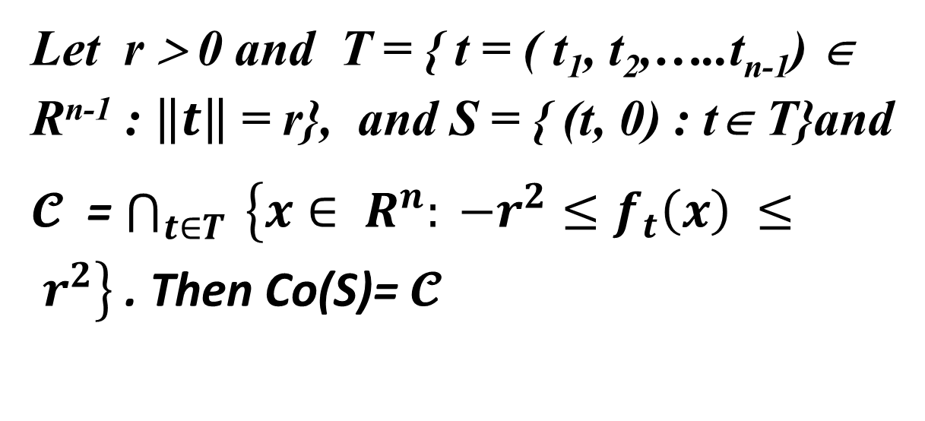
Let r > 0 and T = { t = ( t₁, t₂,…..t_{n-1}) ∈ R^{n-1} : $\left\|t\right\|$ = r}, and S = { (t, 0) : t∈ T}and
$𝓒$ = $\bigcap_{t∈T}{ \left\{x∈ R^{n}: −r^{2}≤f_{t}\left(x\right) ≤ r^{2}\right\} }$. Then Co(S)= $𝓒$
H-Convexity in $R^{n}$,Parvathy K S. St.Mary’s College

Slide 12
Let C = $\bigcap_{t∈T}{ \left\{x∈ R^{n}: −r^{2}≤f_{t}\left(x\right) ≤ r^{2}\right\} }$.
Then C is convex and S ⊂ C. Let C be the H convexity on R^{n} symmetrically generated by
F = { f_{t} : t ∈ T}.Then C is the convex hull of S.
Now consider the points c = (0,0,….,r²) and y′ = (0,0,….,-r²) .Then c and c′ are in C. Now Let
C′ = C ∼ { c, c′}. Then C′ ∉ $𝒞$
H-Convexity in $R^{n}$,Parvathy K S. St.Mary’s College

Slide 13
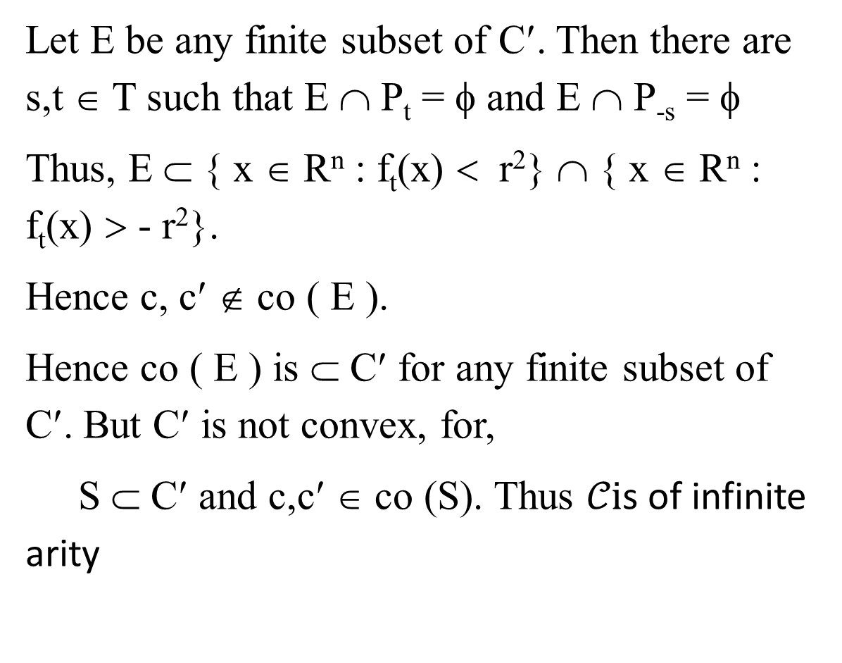
Let E be any finite subset of C′. Then there are s,t ∈ T such that E ∩ P_{t} = φ and E ∩ P_{-s} = φ
Thus, E ⊂ { x ∈ R^{n} : f_{t}(x) < r²} ∩ { x ∈ R^{n} : f_{t}(x) > - r²}.
Hence c, c′ ∉ co ( E ).
Hence co ( E ) is ⊂ C′ for any finite subset of C′. But C′ is not convex, for,
S ⊂ C′ and c,c′ ∈ co (S). Thus $𝒞i$s of infinite arity
H-Convexity in $R^{n}$,Parvathy K S. St.Mary’s College

Slide 14
REFERENCE
1. Lay S. R. “Convex Sets and Applications”
2. Leonard Berkowitz “Convexity and Optimizations in Rn”
3. Limaye B. V “ Functional Analysis”
4. Kesavan S. “Topics in Functional Analysis and Applications”
5. Van de Vel “Theory of Convex Structures” North Holland.
H-Convexity in $R^{n}$,Parvathy K S. St.Mary’s College

