Slide 1
CRYPTOGRAPHY
Sowmya K
Assistant Professor
Dept.of Mathematics
St.Mary’s College,Thrissur.

Slide 2
Terminology
Cryptography : It is the study of methods of sending messages in disguised form .
Plain text: The message we want to send.
Ciphertext: The message in disguised form.
Enciphering /encryption: The process of converting a plain text to a ciphertext.
Deciphering /decryption: The process of converting a ciphertext to a plaintext.
Cryptanalysis: It is the science of breaking secret messages.
Cryptography, Sowmya K, St.Mary’s College, Thrissur.

Slide 3
The plaintext and ciphertext are broken up into message units.
A message unit might be a single letter,a pair of letters(digraph),a triple of letters (trigraph) and so on.
Cryptography, Sowmya K, St.Mary’s College, Thrissur.

Slide 4
Substitution Ciphers
In this method,we substitute a letter of the alphabet for each letter of the plaintext.
Suppose we are using 26 letter alphabet A-Z with numerical equivalents 0-25.
Cryptography, Sowmya K, St.Mary’s College, Thrissur.

Slide 5
Around 50 B C the Roman emperor Julius Caesar sent encoded messages to his general Marcus T Cicero during the Gallic Wars, using a substitution cipher based on modular arithmetic.
A Ceasar cipher shifts each letter by three places to the right, described by the congruences C = P +3 (mod 26).
Cryptography, Sowmya K, St.Mary’s College, Thrissur.

Slide 6
Cryptography, Sowmya K, St.Mary’s College, Thrissur.

Slide 7
Cryptography, Sowmya K, St.Mary’s College, Thrissur.

Slide 8
Cryptography, Sowmya K, St.Mary’s College, Thrissur.

Slide 9
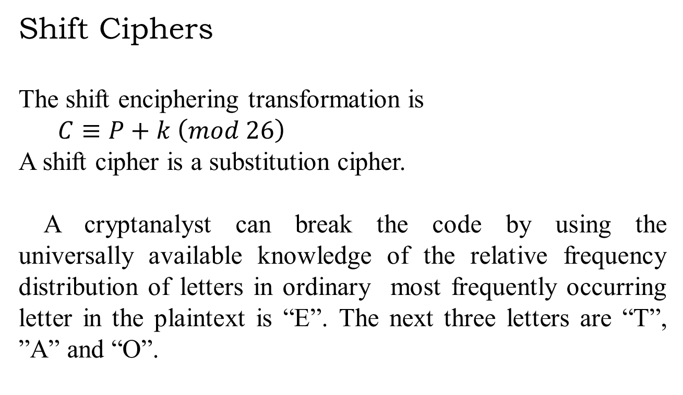
Shift Ciphers
The shift enciphering transformation is
$C≡P+k \left(mod 26\right)$
A shift cipher is a substitution cipher.
A cryptanalyst can break the code by using the universally available knowledge of the relative frequency distribution of letters in ordinary most frequently occurring letter in the plaintext is “E”. The next three letters are “T”, ”A” and “O”.
Cryptography, Sowmya K, St.Mary’s College, Thrissur.

Slide 10
Q.No.5: Decipher the following ciphertext using shift cipher “FQOCUDEM”.Suppose the most frequently occurring letter in the English language is “E” and “U” is the ,most frequently occurring character in the ciphertext.
Solution
The deciphering transformation is 𝑃≡𝐶−16 (𝑚𝑜𝑑 26)
The shift takes “E”=4 to “U”=20.
i.e., 20 ≡ 4+b mod 26
i.e.,b=16
Converting to numerical equivalents
5 16 14 2 20 3 4 12
Using the deciphering transformation ,
15 0 24 12 4 13 14 22
The plaintext is “PAYMENOW”.
Cryptography, Sowmya K, St.Mary’s College, Thrissur.

Slide 11
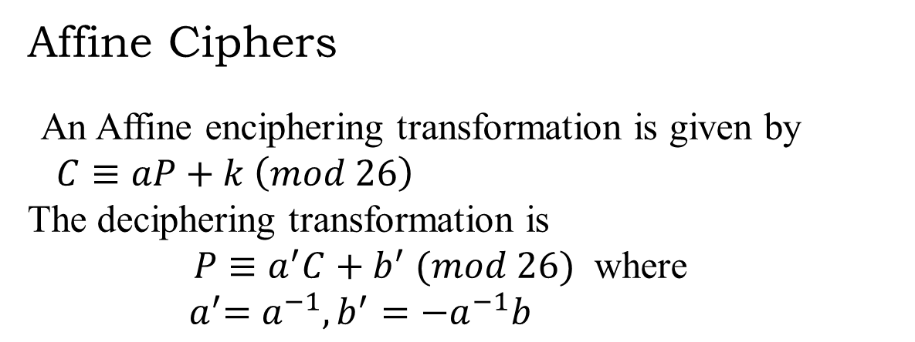
Affine Ciphers
An Affine enciphering transformation is given by
$C≡aP+k \left(mod 26\right)$
The deciphering transformation is
$P≡a^{′}C+b^{′} (mod 26)$ where ${ a}^{′}=a^{−1},b^{′}=−a^{−1}b$
Cryptography, Sowmya K, St.Mary’s College, Thrissur.

Slide 12
Q.No.6:Encipher the message “PAY ME NOW”using the affine transformation on 26 letter alphabet with a=7 ,b=12.
Solution
The enciphering transformation is 𝐶≡7𝑃+12 (𝑚𝑜𝑑 26)
Converting to numerical equivalents
15 0 24 12 4 13 14 22
7P: 105 0 168 84 28 91 98 154
7P+12: 117 12 180 96 40 103 110 166
Mod 26: 13 12 24 8 14 25 6 10
The ciphertext is “NMYSOZGK”
Cryptography, Sowmya K, St.Mary’s College, Thrissur.

Slide 13
Q.No.7:In the 27-letter alphabet (withblank=26),use the affine enciphering transformation with key a=13,b=9 to encipher the message “THRPXDH”
SOLUTION:
The deciphering transformation is P$≡a^{′}C+b^{′}(mod N)$ ,where $a^{′}$=$a^{−1}$and $b^{′}$=${ −a}^{−1}$b.
27 = 2 x 13 +1
i.e 1= 27 -( 2 x 13)
1=-2 x13
ie${13}^{−1}$=-2=25 (mod 27)
$a^{′}$=25 and $b^{′}$=-25x9=18
The numerical equivalents are 19 7 17 15 23 3 7
Corresponding P are 7 4 11 15 26 12 4
The plaintext is “HELP ME”
Cryptography, Sowmya K, St.Mary’s College, Thrissur.

Slide 14
The message units contain two-letter blocks called the digraphs.
If the plaintext has an odd number of letters, add an extra letter may be a blank or “X” or “Q”.
The numerical equivalent of each digraph is 𝑥𝑁+𝑦, where x is the numerical equivalent of the first letter, y is the numerical equivalent of the second letter and N is the number of letters in the alphabet.
Cryptography, Sowmya K, St.Mary’s College, Thrissur.

Slide 15
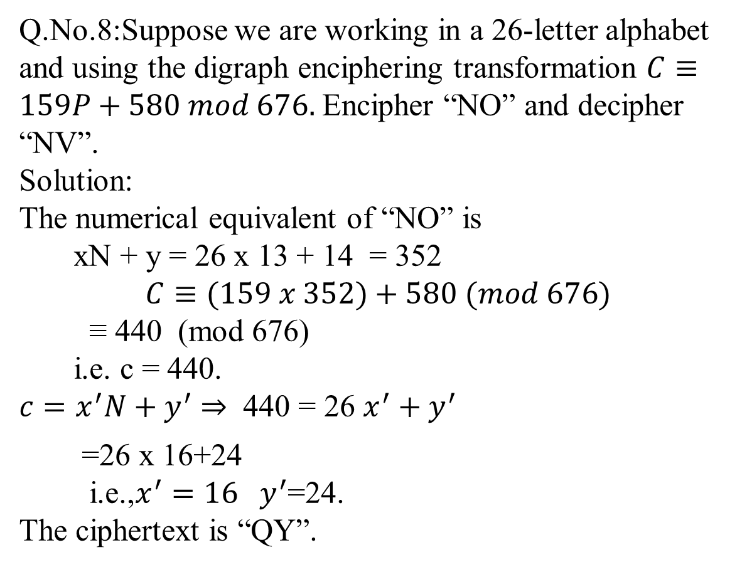
Q.No.8:Suppose we are working in a 26-letter alphabet and using the digraph enciphering transformation $C≡159P+580 mod 676.$ Encipher “NO” and decipher “NV”.
Solution:
The numerical equivalent of “NO” is
xN + y = 26 x 13 + 14 = 352
$$C≡(159 x 352)+580 (mod 676)$$
≡ 440 (mod 676)
i.e. c = 440.
$c=x^{′}N+y^{′}$ 440 = 26 $x^{′}+y^{′}$
=26 x 16+24
i.e.,$x^{′}=16 y^{′}$=24.
The ciphertext is “QY”.
Cryptography, Sowmya K, St.Mary’s College, Thrissur.

Slide 16
Q.No.9:Decipher the ciphertext “PWULPZTQAWHF” which was encrypted using the affine map on digraphs in the 26-letter alphabet.A frequency analysis shows that the most frequently occurring digraphs in the English language are “TH” and “HE”in that order and “IX” and “TQ”in that order.
Solution:
The enciphering key is P$≡a^{′}C+b^{′}$(mod ${26}^{2}$)
To find ${ a}^{′} , b^{′}$
501≡ 231 ${ a}^{′}$+${ b}^{′}$ (mod 676)
186≡ 510 $a^{′}$ +${ b}^{′}$(mod 676)
subtracting,
-279$a^{′}≡315 (mod 676)$
$a^{′}$≡${\text{(−279)}}^{−1}$ 315 (mod 676)
$a^{′}$$≡ − 63$ x 315 (mod 676)
$a^{′}$ ≡ 435 (mod 676)
${ b}^{′}$ =64 (mod 676)
Cryptography, Sowmya K, St.Mary’s College, Thrissur.

Slide 17
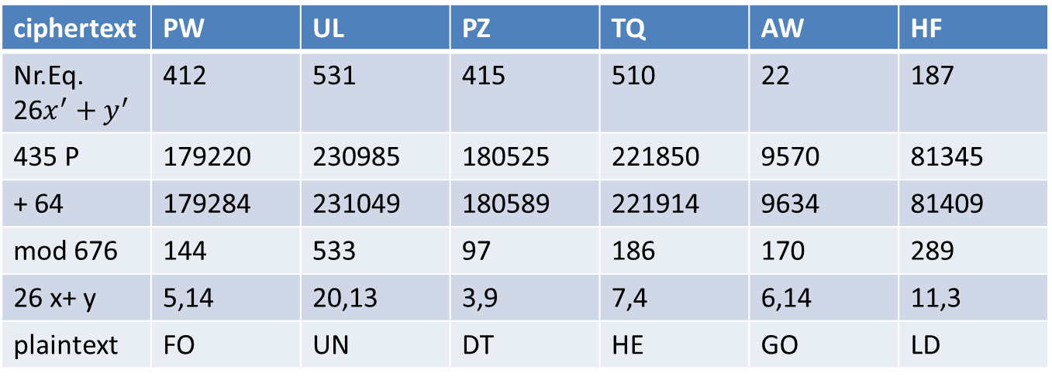
The plaintext is “FOUNDTHEGOLD”
Cryptography, Sowmya K, St.Mary’s College, Thrissur.

Slide 18
REFERENCE
Neal Koblitz, A Course in Number Theory and Cryptography, Springer Verlag, New York,1987.
Cryptography, Sowmya K, St.Mary’s College, Thrissur.

