Slide 1
Kālidāsa
Dr. K.I Treesa
Assistant Professor
Department of Sanskrit
St. Mary’s College Thrissur

Slide 2
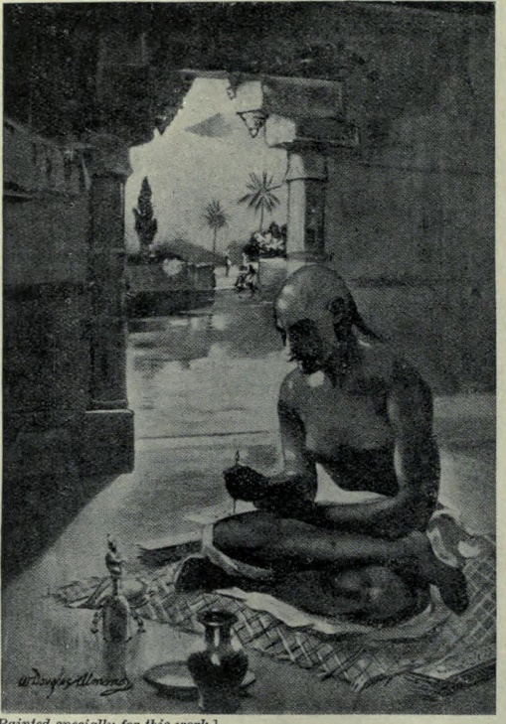
KĀLIDĀSA
Kālidāsa was a classical Sanskrit writer,
widely regarded as the greatest poet and
dramatist in the Sanskrit language of India.
His plays and poetry are primarily based on
the Vedas, the Ramayana, the Mahabharata
and the Puranas.
Much about his life is unknown, only what can be inferred from his poetry and plays. His works cannot be dated with precision, but they were most likely authored within the 4th-5th century CE.
.

Slide 3
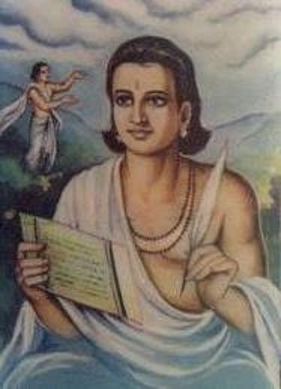
EARLY LIFE
Scholars have speculated that Kalidasa may have lived near the Himalayas, in the vicinity of Ujjain, and in Kalinga.
Lakshmi Dhar Kalla (1891-1953), a Sanskrit scholar and a Kashmiri Pandit, wrote a book titled The birth-place of Kalidasa (1926),

Slide 4
PERIOD
Several ancient and medieval books state that Kalidasa was a court poet of a king named Vikramaditya
The most popular theory is that Kalidasa flourished during the reign of Chandragupta II,
Indian scholars, such as Vasudev Vishnu Mirashi and Ram Gupta, also place Kalidasa in this period. According to this theory, his career might have extended to the reign of Kumaragupta I

Slide 5
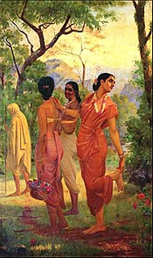
WORKS
Plays
Abhijnanashakuntala is the most famous and is usually judged the best Indian literary effort of any period, the work tells of the seduction of the nymph Shakuntala by King Dushyanta, his rejection of the girl and his child, and their subsequent reunion in heaven.

Slide 6
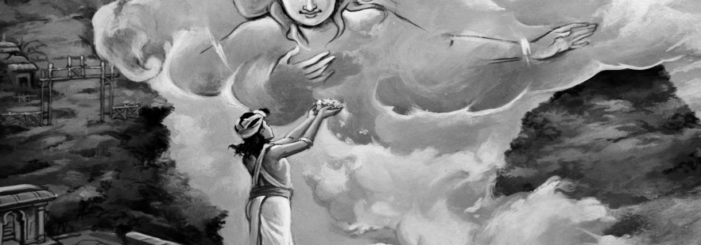
Vikramorvashi tells a legend as old as the Vedas, though very differently. Its theme is the love of a mortal for a divine maiden; it is well known for the “mad scene” (Act IV) in which the king, grief-stricken, wanders through a lovely forest apostrophizing various flowers and trees as though they were his love.
Malavikagnimitra, is of a different stamp—a harem intrigue, comical and playful, but not less accomplished for lacking any high purpose. The play contains datable references, the historicity of which have been much discussed.

Slide 7
Poems
Epics
Raghuvaṃśa The first recounts the legends of the hero Rama’s forebears and descendants.
Kumārasambhava tells the picaresque story of Shiva’s seduction by his consort Parvati, the conflagration of Kama , and the birth of Kumara.
Minor poems
Ṛtusaṃhāra describes the six seasons by narrating the experiences of two lovers in each of the seasons.
Meghadūta
which is the story of a Yaksha trying to send a message to his lover through a cloud and it also describes the mountains, rivers, and forests of northern India.

Slide 8
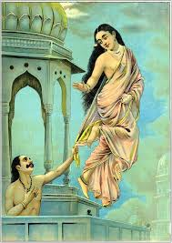
Translations
Montgomery Schuyler, Jr. published a bibliography of the editions and translations of the drama Shakuntala while preparing his work "Bibliography of the Sanskrit Drama".
Sir William Jones published English translation of Sakuntala in 1791 C.E. and Rtusamhar was published by him in original text during
1792 C.E.

Slide 9
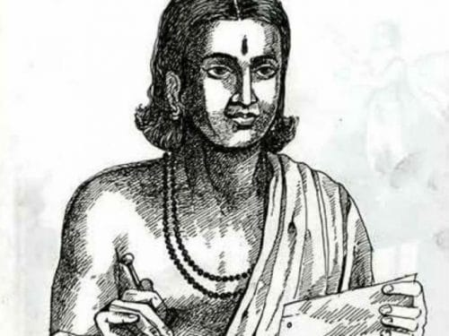
CONCLUSION
The society reflected in Kalidasa’s work is that of a courtly aristocracy sure of its dignity and power. Kalidasa has perhaps done more than any other writer to wed the older, Brahmanic religious tradition, particularly its ritual concern with Sanskrit, to the needs of a new and brilliant secular Hinduism.
Kalidasa, Dr.K.I. Treesa, St Mary's College

Slide 10
REFERENCES
"Kalidasa - Kalidasa Biography - Poem Hunter". www.poemhunter.com. Retrieved 5 October 2015.
Kālidāsa (2001). The Recognition of Sakuntala: A Play In Seven Acts. Oxford University Press. pp. ix. ISBN 9780191606090.
Kalidasa at the Encyclopædia Britannica

