Slide 1

Mushroom polysaccharides in the prevention and treatment of cancer
Dr C R Meera
Assistant Professor & HOD
Department of Microbiology
St. Mary’s College, Thrissur

Slide 2
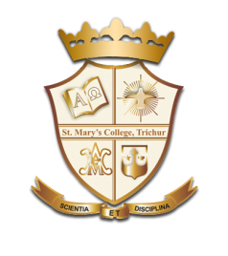
Understanding Cancer
Cancer cells reproduce every 2-6 weeks.
Cancer is a large group of diseases (over 200) characterized by uncontrolled growth and spread of abnormal cells
Mushroom PS in prevention and treatment of cancer, Dr C R Meera, St Mary’s College

Slide 3
Cancer ≠ Tumors
Tumor - spontaneous new tissue growth that serves no physiological purpose. It can be benign, like a wart, or malignant, like most lung cancers.
Benign - noncancerous; tumors that do not spread
Malignant- the property of spreading locally and to distant sites.
Metastasis: The spreading of disease from one part of the body to another. Cancer cells can be spread via blood vessels or the lymphatic system
However, the terms malignant tumor is synonymous with cancer.
Mushroom PS in prevention and treatment of cancer, Dr C R Meera, St Mary’s College

Slide 4
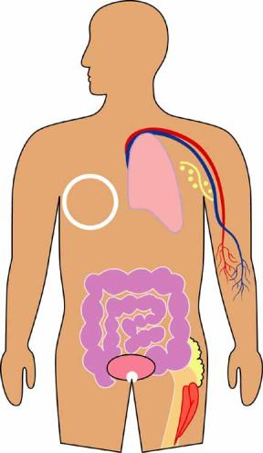
Types of Cancer
Carcinomas (cells that cover internal and external body surfaces)
Lung
Leukemia (Blood Cells)
Breast
Lymphomas
(Lymph nodes &tissues)
Colon
Sarcomas
Cells in supportive tissues – bones & muscles
Bladder
Prostate (Men)
Image Taken from Slideshare
Mushroom PS in prevention and treatment of cancer, Dr C R Meera, St Mary’s College

Slide 5
Cancer Statistics Of India
Every year ~ 85,0000 new cancer cases ; about 58,0000 cancer related death
India has the highest number of the oral and throat cancer cases in the world.
Every third oral cancer patient in the world is from India.
Males -- Oral, Lungs and Stomach cancers
Females -- Cervical, Breast and Oral cancers
Overall cervical cancer is the number one cause of cancer death in India.
Mushroom PS in prevention and treatment of cancer, Dr C R Meera, St Mary’s College

Slide 6
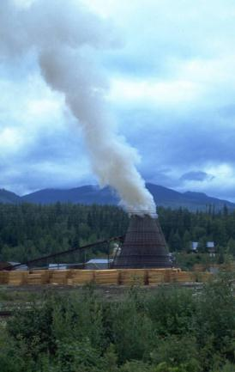
What Causes Cancer?
External factors
Tobacco and Second hand smoke
Air pollution
Industrial pollution
Chemical exposures
Radiations
Infectious organisms
Dramatic poetry
Environment
Mushroom PS in prevention and treatment of cancer, Dr C R Meera, St Mary’s College

Slide 7
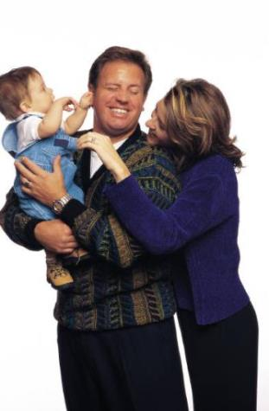
Internal Factors
Inherited mutations
Hormones
Immune conditions
Mutations that occur from metabolism
Mushroom PS in prevention and treatment of cancer, Dr C R Meera, St Mary’s College

Slide 8
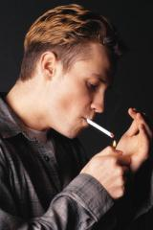

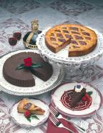
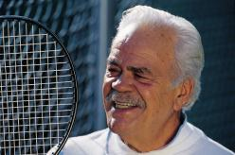
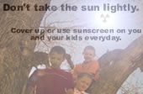
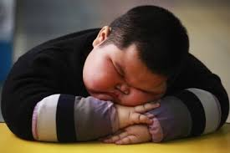
Lifestyle Risks
Smoking
Alcoholism
Diet high fat and low in fruits and vegetables
Lack of exercise
Unprotected exposure to the sun, (UV) rays
Obesity
Mushroom PS in prevention and treatment of cancer, Dr C R Meera, St Mary’s College

Slide 9
How to treat Cancer?
A variety of treatment options for cancer therapy
Surgery
Radiation
Chemotherapy
Depend on
Cancer type
Spread situation
Mushroom PS in prevention and treatment of cancer, Dr C R Meera, St Mary’s College

Slide 10
Surgery can cure cancers when they have not yet metastasized
In 1890, mastectomy performed for first time
Breast cancer: complete removal of the breast cancer
In 1900s: surgical techniques established for remove tumors
New techniques
  Laser surgery
  Electrosurgery: electrical current
  Cryosurgery: liquid nitrogen
  High-intensity focused ultrasound (HIFU)
Surgical removal of the primary tumor is frequently followed by radiation, chemotherapy, or both
Mushroom PS in prevention and treatment of cancer, Dr C R Meera, St Mary’s College

Slide 11
Radiation therapy kills cancer cells by triggering apoptosis or mitotic death
In some cases, surgery is not even practical
  Brain tumor
  Leukemias
Radiation therapy
  High-energy X-rays
  Ionizing radiations
Apoptosis and mitotic death
Mushroom PS in prevention and treatment of cancer, Dr C R Meera, St Mary’s College

Slide 12
Chemotherapy
Use of drugs that circulate in the bloodstream to reach cancer cells wherever they may reside
Drugs for inhibition cancer cells proliferation
Mushroom PS in prevention and treatment of cancer, Dr C R Meera, St Mary’s College

Slide 13
Adverse effects of conventional therapies
Damage to
Hematopoietic tissue
Gastrointestinal mucosa
Gonads
skin
Survival should not be the sole criterion for assessing the treatment results!!
Mushroom PS in prevention and treatment of cancer, Dr C R Meera, St Mary’s College

Slide 14
Biological response modifiers (BRMs)
Fourth method of cancer treatment – Immunotherapy
BRMs are best choice for immunotherapy
BRMs prevent carcinogenesis and induce carcinostasis
Also can be used as adjuncts to conventional treatments of cancer
BRMs are safe for long term use without side effects
Mushroom PS in prevention and treatment of cancer, Dr C R Meera, St Mary’s College

Slide 15
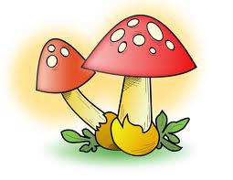
Bioactive compounds of mushrooms
Polysaccharides - the best known and most potent mushroom derived substances
Glycoproteins
Proteoglycans
Terpenoids
Fatty acids
Proteins
Minerals and vitamins
Mushroom PS in prevention and treatment of cancer, Dr C R Meera, St Mary’s College

Slide 16
Mushroom polysaccharides as anticancer agents
History
Lucas et al. (1957) - anti-tumor effect of higher basidiomycetes (specifically extracts of fruiting bodies of Boletus edulis).
Yohida et al. (1962)- Lampteromyces japonicus (kowamura) Sing, an agent active against Ehrlich carcinoma of the mouse.
Gregory (1966) -More than 7000 cultures of higher basidiomyces for anti-tumor activity against rodent tumor systems. Positive inhibitory effects were obtained against sarcoma 180, mammary adenocarcinoma 755, and leukemia L-1210.
Ikekawa et al. (1968) - an essence obtained from the fruit body of edible mushrooms exhibited remarkable anti-tumor activity against sarcoma 180.
Daba (1998)- Pleurotus Ostreatus mushrooms possess a potent anti-tumor activity against Ehrlich ascites carcinoma.
Mushroom PS in prevention and treatment of cancer, Dr C R Meera, St Mary’s College

Slide 17
Mushroom polysaccharides as anticancer agents
Effective against esophageal, stomach, prostate, lung cancers and many other cancers.
Mostly as glucans, some of which are linked by β-(1-3), (1-6) glycosidic bonds and α-(1-3) glycosidic bonds but many are true heteroglycans.
More than 50 mushroom species have yielded potential immunoceuticals that exhibit anticancer activity in vitro or in animal models.
Six commercially available as anticancer drugs for human cancers include Lentinan, Schizophyllan, Active hexose correlated compounds (AHCC), Maitake D-fraction, polysaccharide-K (PSK) and polysaccharide-P (PSP)
Mushroom PS in prevention and treatment of cancer, Dr C R Meera, St Mary’s College

Slide 18
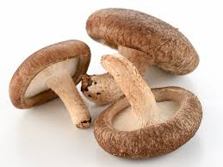
Anti-tumor polysaccharides isolated from macrofungi Lentinus edodes
Compound | Origin | Molecular structure
Lentinan | Lentinus edodes | 1,6-Monoglucosylbranched 1,3-β-D-glucan
Lentinus edodes
(Image from Bio-botanika.com)
Mushroom PS in prevention and treatment of cancer, Dr C R Meera, St Mary’s College

Slide 19
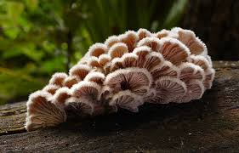
Anti-tumor polysaccharides isolated from macrofungi Schizophyllum commune
Compound | Origin | Molecular structure
Schizophyllan | Schizophyllum commune | 1,6-Monoglucosylbranched 1,3-β-D-glucan
Schizophyllum commune
(Image from en-wikipedia.org)
Mushroom PS in prevention and treatment of cancer, Dr C R Meera, St Mary’s College

Slide 20
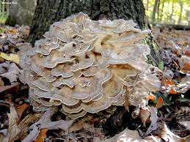
Anti-tumor polysaccharides isolated from macrofungi Grifola frondosa
Compound | Origin | Molecular structure
Maitake D-fraction | Grifola frondosa | 1,6-Monoglucosylbranched 1,3-β-D-glucan
Grifola frondosa
(Image from Mushroomexpert.com)
Mushroom PS in prevention and treatment of cancer, Dr C R Meera, St Mary’s College

Slide 21
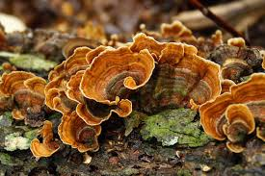
Anti-tumor polysaccharides isolated from macrofungi Coriolus versicolor
Compound | Origin | Molecular structure
PSK | Coriolus versicolor | 1,3 and 1,6-monoglucosylbranched 1,4-β-D glucan with binding to aspartic, glutamic and other acidic amino acids
PSP | Coriolus versicolor | Resemble to PSK structure but is richer in glutamic and aspartic acids
Coriolus versicolor
(Image from mushroomremedy.com)
Mushroom PS in prevention and treatment of cancer, Dr C R Meera, St Mary’s College

Slide 22
Conclusions
Mushroom polysaccharides offer a lot of hope for cancer patients
Safe when taken over long periods of treatment
Reduce the adverse effects of radiotherapy and chemotherapy
Allows the reduction in dose level of the toxic chemotherapeutic compound without reduced efficacy.
Mushroom PS in prevention and treatment of cancer, Dr C R Meera, St Mary’s College

Slide 23
Take home message
Edible Mushrooms are consumed by health conscious people all over the world for their healthcare.
To maintain your good health and longevity, avoid empty processed food and chemical vitamins, use natural foods and include in your diet “the mushrooms-nature's gift to mankind”
Mushroom PS in prevention and treatment of cancer, Dr C R Meera, St Mary’s College

Slide 24
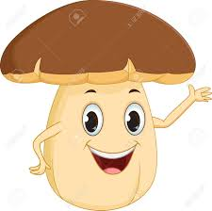
Thank You
Mushroom PS in prevention and treatment of cancer, Dr C R Meera, St Mary’s College

