Slide 1

Microbes in The Environment
Dr. Mabel Merlen Jacob
Assistant Professor
Department of Microbiology
St. Mary’s College,Thrissur

Slide 2


Obsessed with eliminating bacteria and
the microbes causing infection, illness and death??
Not all microorganisms are harmful
Some are essential for life to exist
Many are helpful in
fighting global warming
cleaning up pollution
breaking down plastic
developing a cure for cancer

Slide 3
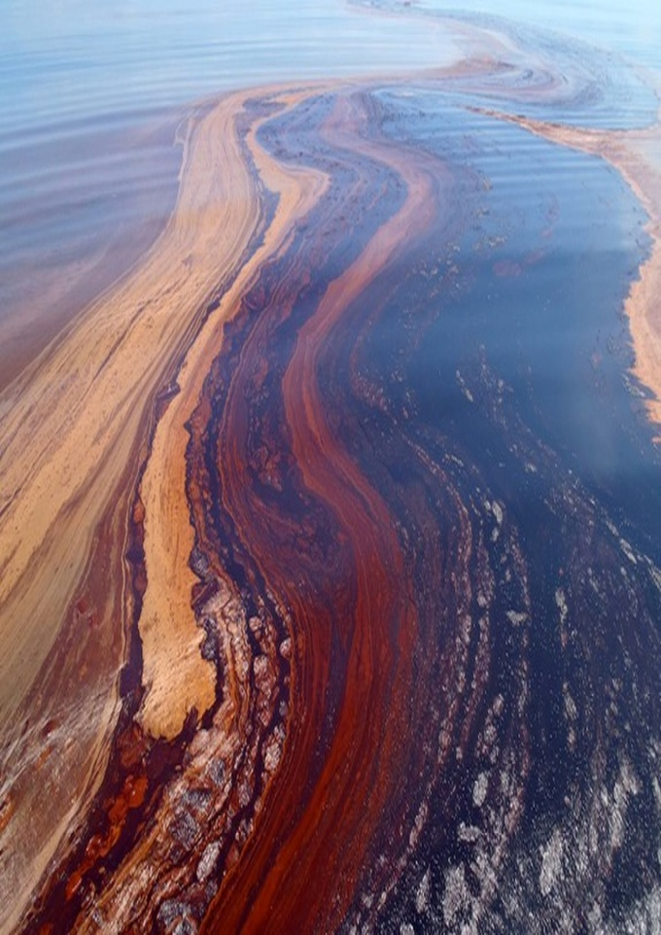
Microorganisms for Bioremediation
Bioremediation - use of microorganisms to remove or detoxify pollutants.
Eg., how to clean up environmental oil spills –
discovery of oil-consuming bacteria
Oceanospirillales, Methylococcaceae & Alcanivorax-
in the cleanup of 2010 oil spill in the Gulf of Mexico.
Alcanivorax borkumensis : oil-degrading bacterium
that lives near the surface in the ocean,
barely detectable in normal conditions;
numbers increase exponentially after an oil spill.
https://www.livescience.com/23126-bacteria-sucked-up-200-000-tons-of-oil-after-bp-spill.html

Slide 4
A. borkumensis generates a biofilm to help emulsify, or break up
the oil into small droplets, so that bacteria can utilize the oil.
https://www.coursehero.com/sg/microbiology/environmental-applications/

Slide 5
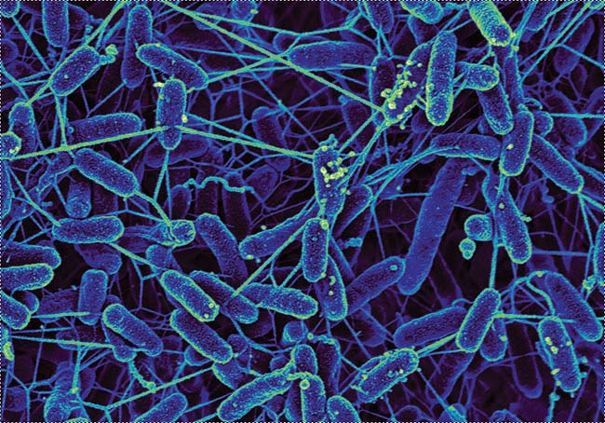
Bacteria Generate Electricity from Pollution
Bacteria with tiny wire-like appendages nanowires
digest toxic waste
(PCBs and chemical solvents)
produce electricity while doing it
Shewanella- a deep-sea bacteria
grows oxygen-seeking nanowires
In low-oxygen environments.
When these nanowires were pricked with platinum electrodes-found to carry current.
https://www.geomicrobes.com/electricigens-when-bacteria-produce-electricity/
Microbes in the environment, Dr. Mabel Merlen Jacob, St. Mary's College

Slide 6
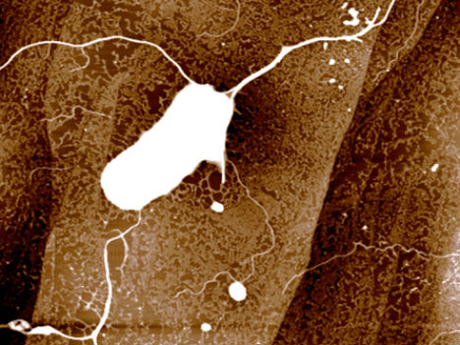
https://www.sciencenews.org/article/bacteria-go-electric
If harnessed effectively, could be used in sewage treatment plants
to digest waste & to power the plant.
Microbes in the environment, Dr. Mabel Merlen Jacob, St. Mary's College

Slide 7
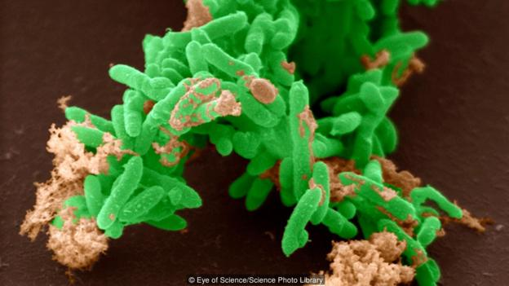
Geobacter Consume Radioactive Contamination
Nanowires grown by certain types of bacteria used to immobilize harmful materials – like uranium
Geobacter (found naturally in soil), electroplates uranium, making it insoluble - so it can’t dissolve and contaminate groundwater
Potential in uranium contamination sites like mines and nuclear plants
to contain the radiation & reduce
consequences of spills
Geobacter metallireducens munching uranium (Credit: Eye of Science/Science Photo Library)
Microbes in the environment, Dr. Mabel Merlen Jacob, St. Mary's College

Slide 8
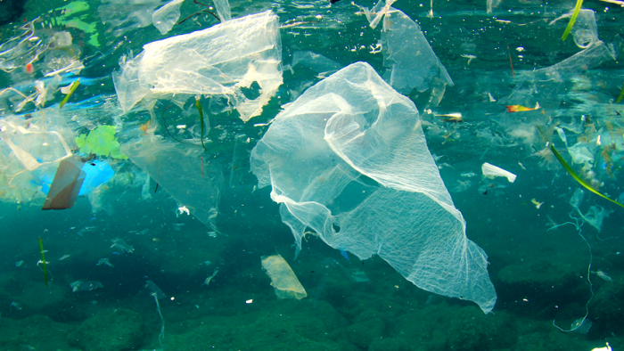
Plastic-Eating Bacteria Breaks Down Bags
Plastic -Ubiquitous & Non-biodegradable
Bacteria are breaking down plastic debris in the world’s oceans
fishing line, plastic bags etc
But the waste that these bacteria produce
travels up the food chain, so harmful to ocean ecosystems
Microbes in the environment, Dr. Mabel Merlen Jacob, St. Mary's College

Slide 9
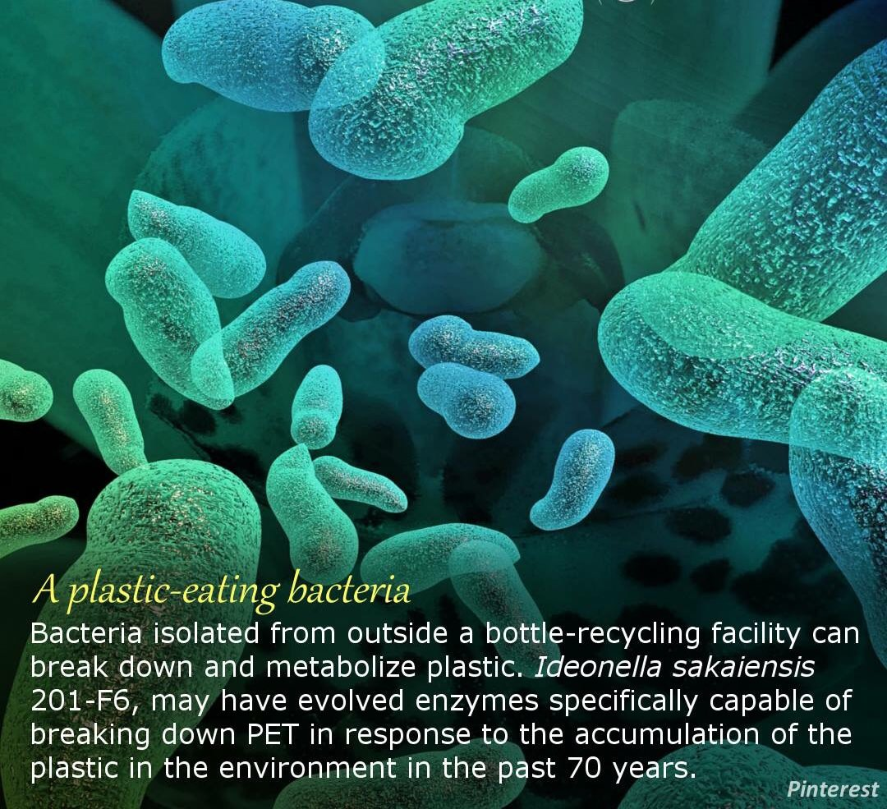
http://www.earthdecks.net/plastic-eating-enzyme/
Microbes in the environment, Dr. Mabel Merlen Jacob, St. Mary's College

Slide 10
Nylon-Eating Bacteria Clean Up Factory Waste
Nylon 6 - polymer ; used in toothbrushes, surgical sutures, ropes, hosiery and violin strings.
Manufacture of Nylon 6 produces toxic byproducts that get carried out in waste water
Flavobacterium produces special enzymes to digest these byproducts
They didn’t have these enzymes previously, and those enzymes aren’t seen in similar bacterial strains.
The ability to produce these enzymes in order to consume a material that didn’t even exist prior to the invention of nylon in 1935!
Microbes in the environment, Dr. Mabel Merlen Jacob, St. Mary's College

Slide 11
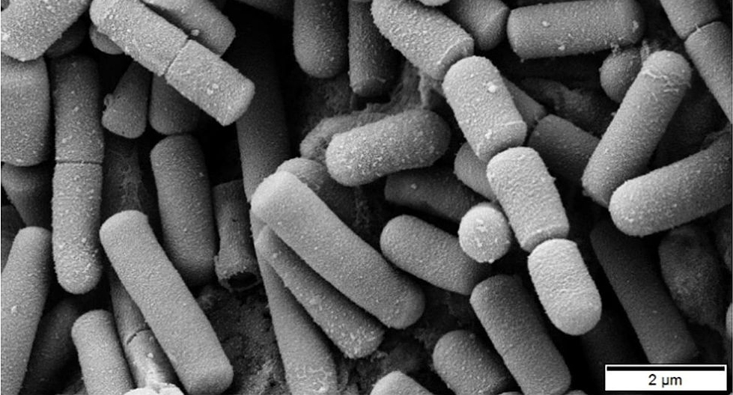
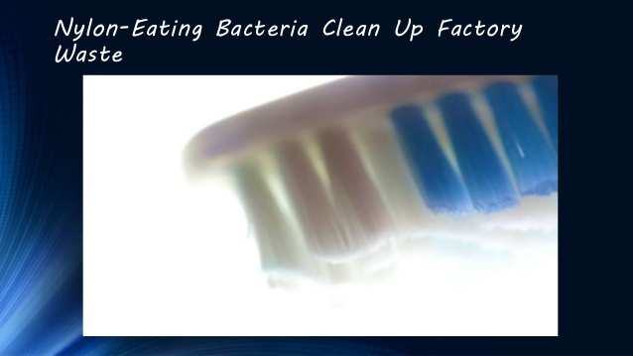
http://blog.drwile.com/nylon-digesting-bacteria-are-almost-certainly-not-a-modern-strain/
Microbes in the environment, Dr. Mabel Merlen Jacob, St. Mary's College

Slide 12
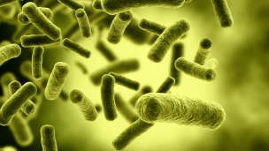
Metabolizing Methane, A Greenhouse Gas
Methane - one of the most dangerous greenhouse gases; produced by industrial and natural processes, decomposition of waste.
Some types of bacteria use copper from the environment to metabolize methane, eliminating both the greenhouse gas and toxic heavy metals all at once.
After eating the methane, the bacteria turn it into methanol – so we can harvest their waste for use as fuel.
http://www.oilandgastechnology.net/health-safety-environment-news/oil-natural-gas-eating-bacteria-clear-spills
Microbes in the environment, Dr. Mabel Merlen Jacob, St. Mary's College

Slide 13
Turning Newspapers into Car Fuel
Microbes named T-103, found in animal waste eat paper and produce butanol
Tulane University developed a method for growing the cellulose-consuming microbes so they can produce fuel in the presence of oxygen, which is lethal to other butanol-producing bacteria.
This could make the whole fuel production process far less expensive and more potentially applicable in the real world.
Butanol produces more energy than ethanol and doesn’t require engine modifications. It can also be carried through existing fuel pipelines.
Microbes in the environment, Dr. Mabel Merlen Jacob, St. Mary's College

Slide 14
Soil-Dwelling Bacteria Kills Cancer
Clostridium sporogenes -used to deliver drugs in cancer therapy by exploitingto its ability to target tumors.
C. sporogenes will only grow in oxygen-depleted environments – like the center of solid tumors, says Professor Nigel Minton of the University of Nottingham
When injected into a tumor log with cancer drugs, the bacteria help the drugs kill the tumor cells without affecting healthy tissue.
Microbes in the environment, Dr. Mabel Merlen Jacob, St. Mary's College

Slide 15
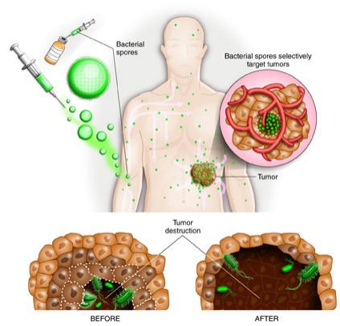
https://www.cancertreatmentsresearch.com/clostridium-as-a-cancer-therapy/
Microbes in the environment, Dr. Mabel Merlen Jacob, St. Mary's College

Slide 16
Panda Poop Bacteria Makes Biofuel
“Who would have guessed that ‘panda poop’ might help solve one of the major hurdles to producing biofuels, which is optimizing the breakdown of the raw plant materials used to make the fuels?” says Ashli Brown, Ph.D., co-author of a study on how bacteria in panda feces can break down the tough plant material known as lignocellulose.
This discovery could speed up development of plant-based biofuels
Several types of digestive bacteria found in the panda feces are similar to those found in termites, which are good at digesting wood.
The bacteria that have been identified for their cellulose-processing abilities can be isolated and grown on a commercial scale.
Just proves how important biodiversity is, and that many species around the world may have more to offer than we realize.
Microbes in the environment, Dr. Mabel Merlen Jacob, St. Mary's College

Slide 17
Turning Human Waste into Rocket Fuel
Human sewage is no less - with the help of the bacteria Brocadia anammoxidans, it could be transformed into hydrazine or the rocket fuel https://www.sciencedaily.com/releases/2015/10/151021083529.htm
The bacteria naturally consume ammonia and produce hydrazine in the process.
Until their discovery, scientists thought that hydrazine was only a man-made substance.
Microbes in the environment, Dr. Mabel Merlen Jacob, St. Mary's College

Slide 18
Sulphur-Eating Bacteria Reduce Acid Run-Off
Sulphur in mine tailings from mining operations react with water and oxygen & produce toxic sulphuric acid- a major environmental problem which also contribute to climate change
Researchers at McMaster University identified two species of bacteria isolated from a mine tailings pond in northern Ontario
They grow using sulphur as an energy source – produce and consume each other’s sulphur-containing waste; reduces the amount of toxic runoff Acid Mine Drainage (AMD).
This runoff dissolves carbonate rocks and releases CO₂, worsening climate change, so the more it is reduced, the less carbon dioxide gas is released into the atmosphere https://phys.org/news/2010-01-sulphur-eating-bacteria-limit-acid-run-off.html
Microbes in the environment, Dr. Mabel Merlen Jacob, St. Mary's College

Slide 19


Microbes in the environment, Dr. Mabel Merlen Jacob, St. Mary's College

Slide 20
References
https://www.momtastic.com/webecoist/2011/09/26/beneficial-bacteria-12-ways-microbes-help-the-environment/
Microbes in the environment, Dr. Mabel Merlen Jacob, St. Mary's College

