Slide 1
General Principles of Food Preservation
Elizabeth P Thomas
Assistant Professor
Department of Microbiology
St. Mary’s College,Thrissur

Slide 2
Introduction
Food is any substance consumed to provide nutritional support for an organism
Good nutrition – an adequate, well balanced diet combined with regular physical activity
Poor nutrition - reduce immunity, increased susceptibility to disease, impaired physical and mental development, and reduced productivity.
General Principles of Food Preservation, Elizabeth P Thomas, St.Mary’s College

Slide 3
Food from plants
Food from animals
Cereal and cereal products
Sugar and sugar products
Vegetables and vegetable products
Fruit and fruit products
Meat and meat products
Poultry and eggs
Fish and other seafood
Milk and milk products
General Principles of Food Preservation, Elizabeth P Thomas, St.Mary’s College

Slide 4
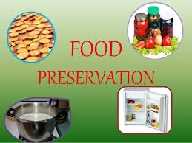
Principles of food preservation
Prevention or delay of microbial decomposition
Prevention or delay of self decomposition
Prevention of damage because of insects,animals and mechanical causes
General Principles of Food Preservation, Elizabeth P Thomas, St.Mary’s College

Slide 5
By keeping out micro organisms(asepsis)
Prevention or delay of microbial decomposition
By removal of microorganism(filteration)
By hindering the growth and activity of microorganism(drying,chemicals)
General Principles of Food Preservation, Elizabeth P Thomas, St.Mary’s College

Slide 6
By destruction or inactivation of food enzymes(blanching)
Prevention or delay of self decomposition
By prevention or delay of purely chemical reactions(antioxidants)
General Principles of Food Preservation, Elizabeth P Thomas, St.Mary’s College

Slide 7
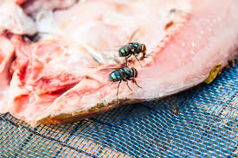
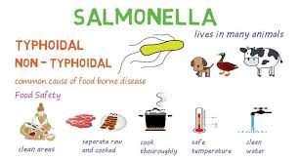
Prevention of damage because of insects , animals, mechanical causes
General Principles of Food Preservation, Elizabeth P Thomas, St.Mary’s College

Slide 8
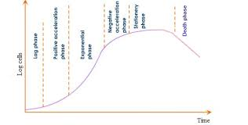
Growth curve of microbial culture and delay of microbial decomposition
Many common methods of food preservation depend on delay in the initiation of growth and hinderace to growth once it begun.
General Principles of Food Preservation, Elizabeth P Thomas, St.Mary’s College

Slide 9
Applications to food preservation
Lengthening of Lag phase and phase of positive acceleration
By introducing as few spoilage organisms -by reducing the amount of contamination
By avoiding the addition of actively growing organisms
Unfavourable environmental conditions
Process methods-heating, irradiation
General Principles of Food Preservation, Elizabeth P Thomas, St.Mary’s College

Slide 10
Methods of food preservation
Asepis
Removal of microorganisms
Maintenance of anaerobic conditions
Use of high temperature
Use of low temperature
Drying
Use of Chemical preservatives
Irradiation
Mechanical destruction-grinding,High pressure
Combinations of any above method
General Principles of Food Preservation, Elizabeth P Thomas, St.Mary’s College

Slide 11
Asepsis - Keeping out of microorganism
In nature-Shells of nuts,skin of fruits,husk
Application-Packing
Removal of microorganism
Filteration-Liquid food
Centrifugation-Milk
Washing-Fruits,Vegetables
Trimming-Fruits,Vegetables
Maintenance of anaerobic conditions
Sealed foods, Using CO₂ and N₂
General Principles of Food Preservation, Elizabeth P Thomas, St.Mary’s College

Slide 12
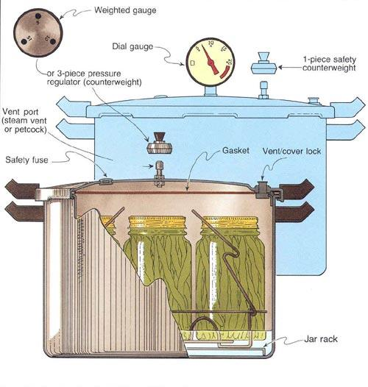
Use of high temperature
Pasteurization
Heating about100⁰C-Baking,Roasting,Cooking,Warming up
Heating above100⁰C -Canning/Appertization
General Principles of Food Preservation, Elizabeth P Thomas, St.Mary’s College

Slide 13
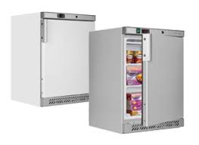
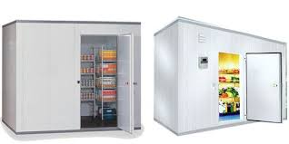
Use of low temperature
Common/Cellar storage
Chilling/Cold Storage
Freezing/Frozen storage
General Principles of Food Preservation, Elizabeth P Thomas, St.Mary’s College

Slide 14
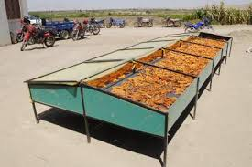
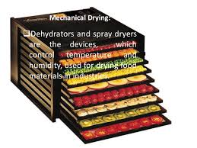
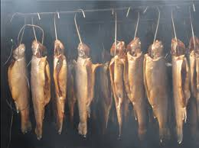
Drying
Solar drying
Mechanical Dryers
Freeze Drying
Smoking
Electronic drying
General Principles of Food Preservation, Elizabeth P Thomas, St.Mary’s College

Slide 15
Chemical preservatives
Natural sources-Salt,Sugar
Organic acid and its salt-Propionates,Benzoates
Nitrites/Nitrates
Sulfer dioxide
Ethylene
Formaldehyde
Alcohol
Wood smoke
General Principles of Food Preservation, Elizabeth P Thomas, St.Mary’s College

Slide 16
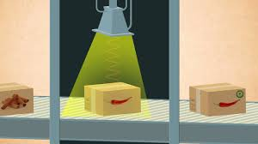
Irradiation(Cold Sterlization)
Non Ionizing-ultraviolet radiation
Ionizing- Gamma rays, Cathod rays
Microwave processing
General Principles of Food Preservation, Elizabeth P Thomas, St.Mary’s College

Slide 17
References
William C Frazier and Dennis C Westhoff, Food microbiology,Tata McGraw -Hill Company
General Principles of Food Preservation, Elizabeth P Thomas, St.Mary’s College

