Slide 1
JSP :JAVA SERVER PAGE
- Basics
Sreejitha T S
Assistant Professor
Department of Vocational Studies
St. Mary’s College , Thrissur

Slide 2
Java Server Page
Java Server Pages (JSP) is a server-side programming technology that enables the creation of dynamic, platform-independent method for building Web-based applications.
JSP have access to the entire family of Java APIs, including the JDBC API to access enterprise databases.
A JSP page consists of HTML tags and JSP tags
JSP Basics ,Sreejitha T S ,St.Mary’s College

Slide 3
Java Server Pages
JavaServer Pages (JSP) is a technology for developing Webpages that supports dynamic content.
This helps developers insert java code in HTML pages by making use of special JSP tags, most of which start with <% and end with %>.
A JavaServer Pages component is a type of Java servlet that is designed to fulfill the role of a user interface for a Java web application
Using JSP, you can collect input from users through Webpage forms, present records from a database or another source, and create Webpages dynamically.
JSP Basics ,Sreejitha T S ,St.Mary’s College

Slide 4
Advantages of JSP over Servlet
Extension to Servlet
JSP technology is the extension to Servlet technology. We can use all the features of the Servlet in JSP.
In addition to, we can use implicit objects, predefined tags, expression language and Custom tags in JSP, that makes JSP development easy.
Easy to maintain
JSP can be easily managed because we can easily separate our business logic with presentation logic.
In Servlet technology, we mix our business logic with the presentation logic.
JSP Basics ,Sreejitha T S ,St.Mary’s College

Slide 5
Advantages of JSP over Servlet
Fast Development:
No need to recompile and redeploy If JSP page is modified, we don't need to recompile and redeploy the project.
The Servlet code needs to be updated and recompiled if we have to change the look and feel of the application.
Less code than Servlet
In JSP, we can use many tags such as action tags, JSTL, custom tags, etc. that reduces the code. Moreover, we can use EL, implicit objects, etc.
JSP Basics ,Sreejitha T S ,St.Mary’s College

Slide 6
JSP Architecture
The web server needs a JSP engine, i.e, a container to process JSP pages. The JSP container is responsible for intercepting requests for JSP pages.
A JSP container works with the Web server to provide the runtime environment and other services a JSP needs. It knows how to understand the special elements that are part of JSPs.
JSP Basics ,Sreejitha T S ,St.Mary’s College

Slide 7
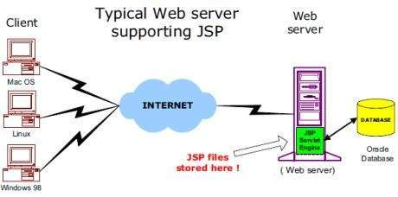
JSP Architecture
The Diagram shows the position of JSP container and JSP files in a Web application
JSP Basics ,Sreejitha T S ,St.Mary’s College

Slide 8
JSP Processing
The following steps explain how the web server creates the Webpage using JSP −
As with a normal page, your browser sends an HTTP request to the web server.
The web server recognizes that the HTTP request is for a JSP page and forwards it to a JSP engine. This is done by using the URL or JSP page which ends with .jsp instead of .html.
JSP Basics ,Sreejitha T S ,St.Mary’s College

Slide 9
JSP Processing
The JSP engine loads the JSP page from disk and converts it into a servlet content. This conversion is very simple in which all template text is converted to println( ) statements and all JSP elements are converted to Java code.
This code implements the corresponding dynamic behavior of the page.
The web server recognizes that the HTTP request is for a JSP page and forwards it to a JSP engine. This is done by using the URL or JSP page which ends with .jsp instead of .html.
JSP Basics ,Sreejitha T S ,St.Mary’s College

Slide 10
JSP Processing
The JSP engine compiles the servlet into an executable class and forwards the original request to a servlet engine.
A part of the web server called the servlet engine loads the Servlet class and executes it. During execution, the servlet produces an output in HTML format. The output is furthur passed on to the web server by the servlet engine inside an HTTP response.
The web server forwards the HTTP response to your browser in terms of static HTML content.
JSP Basics ,Sreejitha T S ,St.Mary’s College

Slide 11
JSP Processing
The JSP engine compiles the servlet into an executable class and forwards the original request to a servlet engine.
A part of the web server called the servlet engine loads the Servlet class and executes it. During execution, the servlet produces an output in HTML format. The output is furthur passed on to the web server by the servlet engine inside an HTTP response.
The web server forwards the HTTP response to your browser in terms of static HTML content.
Finally, the web browser handles the dynamically-generated HTML page inside the HTTP response exactly as if it were a static page
JSP Basics ,Sreejitha T S ,St.Mary’s College

Slide 12
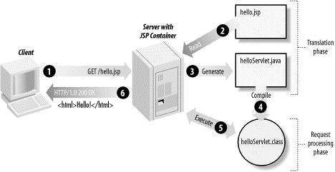
JSP Architecture
Following diagram shows the position of JSP container and JSP files in a Web application
JSP Basics ,Sreejitha T S ,St.Mary’s College

Slide 13
REFERENCE
https://www.javatpoint.com
https://www.tutorialspoint.com
JSP Basics ,Sreejitha T S ,St.Mary’s College

