Slide 1
POINTERS in C
Neethu Narayanan
Assistant Professor
Department of Vocational Studies
St. Mary’s College, Thrissur

Slide 2
POINTERS- DEFINITIONS
Pointers are variables that contain memory addresses as their values.
A variable name directly references a value.
A pointer indirectly references a value. Referencing a value through a pointer is called indirection.
A pointer variable must be declared before it can be used.

Slide 3
POINTERS-EXAMPLE
Examples of pointer declarations:
FILE *fptr;
int *a;
float *b;
char *c;
The asterisk, when used as above in the declaration, tells the compiler that the variable is to be a pointer, and the type of data that the pointer points to, but NOT the name of the variable pointed to.

Slide 4
POINTERS-EXAMPLE
#include <stdio.h>
int main ( )
{
FILE *fptr1 , *fptr2 ; /* Declare two file pointers */
int *aptr ; /* Declare a pointer to an int */
float *bptr ; /* Declare a pointer to a float */
int a ; /* Declare an int variable */
float b ; /* Declare a float variable */

Slide 5
POINTERS
aptr = &a ;
bptr = &b ;
fptr2 = fopen ( "my_out_file.dat" , "w" ) ;
fptr1 = fopen ( "my_in_file.dat" , "r" ) ;
if ( fptr1 != NULL )
{
fscanf ( fptr1, "%d%f" , aptr , bptr ) ;
fprintf ( fptr2, "%d %d\n" , aptr , bptr ) ;
fprintf ( fptr2, "%d %f\n" , *aptr , *bptr ) ;
fprintf ( fptr2, "%d %f\n" , a , b ) ;
fprintf ( fptr2, "%d %d\n" , &a , &b ) ;
return 0 ;
}

Slide 6
Use of & and *
& -- "address operator" which gives or produces the memory address of a data variable
* -- "dereferencing operator" which provides the contents in the memory location specified by a pointer

Slide 7
CONCEPT OF ADDRESS AND POINTERS
Memory can be conceptualized as a linear set of data locations.
Variables reference the contents of a locations
Pointers have a value of the address of a given location.
Pointers can be used to pass addresses of variables to called functions, thus allowing the called function to alter the values stored there.
POINTERS AND FUNCTIONS

Slide 8
POINTERS AND FUNCTIONS
Call by Value
Swap function that did not change the values stored in the main program because only the values were passed to the function swap.
If instead of passing the values of the variables to the called function, we pass their addresses, so that the called function can change the values stored in the calling routine. This is known as "call by reference" since we are referencing the variables.

Slide 9
POINTERS AND FUNCTIONS
#include <stdio.h>
void swap ( int *a, int *b ) ;
int main ( )
{
int a = 5, b = 6;
printf("a=%d b=%d\n",a,b) ;
swap (&a, &b) ;
printf("a=%d b=%d\n",a,b) ;
return 0 ;
}
void swap( int *a, int *b )
{
int temp;
temp= *a; *a= *b; *b = temp ;
printf ("a=%d b=%d\n", *a, *b);
}
Results:
a=5 b=6
a=6 b=5
a=6 b=5

Slide 10
ARITHMETIC AND LOGICAL OPERATIONS on
POINTERS
A pointer may be incremented or decremented
An integer may be added to or subtracted from a pointer.
Pointer variables may be subtracted from one another.
Pointer variables can be used in comparisons, but usually only in a comparison to NULL.

Slide 11
ARITHMETIC AND LOGICAL OPERATIONS ON POINTERS
When an integer is added to or subtracted from a pointer, the new pointer value is changed by the integer times the number of bytes in the data variable the pointer is pointing to.
For example, if the pointer valptr contains the address of a double precision variable and that address is 234567870, then the statement:
valptr = valptr + 2;
would change valptr to 234567886

Slide 12
POINTER OPERATIONS in C
Creation
& variable Returns variable’s memory address
Dereference
pointer Returns contents stored at address
Indirect assignment
pointer = val Stores value at address
Assignment
pointer = ptr Stores pointer in another variable

Slide 13
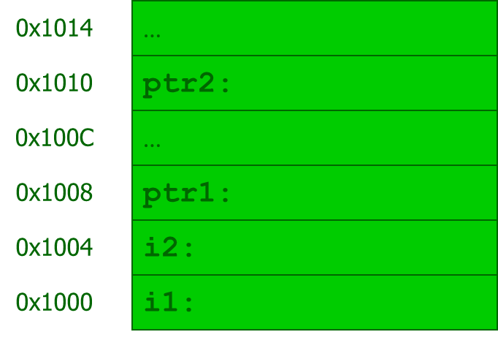
USING POINTERS
int i1;
int i2;
int *ptr1;
int *ptr2;
i1 = 1;
i2 = 2;
ptr1 = &i1;
ptr2 = ptr1;
*ptr1 = 3;
i2 = *ptr2;

Slide 14
POINTERS ARITHMETIC
pointer + number pointer – number
E.g., pointer + 1 adds 1 something to a pointer
char *p;
char a;
char b;
p = &a;
p += 1;
int *p;
int a;
int b;
p = &a;
p += 1;
In each, p now points to b
(Assuming compiler doesn’t reorder variables in memory)
Adds 1*sizeof(char) to the memory address
Adds 1*sizeof(int) to the memory address

Slide 15
REFERENCE
www.d.umn.edu/~rmaclin/cs1622
www.clear.rice.edu/comp321

