Slide 1
Sergei Nikolaievich Winogradsky And Martinus Willem Beijerinck
Dr. Greeshma P.V
Assistant Professor
Department of Microbiology
St. Mary’s College,Thrissur

Slide 2
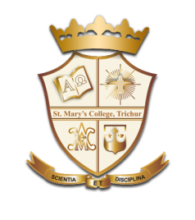
Sergei Nikolaievich Winogradsky
Winogradsky was born in Kiev (then in the Russian Empire). In this early stage of his life, Winogradsky was "strictly devoted to the orthodox faith.
He entered the Imperial Conservatoire of Music in St Petersburg in 1875 to study piano. However, after two years of music training, he entered the University of Saint Petersburg in 1877 to study chemistry under Nikolai Menshchutkin and botany under Andrei Sergeevich Famintzin.
He received a diploma in 1881 and stayed at the St. Petersburg University for a degree of master of science in botany in 1884. In 1885, he began work at the University of Strasbourg
Sergei N Winogradsky and Martinus W Beijerinck, Dr. Greeshma P.V, St.Mary’s College

Slide 3
He returned to St. Petersburg for the period 1891–1905, and headed the division of general microbiology of the Institute of Experimental Medicine
He retired from active scientific work in 1905, dividing his time between his private estate and Switzerland. In 1922, he accepted an invitation to head the division of agricultural bacteriology at the Pasteur Institute at an experimental station at Brie-Comte-Robert, France.
Winogradsky retired from active life in 1940 and died in Brie-Comte-Robert in 1953.
Sergei N Winogradsky and Martinus W Beijerinck, Dr. Greeshma P.V, St.Mary’s College

Slide 4
Discoveries
Winogradsky discovered various biogeochemical cycles and parts of these cycles. These discoveries include
His work on bacterial sulfide oxidation for which he first became renowned, including the first known form of lithotrophy (in Beggiatoa)
His work on the Nitrogen cycle including
The identification of the obligate anaerobe Clostridium pasteurianum is a free living microbe capable of fixing atmospheric nitrogen and not living in legume root nodules.
Chemosynthesis – his most noted discovery
The Winogradsky column
Sergei N Winogradsky and Martinus W Beijerinck, Dr. Greeshma P.V, St.Mary’s College

Slide 5
The Winogradsky Column
The Winogradsky column is a simple device for culturing a large diversity of microorganisms. Invented in the 1880s by Sergei Winogradsky, the device is a column of pond mud and water mixed with a carbon source such as newspaper (containing cellulose), blackened marshmallows or egg-shells (containing calcium carbonate), and a sulfur source such as gypsum (calcium sulfate) or egg yolk.
Incubating the column in sunlight for months results in an aerobic/anaerobic gradient as well as a sulfide gradient
Sergei N Winogradsky and Martinus W Beijerinck, Dr. Greeshma P.V, St.Mary’s College

Slide 6
Sergei N Winogradsky and Martinus W Beijerinck, Dr. Greeshma P.V, St.Mary’s College

Slide 7
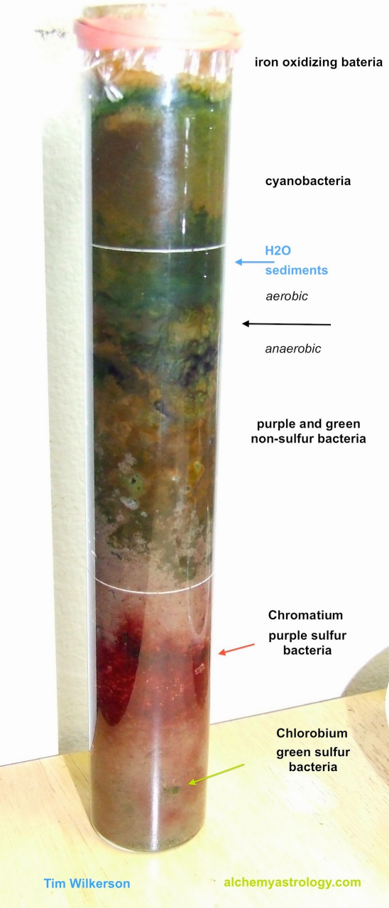
These two gradients promote the growth of different microorganisms such as Clostridium, Desulfovibrio, Chlorobium, Chromatium, Rhodomicrobium, and Beggiatoa, as well as many other species of bacteria, cyanobacteria, and algae
Aerobic colors
green - eukaryal algae or cyanobacteria
red/brown - cyanobacteria or thiobacilli
red/purple - purple non-sulfur Bacteria
white - sulfur oxidizing Bacteria
Anaerobic colors
red/purple - purple sulfur Bacteria
green - green sulfur Bacteria
black - sulfate reducers
Sergei N Winogradsky and Martinus W Beijerinck, Dr. Greeshma P.V, St.Mary’s College

Slide 8
Nitrogen Fixing Bacteria and the Discovery of Chemosynthesis
In 1888, Winogradsky moved from Strasbourg to the Swiss Polytechnic Institute in Zurich, Switzerland; there he began studying bacteria involved in nitrogen fixing.
It had already been established by Martinus Beijerinck in Holland that bacteria growing in nodules on the roots of pea plants were able to fix nitrogen – in other words bacteria could convert airborne nitrogen into water-soluble nitrates required by green plants.
Sergei N Winogradsky and Martinus W Beijerinck, Dr. Greeshma P.V, St.Mary’s College

Slide 9
During three years in Zurich, Winogradsky discovered three entirely new genera of nitrogen fixing bacteria.
He also provided chemical proof of two separate steps in nitrogen fixing: firstly, the oxidation of ammonium to form nitrite, then the oxidation of nitrite to form nitrate.
And he made his greatest discovery: chemosynthesis.
Sergei N Winogradsky and Martinus W Beijerinck, Dr. Greeshma P.V, St.Mary’s College

Slide 10
Chemosynthesis
Winogradsky discovered an entirely new process – chemosynthesis – in which organisms use chemical reactions rather than light as the energy source to build organic matter.
In the case of Beggiatoa, the energy is produced by the reaction of hydrogen sulfide with oxygen.
In the case of nitrogen fixing bacteria, the energy is produced by the oxidation of nitrogen and its compounds.
Sergei N Winogradsky and Martinus W Beijerinck, Dr. Greeshma P.V, St.Mary’s College

Slide 11
Sergei N Winogradsky and Martinus W Beijerinck, Dr. Greeshma P.V, St.Mary’s College

Slide 12
Born in Amsterdam, Beijerinck studied at the Technical School of Delft, where he was awarded the degree of Chemical Engineer in 1872. He obtained his Doctor of Science degree from the University of Leiden in 1877.
He became a teacher in microbiology at the Agricultural School in Wageningen (now Wageningen University) and later at the Polytechnische Hogeschool Delft (Delft Polytechnic, currently Delft University of Technology) (from 1895)
Sergei N Winogradsky and Martinus W Beijerinck, Dr. Greeshma P.V, St.Mary’s College

Slide 13
He established the Delft School of Microbiology. His studies of agricultural and industrial microbiology yielded fundamental discoveries in the field of biology.
Beijerinck never studied human disease.
In 1885 he became member of the Royal Netherlands Academy of Arts and Sciences
Sergei N Winogradsky and Martinus W Beijerinck, Dr. Greeshma P.V, St.Mary’s College

Slide 14
Sergei N Winogradsky and Martinus W Beijerinck, Dr. Greeshma P.V, St.Mary’s College

Slide 15
Scientific contributions
He is considered one of the founders of virology.In 1898, he published results on the filtration experiments demonstrating that tobacco mosaic disease is caused by an infectious agent smaller than a bacterium
Beijerinck also discovered nitrogen fixation, the process by which diatomic nitrogen gas is converted to ammonium ions and becomes available to plants. Bacteria perform nitrogen fixation, dwelling inside root nodules of certain plants (legumes). In addition to having discovered a biochemical reaction vital to soil fertility and agriculture, Beijerinck revealed this archetypical example of symbiosis between plants and bacteria.
Sergei N Winogradsky and Martinus W Beijerinck, Dr. Greeshma P.V, St.Mary’s College

Slide 16
Beijerinck discovered the phenomenon of bacterial sulfate reduction, a form of anaerobic respiration. He learned bacteria could use sulfate as a terminal electron acceptor, instead of oxygen. This discovery has had an important impact on our current understanding of biogeochemical cycles. Spirillum desulfuricans, now known as Desulfovibrio desulfuricans, the first known sulfate-reducing bacterium, was isolated and described by Beijerinck.
Beijerinck invented the enrichment culture, a fundamental method of studying microbes from the environment.
Sergei N Winogradsky and Martinus W Beijerinck, Dr. Greeshma P.V, St.Mary’s College

Slide 17
Sergei N Winogradsky and Martinus W Beijerinck, Dr. Greeshma P.V, St.Mary’s College

Slide 18
Early in his career, Beijerinck studied plant galls, swellings of plant tissue now known to be caused by the invasion of various infectious agents.
His investigations increasingly focused on fermentation, a process brought about by the growth of yeast and other microorganisms in an anaerobic environment (one lacking air).
In 1888 he isolated the bacterium Bacillus radicicola (later classified as a type of Rhizobium), which lives in the root nodules of leguminous plants. He later made other important advances in plant and soil science through his studies of Azotobacter (a group of soil microorganisms), denitrifying bacteria (which convert soil nitrates to free atmospheric nitrogen), nitrogen fixation, and tobacco mosaic virus.
Sergei N Winogradsky and Martinus W Beijerinck, Dr. Greeshma P.V, St.Mary’s College

Slide 19
He used the term filterable virus to describe the ability of the latter agent to pass through a fine-pored filter. He described the virus as contagium vivum fluidum, thinking it was a fluid rather than a particulate entity. Beijerinck also developed the principles of enrichment culture, which allowed a better understanding of the role of microorganisms in natural processes. He received international recognition for this discovery
Sergei N Winogradsky and Martinus W Beijerinck, Dr. Greeshma P.V, St.Mary’s College

Slide 20
THANK YOU

