Slide 1
Antigens
Dr. C.R.Meera
HOD & Assistant Professor
Department of Microbiology
St. Mary’s College, Thrissur

Slide 2
Antigens
Anything foreign to the body is considered as antigens
An antigen is defined as any substance which, when introduced parenterally into the body, stimulates the production of an antibody with which it reacts specifically and in an observable manner.
Some antigens may not induce antibodies but may sensitize specific lymphocytes leading to cell mediated immunity or may cause immunological tolerance.
Antigens, Dr C R Meera, St.Mary’s College, TCR

Slide 3
“Parenteral” means “outside the intestinal tract”.
When antigens are orally given, they are denatured by the intestinal enzymes and their antigenicity is destroyed, so no antibody formation takes place.
When given parentarally, they are not denatured, hence induce antibody production.
However, some antigens given as oral vaccines are exceptions.
Antigens, Dr C R Meera, St.Mary’s College, TCR

Slide 4
“Specifically”
An antigen introduced into the body reacts only with those particular immunocytes (B or T lymphocytes) which carry the specific marker for that antigen and which produce an antibody or cells complementary to that antigen only.
The antibody so produced will react only with that particular antigen and with no other, however cross reactions may occur between closely related antigens.
Antigens, Dr C R Meera, St.Mary’s College, TCR

Slide 5
Attributes of antigenicity
1. Induction of an immune response (immunogenicity)
2. Specific reaction with antibodies or sensitized cells (immunological reactivity)
Immunogenicity and antigenicity are related, but distinct.
Immunogenicity is the ability to induce a humoral or cell mediated immune response.
B cells + antigen→ effector B cells + memory B cells
(plasma cells)
T cells + antigen→effector T cells + memory T cells
Antigens, Dr C R Meera, St.Mary’s College, TCR

Slide 6
A substance that induces a specific immune response is usually called an antigen, it is more appropriately called an immunogen.
Antigenicity is the ability to combine specifically with the final products of the above responses (ie., antibodies or cell-surface receptors).
All molecules that have the property of immunogenicity also have the property of antigenicity, but the reverse is not true.
Based on the ability to carry out the above mentioned attributes, antigens may be classified into different types.
Antigens, Dr C R Meera, St.Mary’s College, TCR

Slide 7
Haptens
A complete antigen= immunogenicity + antigenicity
A complete antigen is able to induce antibody formation and produce a specific and observable reaction with the so produced antibody.
Haptens are substances that are incapable of inducing antibody formation by themselves but can react specifically with antibodies.
Haptens are antigenic, but lack immunogenicity.
The term hapten is derived from the Greek haptein which means “to fasten”.
Haptens become immunogenic on combining with a larger molecule carrier or they are low molecular weight molecules that can be made immunogenic by conjugation to a suitable carrier.
Antigens, Dr C R Meera, St.Mary’s College, TCR

Slide 8
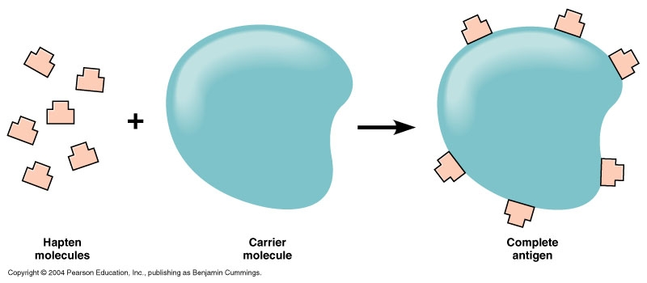
Formation of Complete Antigen
Antigens, Dr C R Meera, St.Mary’s College, TCR

Slide 9
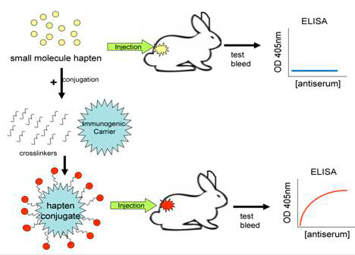
Effect of Hapten on immune sera production
Taken from Abcam.com
Antigens, Dr C R Meera, St.Mary’s College, TCR

Slide 10
Types of Haptens
Haptens may be complex or simple.
Complex haptens can precipitate with specific antibodies simple haptens are nonprecipitating.
Complex hapten is polyvalent and simple hapten is univalent, since it is assumed that the precipitation requires the antigen to have two or more antibody combining sites.
Antigens, Dr C R Meera, St.Mary’s College, TCR

Slide 11
Epitope
The smallest unit of antigenicity is known as the antigenic determinant or epitope.
Epitope is the portion of an antigen that is recognized and bound by an Ab or TCR/MHC complex.
The epitope is a small area on the antigen
usually consisting of four or five aminoacid or monosaccharide residues
possess a specific chemical structure, electric charge and spatial configuration, capable of sensitizing an immunocyte and of reacting with its complementary site on the specific antibody or T cell receptor.
Antigens, Dr C R Meera, St.Mary’s College, TCR

Slide 12
Epitope
Epitopes when present as a single linear segment of the primary sequence is called sequential or linear epitope.
When formed by bringing together on the surface residues from different sites of the peptide chain during its folding into tertiary structure, it is called conformational epitope.
T cells recognize sequential epitopes where as B cells recognize conformational epitopes.
Antigens, Dr C R Meera, St.Mary’s College, TCR

Slide 13
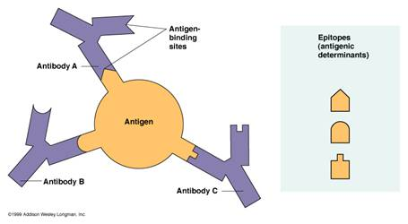
Epitope
Antigens, Dr C R Meera, St.Mary’s College, TCR

Slide 14
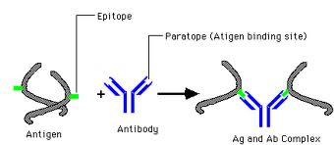
The combining area on the antibody molecule, corresponding to the epitope, is called the paratope.
Epitopes and paratopes determine the specificity of immunological reactions.
Taken from Canacopegdl.com
Antigens, Dr C R Meera, St.Mary’s College, TCR

Slide 15
Adjuvants
Adjuvants (from Latin adjuvare-to help) are substances that, when mixed with an antigen and injected with it, enhance the immunogenicity of that antigen.
Adjuvants are often used to boost the immune response when an antigen has low immunogenicity or when only small amounts of an antigen are available.
They are known to exert one or more of the following effects:
1.Prolong antigen persistence
2.Enhance co-stimulatory signals
3.Induce granuloma formation
4.Stimulate lymphocyte proliferation nonspecifically
Examples- Freund’s complete adjuvant, Aluminium potassium sulfate (alum), Mycobacterium tuberculosis, Bacterial lipopolysaccharide (LPS) etc.
Antigens, Dr C R Meera, St.Mary’s College, TCR

