Slide 1
ONCOGENES
Dr. Dhanya K C
Assistant Professor
Department of Microbiology
St. Mary’s College, Thrissur

Slide 2
Cancer is a genetic disease and is mostly caused by somatic mutations.
The characteristic properties of cancer cells - consequences of genetic changes in the tumor cells - Genomic instability
Self-sufficient proliferation of growth
Refractory to inhibitory signals
Survival without survival signals
Unlimited replicative potential
Recruitment of blood supply
Invasion and metastasis
Cancer cells contain multiple alterations in the number and structure of genes and chromosomes, mainly acquired by mutations in somatic cells.
Oncogenes, Dr.Dhanya KC, St.Mary’s College

Slide 3
Individual genes display point mutations such as base changes, insertions and deletions, or can be affected by chromosomal translocations or inversions.
These changes lead to the
expression of altered gene products,
decreased or increased gene expression
novel gene products like fusion proteins.
Two classes of genes affected by genetic and epigenetic alterations in cancer cells are oncogenes and tumor suppressor genes.
Oncogenes contribute to tumor development by increased or misdirected activity.
Tumor suppressors - insufficient or lost function supports tumor development.
Typically, in human cancers activation of oncogenes and inactivation of tumor suppressor genes - both are observed.
Oncogenes, Dr.Dhanya KC, St.Mary’s College

Slide 4
Oncogenes
Stimulate Proliferation
Inhibit Differentiation
Inhibit Apoptosis
Tumor Suppressor Genes
Inhibit Proliferation
Promote Differentiation
Stimulate Apoptosis
Oncogenes, Dr.Dhanya KC, St.Mary’s College

Slide 5
Oncogenes are cellular or viral (i.e., inserted into the cell by a virus) genes; their expression can cause the development of cancer.
Proto-oncogenes are normal cellular genes - conversion to oncogenes occur via several mechanisms. Gain-of-function mutations of proto-oncogenes stimulate cells to multiply.
Tumor suppressors (anti-oncogenes) are cellular genes; their inactivation increases the probability of tumor formation. Loss-of-function mutations - relieve cells of control in replication.
About one hundred potential oncogenes (cellular and viral) and thirty tumor suppressors have been recognized.
Oncogenes, Dr.Dhanya KC, St.Mary’s College

Slide 6
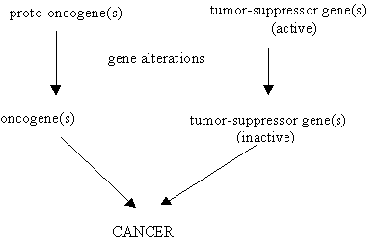
Oncogenes, Dr.Dhanya KC, St.Mary’s College
Oncogenes, Dr.Dhanya KC, St.Mary’s College

Slide 7
Oncogenes
Oncogenes, Dr.Dhanya KC, St.Mary’s College

Slide 8
Oncogenes are activated versions of normal cellular genes involved in
regulating cell replication
Growth
Survival
Differentiation
Motility
Oncogenes were first described in association with the retroviruses.
Eg. Rous sarcoma virus (contains the v-src oncogene) - induces sarcomas in chickens.
Oncogenes become activated by
genetic mutations
chromosomal translocations
Gene amplification
Oncogenes, Dr.Dhanya KC, St.Mary’s College

Slide 9
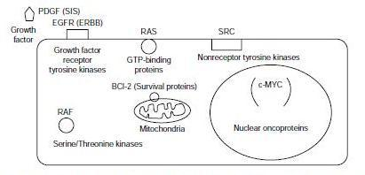
Representative oncogene products.
Oncogenes, Dr.Dhanya KC, St.Mary’s College

Slide 10
Classification of oncogenes
Oncogenes may be divided into five groups based on the functional and biochemical properties of protein products of their normal proto-oncogene counterparts.
(1) growth factors
(2) growth factor receptors
(3) signal transducers
(4) Transcription factors
(5) regulators of cell death
Oncogenes, Dr.Dhanya KC, St.Mary’s College

Slide 11
Growth factors
Oncogenic activation of growth factors (GF) - results from transcriptional activation of the gene - leads to overproduction of the growth factor.
The SIS gene (the v-sis gene is the oncogene in simian sarcoma virus) encodes the PDGF B chain (platelet-derived growth factor PDGF-B chain).
The int-2 gene (common site of integration of mouse mammary tumor virus) encodes an FGF (Fibroblast growth factors)-related growth factor.
The KGF (also called HST) gene encodes an FGF-related growth factor - identified in gastric carcinoma and Kaposi's sarcoma.
Oncogenes, Dr.Dhanya KC, St.Mary’s College

Slide 12
Growth factor receptors
Mutations resulting in constitutively active receptors.
Receptor tyrosine kinases, RTK
The epidermal growth factor receptor (EGFR or HER1) -amplified in numerous cancers, in particular in squamous cell carcinomas.
The NEU gene - identified as an EGFR and HER2 (human EGF receptor 2) gene. The conversion of proto-oncogenic to oncogenic NEU - a single amino acid change in the transmembrane domain.
The KIT gene which encodes the receptor for stem cell factor (SCF) is found constitutively activated in sarcomas.
G-Protein coupled receptors
The MAS gene - is angiotensin receptor - identified in a mammary carcinoma and human epidermoid tumors.
Oncogenes, Dr.Dhanya KC, St.Mary’s College

Slide 13
Signal transducers
(i) Membrane Associated Non-Receptor Tyrosine Kinases
The SRC gene, the first identified oncogene is the archetypal protein tyrosine kinase.
Reciprocal translocation between the ABL chromosome (chromosome 9) and chromosome 22 near a locus termed the break-point cluster region (BCR). The result is a constitutively active ABL tyrosine kinase domain fused to the BCR coding region forming the BCR-ABL fusion protein - the Philadelphia chromosome (Ph⁺⁾ - chronic myelogenous leukemias (CMLs)
Oncogenes, Dr.Dhanya KC, St.Mary’s College

Slide 14
Signal transducers (contd..)
(ii) Membrane Associated G-Proteins
The RAS family
Three different homologs of the RAS gene (RAS, N-RAS and H-RAS) - Each identified in a different type of tumor - one of the most frequently disrupted genes in colorectal carcinomas. Oncogenic RAS genes have undergone point mutations that eliminate the intrinsic GTPase activity of the RAS protein, permanently “switching on” RAS.
(iii) Serine/Threonine Kinases
The RAF gene is involved in the signaling pathway of most RTKs. Since the normal RAF gene product, RAF, is responsible for threonine phosphorylation of MAP kinase (MAPK) following receptor activation, oncogenic RAF leads to constitutive activation of the downstream MAPK pathway.
Oncogenes, Dr.Dhanya KC, St.Mary’s College

Slide 15
Transcription factors
A considerable number of transcription factors have been shown to possess oncogenic activity when deregulated. Examples of well-known oncogenic transcription factors include MYC, FOS, JUN, NFKB, etc.
A disrupted human MYC gene - in several hematopoietic cancers.
Disruption of MYC - the result of retroviral integration, transduction and chromosomal rearrangements.
Three MYC genes, each of which has been shown to be involved in cancer: MYC, N-MYC, and L-MYC.
The FOS gene - in the feline osteosarcoma virus. The protein interacts with a second proto-oncogenic protein, JUN to form a transcriptional regulatory complex.
Oncogenes, Dr.Dhanya KC, St.Mary’s College

Slide 16
Regulators of cell survival and death
Normal tissues are maintained by a regulated balance between cell proliferation and cell death (apoptosis).
The only proto-oncogenes regulating programmed cell death are members of the BCL2 family.
The BCL2 gene encodes a protein, BCL-2, localized to the inner mitochondrial membrane, endoplasmic reticulum, and nuclear membrane.
Expression of antiapoptotic BCL-2 family members ↑↑ - cells are vulnerable to other cancer causing mutations.
e.g. BCL-2 and BCL-XL
Oncogenes, Dr.Dhanya KC, St.Mary’s College

Slide 17
Conversion of proto-oncogenes to oncogenes
1. Point mutations in a single gene that can either affect the coding region of the gene resulting in the formation of an abnormal oncoprotein with enhanced stability or activity, or may affect regulatory elements resulting in enhanced or deregulated expression. (e.g. RAS)
2. Chromosomal translocations or rearrangements leading to over expression of an oncoprotein.
(e.g. Burkitt’s lymphoma, the proto-oncogene c-MYC on chromosome 8 is translocated to one of the three chromosomes containing the genes that encode antibody molecules: immunoglobulin heavy chain locus (chromosome 14) or one of the light chain loci (chromosome 2 or 22). c-MYC now finds itself in a region of vigorous gene transcription, leading to overproduction of the c-MYC protein)
Oncogenes, Dr.Dhanya KC, St.Mary’s College

Slide 18
Conversion of proto-oncogenes to oncogenes (contd..)
3. Gene amplification can lead to over expression of the oncogene.
c-MYC amplification – breast, stomach, lung, cervix, colon, neuroblastomas and glioblastomas.
4. Insertional mutagenesis
Murine leukemia viruses (lack cancer genes) induce tumors by integrating into the genome and insertionally mutating cellular protooncogenes, tumor-suppressor genes, or both. fusion of one protein to another might lead to its constitutive activity.
(e.g. fusion of the promyelocytic leukemia (PML) protein to the retinoic acid receptor-alpha (RARα) generates the transforming protein of acute promyelocytic leukemias)
Oncogenes, Dr.Dhanya KC, St.Mary’s College

Slide 19
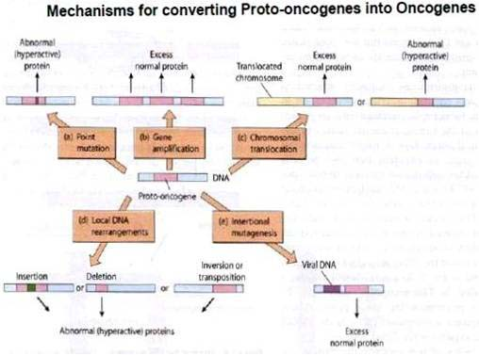
Oncogenes, Dr.Dhanya KC, St.Mary’s College

Slide 20
Individual oncogenes are insufficient to cause cancer, collaboration with other oncogenes or with loss of tumor suppressors is required – termed “oncogene collaboration” or “oncogene cooperation”.
Oncogenes, Dr.Dhanya KC, St.Mary’s College

Slide 21
The Ras subfamily (an abbreviation of RAt Sarcoma) is a protein subfamily of small GTPases that are involved in cellular signal transduction pathways that control actin cytoskeletal integrity, proliferation, differentiation, cell adhesion, apoptosis, and cell migration.
Ras communicates signals from outside the cell to the nucleus. Mutations in ras genes can permanently activate it and cause inappropriate transmission inside the cell even in the absence of extracellular signals.
These signals result in cell growth and division.
Ultimately lead to oncogenesis, decreased apoptosis and cancer.
Oncogenes, Dr.Dhanya KC, St.Mary’s College

Slide 22
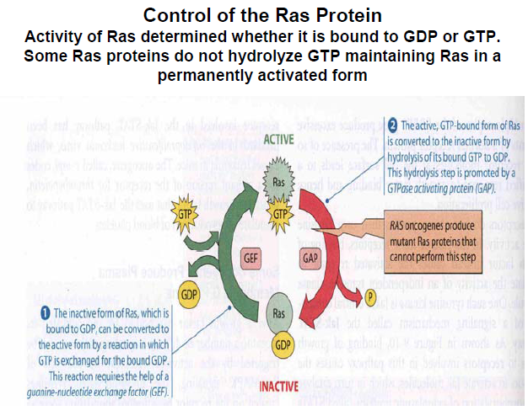
Oncogenes, Dr.Dhanya KC, St.Mary’s College

Slide 23
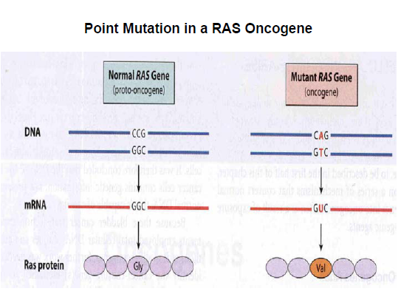
Oncogenes, Dr.Dhanya KC, St.Mary’s College

Slide 24
The cellular proto-oncogene, c-MYC, encodes the protein c-MYC - promote cell cycle progression, differentiation, cell death and angiogenesis.
In normal dividing cells, c-MYC expression is maintained at a relatively constant intermediate level throughout the cell cycle, whereas in its oncogenic form c-MYC might be constitutively expressed at levels ranging from moderate to very high, and is non-responsive to external signals.
Oncogenic c-MYC, resulting from a translocational event, is instrumental in the progression of Burkitt’s lymphoma. Other cancers include breast, colon, cervical, and small-cell lung carcinomas, osteosarcomas, glioblastomas, melanoma, and myeloid leukemias.
Oncogenes, Dr.Dhanya KC, St.Mary’s College

Slide 25
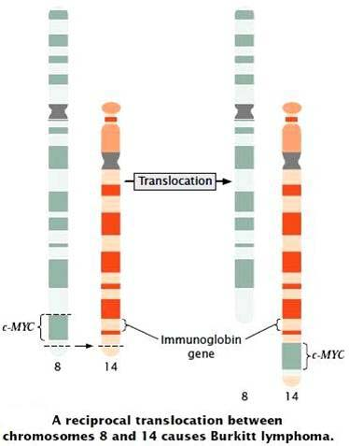
c-MYC and Burkitt’s lymphoma
Oncogenes, Dr.Dhanya KC, St.Mary’s College

Slide 26
BCR-ABL fusion protein is an oncogene fusion protein consisting of BCR and ABL.
The non-receptor tyrosine kinase c- ABL is needed for various cellular processes.
Its oncogenic counterpart, the BCR–ABL fusion protein, causes certain human leukemias.
It is generally associated with chronic myeloid leukemia but it can also be associated with acute lymphoblastic leukemia as Philadelphia chromosome.
Oncogenes, Dr.Dhanya KC, St.Mary’s College

Slide 27
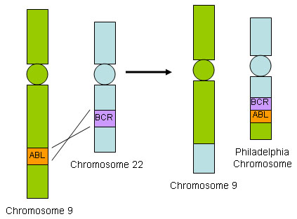
BCR-ABL fusion protein - Chromosomal Translocation in chronic myeloid leukemia - Philadelphia chromosome
Oncogenes, Dr.Dhanya KC, St.Mary’s College

Slide 28
The BCL-2 Family comprises both proapoptotic and antiapoptotic members, the balance determines whether or not a cell undergo apoptosis.
Bcl-2 subfamily (antiapoptotic): Bcl-2, Bcl-XL, Bcl-w, etc.
Bax subfamily (pro-apoptotic): Bax, Bak and Bok
BH3 subfamily (pro-apoptotic): Bad, Bid, Bik, etc.
BCL-2 (B-cell lymphoma 2) in human follicular lymphoma involves a chromosome translocation event that moves the BCL-2 gene from chromosome 18 to 14 (t14;18) linking the BCL-2 gene to an immunoglobulin locus.
The Bcl-2 gene implicated in a number of cancers - melanoma, breast, prostate and lung carcinomas and involved in resistance to conventional cancer treatment.
Oncogenes, Dr.Dhanya KC, St.Mary’s College

Slide 29
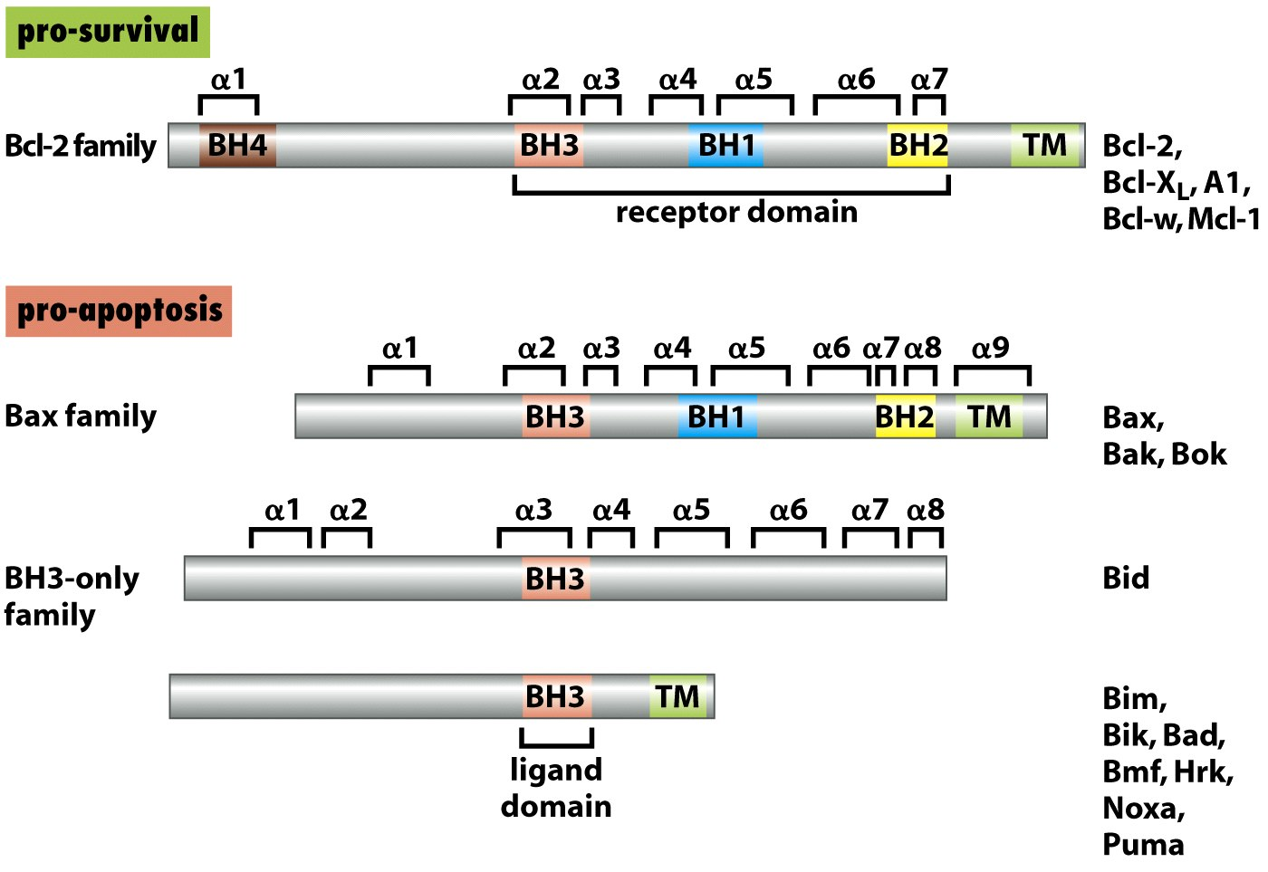
Bcl-2 Family Proteins
Oncogenes, Dr.Dhanya KC, St.Mary’s College

Slide 30
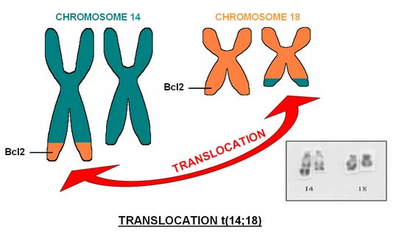
BCL-2 in human follicular lymphoma
Oncogenes, Dr.Dhanya KC, St.Mary’s College

Slide 31
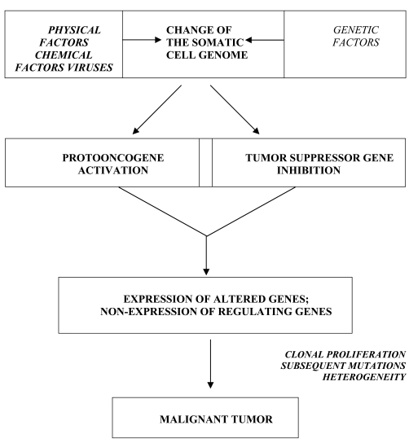
Oncogenes, Dr.Dhanya KC, St.Mary’s College

Slide 32
REGRESSING TUMORS BY INACTIVATING ONCOGENES – A THERAPEUTIC TARGET
Several potential strategies can be used
Introduce a gene encoding for a ribozyme, which is an RNA that has catalytic activity and cleaves mRNA resulting in reduced expression of the oncogene.
Introduce a gene that encodes for the oncogene antisense. When expressed in tumor cells, the antisense nucleotides block translation by binding to the oncogene mRNA and also target the mRNA for degradation by RNase H.
Introduce the gene that encodes for a portion of an antibody molecule, referred to as a single chain Fv molecule (scFv), that is specific for the oncogene product. When expressed within the tumor cells, the scFv can bind to and thereby inactivate the oncogene product.
Oncogenes, Dr.Dhanya KC, St.Mary’s College

Slide 33
The drug imatinib (gleevec), for the treatment of chronic myelogenous leukemia target the BCR/ABL tyrosine kinase. Also PDGFR, c-kit.
Trastuzumab (Herceptin) is a monoclonal antibody that interferes with the HER2/neu receptor (which is over expressed in up to 30% of primary human breast cancers)
Oncogenes, Dr.Dhanya KC, St.Mary’s College

Slide 34
THANK YOU…

