Slide 1
Probability Theory
Shitha Francis
Assistant Professor
Department of Statistics
St. Mary’s College, Thrissur

Slide 2
INTRODUCTION
Probability is a number associated with an event intented to represent its likelihood, chance of occurring, degree of uncertainty and so on.
The probability theory has its origin in ‘Games of chance’.
the concept of probability is similar to that of distance, velocity or volume.
Example : Coin toss experiment, die rolling experiment
Probability Theory, Shitha Francis , St.Mary’s College

Slide 3
Classical Definition of Probability
concepts
Random Experiment
Trial and Event
Equally likely events
Exhaustive events
Mutually exclusive events
Favourable cases
Probability Theory, Shitha Francis , St.Mary’s College

Slide 4
Classical or Mathematical or a priori Definition
If a trail results in n mutually exclusive, equally likely and exhaustive cases and m of them are favourable(m<n)to the happening of an event A,then
P(A)=m/n ; 0≤P(A) ≤1
Probability Theory, Shitha Francis , St.Mary’s College

Slide 5
Example
what is the probability that a leap year selected at
random will contain 53 sundays
P(A)=2/7
Probability Theory, Shitha Francis , St.Mary’s College

Slide 6
Frequency Definition
the trials be repeated over a large number of times under essentially homogeneous conditions.
P(A)=lim m/n
Probability Theory, Shitha Francis , St.Mary’s College

Slide 7
Permutations
it refers to the arrangement which can be taking some of things (say r)at a time or all of ‘n’ things at a time with attention given to the order of arrangement of the selected objects
mathematical notation nPr
Probability Theory, Shitha Francis , St.Mary’s College

Slide 8
Combination
It is a grouping or a selection or a collection of all or a part of a given number of things without reference to their order of arrangement
mathematical notation nCr
Probability Theory, Shitha Francis , St.Mary’s College

Slide 9
Axiomatic Definition of probability
Axiom1 : 0≤P(A)≤1
Axiom2 : P(S)=1
Axiom 3 : countable addition
Probability Theory, Shitha Francis , St.Mary’s College

Slide 10
Addition Theorem
If A and B are two mutually exclusive events or disjoint
P(AꓴB)=P(A)+P(B)
2. If A and B are not mutually exclusive events or not disjoint
P(AꓴB)=P(A)+P(B) -P(AB)
Probability Theory, Shitha Francis , St.Mary’s College

Slide 11
Conditional Probability
Probability of an event A given that B has happened is called conditional probability of A given B , denoted by P(A/B)
P(A/B)=P(AꓵB)/P(B) ;P(B)≠0
Similarly
P(B/A)= P(AꓵB)/P(A) ;P(a)≠0
Probability Theory, Shitha Francis , St.Mary’s College

Slide 12
If A and B are independent
P(A/B)=P(A) and P(B/A)=P(B)
Since P(AꓵB)=P(A)*P(B)
Probability Theory, Shitha Francis , St.Mary’s College

Slide 13
Multiplication Theorem
If A and B are any two events ,
P(AꓵB)=P(A) P(B/A) and
=P(B) P(A/B)
Since A and B are independent , P(AB)=P(A)*P(B)
Probability Theory, Shitha Francis , St.Mary’s College

Slide 14
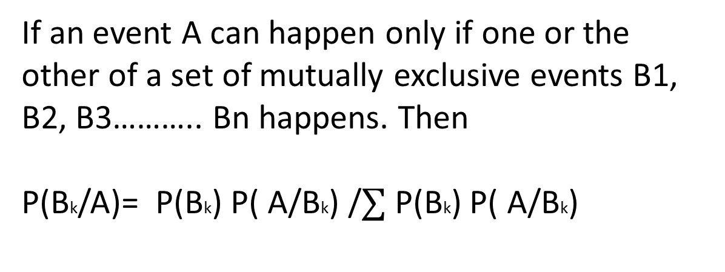
Baye’s theorem
If an event A can happen only if one or the other of a set of mutually exclusive events B1, B2, B3……….. Bn happens. Then
P(Bk/A)= P(Bk) P( A/Bk) /$∑$ P(Bk) P( A/Bk)
Probability Theory, Shitha Francis , St.Mary’s College

Slide 15
Example
Let A stand for patient died, B1 for correctly diagnosed and B2 for not correctly diagnosed
P(B1) =0.6 , P(B2) =0.4 P( A/B1)=0.4, P( A/B2)=0.6
P(B2/A)=(0.4*0.7)/((0.6*0.4)+(0.4*0.7))
= 0.54
Example
Probability Theory, Shitha Francis , St.Mary’s College

Slide 16
Referrence
S.P Gupta: Statistical methods-S Chand and Sons, New Delhi
Taro Yamane : Statistics: An introductory Analysis
Probability Theory, Shitha Francis , St.Mary’s College

