Slide 1
QUALITY CONTROL
Rakhi Chandran
Assistant Professor
Department of Statistics
St. Mary’s College Thrissur

Slide 2
BASIC DEFINITIONS
Quality refers to the good quality item which conforms to the standards specified for measurement
Statistical Quality Control is a statistical method for maintaining and improving the quality of the products produced
Specifications limits are stipulated by the buyers. The buyers are expected to accept those items which fall within these limits
Statistical Quality Control, Rakhi Chandran, St.Mary’s College

Slide 3
VARIATIONS IN PRODUCTS
Allowable Variation –These variations are random in nature and are beyond the control of the human beings .It can be reduced but cannot be eliminated
Preventive Variation-These variations can be eliminated by taking appropriate steps
Statistical Quality Control, Rakhi Chandran, St.Mary’s College

Slide 4
CAUSES FOR VARIATION
Chance causes-Causes for allowable variations .
Assignable causes-Causes for preventive variations.
Variation due to chance causes lie within $μ±3σ$ limits and those limits are called natural tolerance limits.
Statistical Quality Control, Rakhi Chandran, St.Mary’s College

Slide 5
PROCESS CONTROL AND PRODUCT CONTROL
A production process is said to be under statistical control when the manufactured items lie within the natural tolerance limits.
In this process assignable causes are absent and the process is governed by the chance causes alone.
Process control is achieved through the technique of control charts
Controlling the quality of product by critical examination at strategic points is called product control
It is achieved through sampling inspection plans
Statistical Quality Control, Rakhi Chandran, St.Mary’s College

Slide 6
Control Charts
It Consist of three lines. They are
Central line (C.L)-Drawn at the mean of the observations
Upper Control limit (U.C.L)-Three sigma distance above the mean
Lower Control Limit (L.C.L)-Three Sigma distance below the mean
Statistical Quality Control, Rakhi Chandran, St.Mary’s College

Slide 7
Types of Control Charts
Control chart for variables
Mean chart known as $\overline{x }$ chart
Range chart known as R chart
Control chart for attributes
C chart
P chart
np chart
Statistical Quality Control, Rakhi Chandran, St.Mary’s College

Slide 8
$\overline{ X}$ Chart
Compute the mean of each sample $\overline{x_{1}}$,$\overline{x_{2}}$,…..$\overline{x_{k}}$ where k denote the number of samples.
Compute $\overset{̿}{X}$=$\frac{\overline{x_{1}}\text{+} \overline{x_{2}}\text{+}\text{…..} \text{+}\overline{x_{k}}}{k}$
Choose the central line as $\overset{̿}{X}$
Fix the UCL and LCL using following formula
When $μ$ and $σ$ are not known
a) UCL=$\overset{̿}{X}$+$A_{2}\overline{R}$
b) LCL=$\overset{̿}{X}−A_{2}\overline{R}$
Statistical Quality Control, Rakhi Chandran, St.Mary’s College

Slide 9
$\overline{ X}$Chart (Continued)
After fixing LCL ,CL and UCL the sample mean are plotted on the chart
Statistical Quality Control, Rakhi Chandran, St.Mary’s College

Slide 10
R CHART
Calculate the range R for each sample
Compute $\overline{R}$=$\frac{R_{1}+R_{2}+…..R_{k}}{k}$, k being the sample number
Choose the central line as $\overline{R}$
Fix the UCL and LCL using following formula
UCL=$D_{4}\overline{R}$
LCL=$D_{3}\overline{R}$
After fixing LCL ,CL and UCL range values are plotted on the chart
Statistical Quality Control, Rakhi Chandran, St.Mary’s College

Slide 11
C CHART
Find $\overline{c}$=$\frac{c_{1}+c_{2}+…+c_{n}}{n}$$c_{1},c_{2},…,c_{n }Denote the defect counted in several units$
Choose the central line as $\overline{c}$
Fix the UCL and LCL using following formula
UCL=$\overline{c}$+3$\sqrt{\overline{c}}$
LCL=$\overline{c}\text{−}\text{3}\sqrt{\overline{c}}$
After fixing LCL ,CL and UCL defects are plotted on the chart
Statistical Quality Control, Rakhi Chandran, St.Mary’s College

Slide 12
P CHART
Compute the fraction defective P for each sample
Obtain the average fraction defectives $\overline{P}$ from all the given samples.
Choose the central line as $\overline{P}$.
Fix the UCL and LCL using following formula
UCL=$\overline{P}$+3$\sqrt{\frac{\overline{P}(1−\overline{P})}{n}}$
LCL=$\overline{P}\text{−}\text{3}\sqrt{\frac{\overline{P}(1−\overline{P})}{n}}$
After fixing LCL ,CL and UCL fraction defectives are plotted on the chart
Statistical Quality Control, Rakhi Chandran, St.Mary’s College

Slide 13
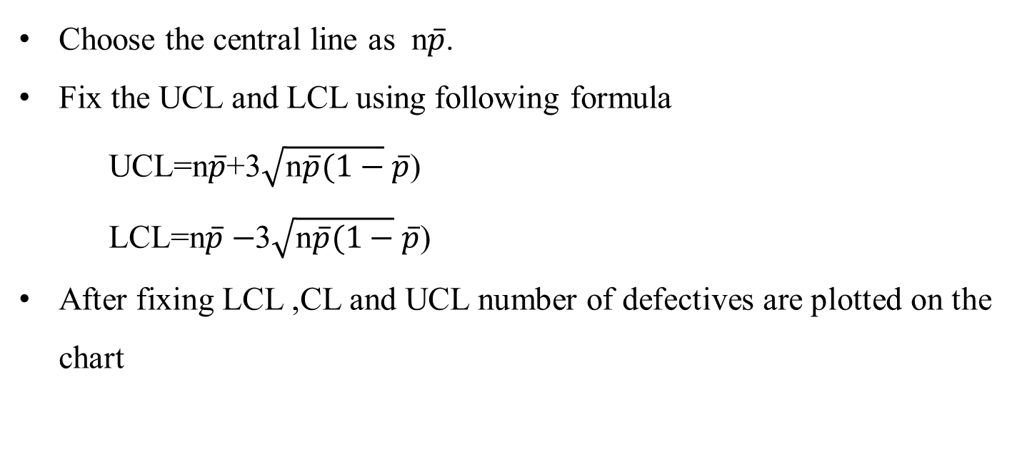
np CHART
Choose the central line as n$\overline{p}$.
Fix the UCL and LCL using following formula
UCL=n$\overline{p}$+3$\sqrt{\text{n}\overline{p}(1−}\overline{p}$)
LCL=n$\overline{p}−$3$\sqrt{\text{n}\overline{p}(1−}\overline{p}$)
After fixing LCL ,CL and UCL number of defectives are plotted on the chart
Statistical Quality Control, Rakhi Chandran, St.Mary’s College

Slide 14
REFERENCE
Montegomery D C , Introduction to statistical Quality Control, John Wiley And Sons
Statistical Quality Control, Rakhi Chandran, St.Mary’s College

Slide 15
THANK YOU
Statistical Quality Control, Rakhi Chandran, St.Mary’s College

